Slide 1
Cervical Neoplasia and Carcinoma
Dr Farah Farzaneh
OB & Gyn,
Gyn-ocology Fellowship
SBMU/PGRC
Beckmann and Ling’s Ob &Gyn 2019
CHAPTEr 47

Slide 2
Abbreviations:
Ph/Ex: Physical Exam
RF: risk factors
Tr: treatment
Ca: Cancer
Dx: Diagnosis
F/U: follow up
Cx: cervix

Slide 3
Students should be able to:
outline appropriate screening for cervical neoplasia
management of patients with abnormal screening
to discuss pathogenesis of cx ca
to identify RFs, common presenting signs/symptoms, Ph/Ex findings.

Slide 4
INTRODUCTION…
Worldwide
Cx Ca is the 4th most common ca among women (after breast, colon, lung)
The most common cause of mortality from gyn-ca,> 250,000 deaths/yr
USA:
The incidence& mortality from cx ca have decreased in the past several decades
In countries where cytologic screening is not widely available, cx ca remains common

Slide 5
Introduction…
Cx ca can be thought of as a preventable ca.
It is preceded by an identifiable precursor lesion CIN
CIN may (but not always) progress to invasive ca
CIN can be easily detected by
an inexpensive and noninvasive screening test (cx cytology test)
may be augmented with supplemental tests such as HPV DNA typing
F/U Dx procedure (colposcopy)
CIN is treatable with simple and effective therapies,
including cryotherapy, laser ablation, LEEP, CKC, all of which have high cure rates.
Vaccine exists, may have a significant impact in reducing an individual’s risk

Slide 6
CERVICAL INTRAEPITHELIAL NEOPLASIA (CIN)
Etiology : HPV
30 / 170 types of HPV infect the anogenital tract.
H R: 16, 18, 31, 33, 35, 39, 45, 51, 52, 56, 58, 59, 68, 73, 82
The majority of cx ca are caused by HPV 16 &18.
LR: not associated with ca
LR types 6&11 are associated with genital warts (condylomata acuminata) and with LSILs
HPV infects the cells of the cx.

Slide 7
Cervical anatomy
The size and shape of the cervix changes depending on:
age, hormonal status, N0. of children (parity)
Internal os:
The upper part of the cervix that opens into the endometrial cavity
External os:
The lower part that opens into the vagina
Ectocervix:
The exterior portion of the cervical canal
Endocervical canal:
The interior cervical canal
The walls of the endocervical canal contain numerous folds and plicae.

Slide 8
The cx and the TZ.(B) Ant view of the cx and exocx.

Slide 9
The histology of the cervix is complex
Overlying the fibrous stroma of the cervix is the epithelium
a meshwork of cells.
The epithelium is of two types:
columnar (glandular) epithelium:
a single layer of mucus-secreting cells; arranged into deep folds or crypts
stratified nonkeratinizing squamous epithelia
The area where the 2 types of epithelia meet is called the SCJ

Slide 10
SCJ
Clinically important,
The site of > 90% CIN
During childhood:
located just inside the ex os.
During puberty:
Influence of hormones& the acidification of the vaginal environment
subcolumnar cells undergo metaplasia, a process of transformation

Slide 11
SCJ
The metaplasia of subcolumnar cells
causes the SCJ to “roll out,” or evert, from its prepubertal position inside the ex os to a position on the enlarged cx surface
Columnar epithelium is also rolled onto the cervical surface,
where it is exposed to vaginal secretions, irritants, and a changing hormonal milieu.

Slide 12
TZ
The area between the original SCJ (on ectocervix) and the active SCJ
As metaplasia continues, the metaplastic epithelium covers and eventually becomes indistinguishable from the original squamous epithelium
Nabothian cysts:
Glands in the columnar epithelium trapped during this metaplastic activity by sq ep
No pathologic but, a normal consequence of the dynamic histology of the cx.
The metaplastic cells within the TZ represent the newest and least mature cells in the cx,
most vulnerable to oncogenic change.
The rate of metaplasia is highest during adolescence and early pregnancy.
During perimenopause
the new SCJ recedes upward into the endocx canal

Slide 13
locations of the TZ, the SCJ, during a woman’s lifetime. The arrows: the active TZ

Slide 14
HPV infection
of cx cells may or may not result in neoplastic change
Most HPV infections are transient
The host’s immune system is able to eradicate the virus before it can cause neoplastic changes in cx cells
Several host or environmental factors act as cofactors.
If the HPV DNA is not integrated into the host genome
encapsulated virions are produced; histologically “koilocytes,” cells:
shrunken or withered-appearing nuclei surrounded by perinuclear clearing.
If HPV DNA is integrated into the host DNA
the expression of the cell’s regulatory genes may be altered,
leading to the transformation of the cells into intraepithelial lesions or ca

Slide 15
Risk Factors for Cervical Neoplasia…
> 1 sexual P or a male sexual P who has had sex with>1 p
1st intercourse at an early age (<18 yrs)
Male sexual P who has had a sexual P with cx ca
Smoking
HIV infection
Organ (especially kidney) transplant
STI
DES exposure
Hx of cx ca or HG SIL
Infrequent or absent cx cytology screening tests

Slide 16
Risk Factors for cervical neoplasia…
immunosuppressed patients
HIV, organ transplant recipients, CRF, Hodgkin lymphoma
immunosuppressive therapy for other reasons.
Cigarette smoking
3.5 X among smokers vs nonsmokers
Carcinogens from cigarette smoke have been found in high concentrations in the cervical mucus of smokers: plausible biologic explanation for this association
1st intercourse at a young age
high rate of metaplasia that occurs in the TZ during adolescence
higher proportion of new or immature cervical cells in this region
Age of onset of screening is not affected by age of 1st intercourse

Slide 17
Persistent HPV infection increases the risk of persistent or progressive cx dysplasia
HPV 16 is more likely to be persistent than other oncogenic HPV types.
the relative risks of genetic susceptibility to cx ca, are small.
the natural history of CIN still not completely understood.
LG lesions are necessary precursors to the HG lesions?
Many with CIN 2/3 without prior CIN 1 lesions

Slide 18
Classification
To establish management guidelines that decrease the likelihood of progression of precursor lesions to more advanced lesions.
Established in 1988 and updated in 1991, 2001, and 2014, the Bethesda Classification outlines the various possible results of the cervical cytology test.
The Lower Anogenital Tract Squamous Terminology (LATS) consensus uses terminology similar to Bethesda

Slide 19
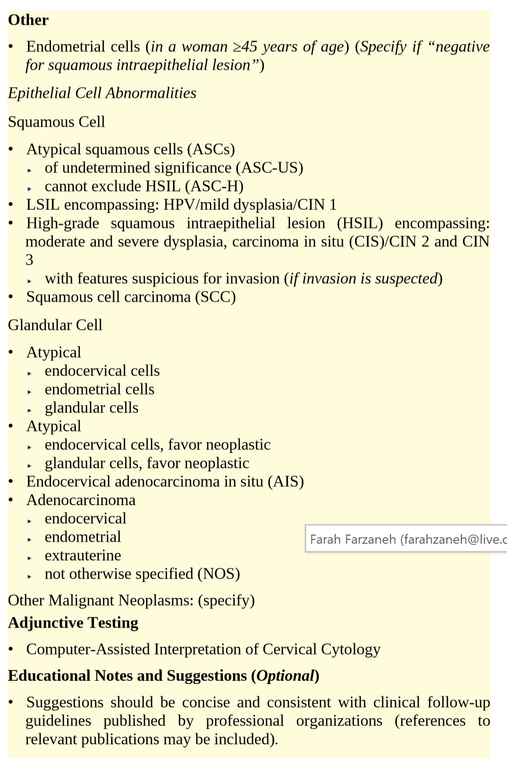

Slide 20
The classification used by the Bethesda system
Two epithelial lesions categories precancerous or cancerous
squamous lesions
Precancerous:
ASCs (ASC-US / ASC-H), LSILs, or HSILs
Cancerous:
invasive SCC
glandular lesions
Precancerous:
AGCs (endocx, endometrial, NOS); atypical, favor neoplastic; endocervical AIS
Cancerous:
adenocarcinoma
LSIL encompasses HPV infection, mild dysplasia, or CIN 1.
HSIL encompasses CIN 2 and CIN 3(also designated CIS)

Slide 21
Comparison of Cx cytology descriptive convenions

Slide 22
Evaluation of Ab Cx Cytology Test Results
If an abnormal cervical cytologic
Then vagina& bimanual exam
To exclude the presence of invasive ca
For grading & distribution of the abnormal SIL:
Or repeat cytology,
Or HR- HPV testing,
Or colposcopy with directed bx, endocx assessment

Slide 23
Colposcopy+directed bx+endocx assessment
standard of care & the technique of choice for tr decisions
A colposcope is a binocular stereomicroscope
Variable magnification (usually 7× to 15×)
light source + a green filter to aid in the identification of ab-appearing blood vessels
Areas with changes consistent with dysplasia are identified, allowing directed bx

Slide 24
Colposcopy+directed bx+endocx assessment
Colpo criteria, such as white epithelium, abnormal vascular patterns, punctate lesions
To facilitate the exam, the cx is washed with a 3- 4% AA
dehydrates cells, so those with large nuclei (metaplasia, dysplasia, or HPV infection) to appear white.
Lesions usually appear with relatively discrete borders near the SCJ within 10-90 sec of AA application.
Tissue samples for bx can be collected;
N0. of samples obtained varying depending on the N0.& severity of abnormal areas found

Slide 25
Colposcopic image of the cx. The white epithelium +coarse mosaic pattern of the underlying capillaries in this colpophotograph: CIN

Slide 26
Colposcopy
Satisfactory
Visualization of the entire SCJ
Unsatisfactory
If the SCJ is not visualized in its entirety
or if the margins of abnormal areas are not seen entirety
ECC:
a small curette to collect cells from the endocx canal.
An endocx brush can be used to retrieve additional cells dislodged in the curette specimen.

Slide 27
HPV DNA Testing
As an adj screening tool for cx neoplasia in women> 30 yrs.
As a triage tool for ASC-US
In the management of nonadolescent women with LSIL.
To identify women whose cx cytology test results are caused by other, non–HPV-associated phenomena, (i.e. infection)
Also used in the initial workup of women with AGC.

Slide 28
Management of women with ASCUS.

Slide 29
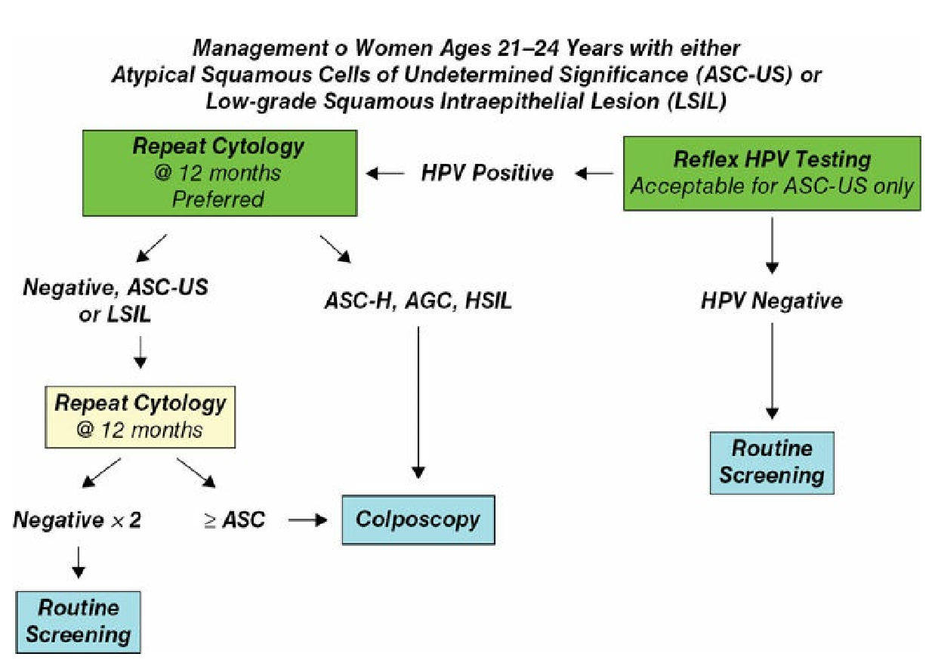
LSIL: 3% of cx cytology

Slide 30
Pregnant women with LSIL
should not undergo ECC
should not have >1 colposcopy during pregnancy.
colposcopic bx only if there is strong clinical suspicion of ca
The cx should be carefully inspected colposcopically
Colposcopic exam can be deferred until at least 6 w following delivery

Slide 31
Management of women with LSIL (ASCCP)

Slide 32
Postmenopausal women
If with LSIL
Earlier guidelines: repeat cytologic screening after tr with vaginal E cream
Current guidelines: LSIL and ASCUS same way as the general population
At the age of 65 yrs, screening should be discontinued
If Hx of NML cx screening results
and no Hx of CIN 2 or higher

Slide 33
HSIL/ASC-H
HSIL : 0.5% of all cx cytology test (US)
The rate of HSIL decreases with age.
CIN 2/3 is identified in 84-97% of women with HSIL
Immediate tr with LEEP
or colposcopic exam, followed by appropriate tr and F/U
Invasive ca is identified in 2% with HSIL.
ASC-H is evaluated by colposcopy
it carries a higher risk of underlying CIN 2 to CIN 3 lesions.

Slide 34
Management of women with ASC-H may vary if pregnant or ages 21-24 yrs

Slide 35
Management of women with HSIL (ASCCP)

Slide 36
AGC and Other Glandular Abnormalities
0.4% of epithelial cell abnormalities
The risk associated with AGC is dramatically > ASC.
The risk increases from AGC-NOS to AGC, favor neoplasia, to AIS
Women with AGC of any type
colposcopic evaluation, HPV DNA testing, ECC.
If ≥ 35 yrs or is at risk for endometrial neoplasia (unexplained vaginal bleeding, chronic anovulation), endometrial sampling should be done
If atypical endometrial cells, an endometrial bx should be done& ECC

Slide 37
Initial workup of women with AGC

Slide 38
Knowledge of HPV status in women with AGC who do not have CIN 2 or CIN 3 or glandular neoplasia allows expedited triage:
cotesting at 12 months.
If pos HPV or an ab cervical cytology: referred to colposcopy;
If neg on both tests: repeating cotesting after another 12 or 24 months from the original cervical cytology.

Slide 39
Ablative Methods
Destroy the affected cervical tissue
Cryotherapy, laser ablation, electrofulguration, cold coagulation
all outpatient procedures, with regional anesthesia.
should be used only with an adequate colposcopy and appropriate correlation
Laser therapy is now only rarely performed in the US

Slide 40
Cryotherapy
Outpatient method used to treat persistent CIN 1
The procedure involves covering the SCJ and all identified lesions
3min freeze followed by a 5-min thaw, with a repeat 3-min freeze
Healing after cryotherapy may take up to 4 or 5 weeks
Profuse watery discharge often mixed with necrotic cellular debris
A F/U cx cytology test is usually performed 12 w following the freezing
The cure rate for CIN 1 using this technique approaches 90% to 95%.

Slide 41
Excisional Methods…
Remove the affected tissue
Are performed under regional or GA
Provide a specimen for pathologic evaluation.
Procedures:
Cold knife conization (CKC),
LEEP (large loop excision of the transformation zone [LLETZ]),
Laser conization
Electrosurgical needle conization.

Slide 42
Excisional methods…
Conization: the extent depends on the ECC (pos or neg)
LEEP: thermal damage, obscuring the histology.
Thermal damage not a problem if sq epithelial abnormalities,
In cases of glandular abnormalities, CKC may be more appropriate
If the margins pos; repeat conization or close F/U
If the margins are positive for a HG lesion or CIS,
no desire for future childbearing: hysterectomy,
to preserve her fertility, colpo + ECC and HPV DNA testing

Slide 43
Follow up
After treatment of CIN
F/U co-testing at 12 and 24 months
If NML,
repeat cotest is 3 yrs after tr and then to routine testing for at least 20 yrs.
If any of the F/U testing abnormal:
colpo + ECC

Slide 44
CERVICAL CARCINOMA
Between 1950 -1992, the death rate from Cx Ca declined by 74%.
Due to cervical cytology cancer screening
The death rate continues to decline by approximately 4% /yr.
The average age at diagnosis 50 yrs
Advanced CIN precedes invasive carcinoma by approximately 10 years
The etiology HPV in> 90%
The two major histologic types: SCCs 80% and adenocarcinomas 15%.
Tne rest 5%: histologies different from SCC and adenocarcinoma.

Slide 45
Spread patterns of cervical carcinoma

Slide 46
Signs and Symptoms
Early cx ca
variable and nonspecific
watery vag dis, IMB, PCB
accurate Dx: cytologic screening, colpo directed Bx, Bx of a gross or palpable lesion.
If suspected microinvasion/ early-stage: conization indicated
CKC provides the most accurate evaluation of the margins
Possibility of invasion or to define the depth and extent of microinvasion.
Cx Ca is staged clinically based on the FIGO classification
based on the histologic assessment and on ph/lab exam
Spread: direct invasion and by lymphatic metastasis
Various optional exam: sono, CT, MRI, lymphangiography, laparoscopy, FNA

Slide 47
FIGO staging of Cx Ca

Slide 48
FIGO staging of Cx Ca

Slide 49
Cervical Cancer Management
SCC & adenoca should be managed similarly
Except: microinvasive disease.
Criteria for microinvasive adenocarcinomas have not been established.
Stage Ia1, microinvasive SCC, conization or simple extrafascial hysterectomy
Stage Ia2, invasive SCC, should be treated with rad hys with LND or RT
Stage Ib1 should be distinguished from stage Ib2
For bulky stage Ib and selected IIa, either rad hys with LND or RT with cisplatin-based CT
Adj RT after surgery, based on pathologic RFs, especially stage Ib2 ca
≥Stage IIb EBRT and concurrent cisplatin-based CT

Slide 50
Cervical Cancer Management
RT to the tumor sites and potential spread areas
while minimizing the amount of RT adjacent uninvolved tissues
Complications of RT:
cystitis/proctitis
unusual complications: intestinal/vag fistulae, small bowel obstruction, hemorrhagic proctitis/cystitis
Tissue damage and fibrosis incurred by RT progress over many yrs,
may complicate long-term management.
FU, exam Q 4 mo 2yrs; Q 6 mo next 3 yrs
cytology annually to perpetuity and CXR annually for up to 5 yrs

Slide 52
Treatment for recurrent disease
Poor cure rates
Most CT protocols; palliative efforts
Specific “spot” RT to areas of recurrence; limited benefit
Central recurrence (upper vag or the residual cx in radiation patients):
May benefit from ultraradical surgery with partial or total pelvic exenteration.

Slide 53
Prevention
Sexual abstinence
Barrier protection
Regular gynecologic exam
Cytologic screening
Tr of precancerous lesions
Limiting the number of sexual partners
HPV Vaccination
3 vaccines (bivalent, quadrivalent, and 9-valent)
Virus-like particles that consist of the main structural HPV-L1 protein but lack the viral genetic material and, thus, are noninfectious.
Stimulate the production of Ig G–type-specific Ab
The Q vaccine: to prevent 91% of new and 100% of persistent infections

Slide 54
Current Guidelines for HPV
2-3 separate doses
<age 15, 2 doses are required, 6 to 12 months apart.
≥ age 15 , 3 doses are required. 0, 1-2 ,6 mo
Boys/girls; 11-12 yrs
Can be given as young as 9 yrs

Slide 55
HPV Vaccination; Key points
Previous exposure to HPV is not a contraindication
Testing for HPV is currently not recommended before vaccination
Not recommended for pregnant women
Safe in breastfeeding
Current Cx Ca screening remain unchanged

Slide 56
CLINICAL CASE
A 27-year-old comes to see you:
her cervical cytology smear shows atypical cells
Her primary care physician stated that she would need a procedure and that this could signify cervical cancer
She is clearly concerned.

Slide 57
Clinical F/U
You explain that a colposcopy is a diagnostic procedure that will provide more information
On colposcopic examination, you see the full TZ and notice a small acetowhite area at the 3:00 position, which you biopsy
The biopsy results demonstrate no evidence of dysplasia or cancer
You relay this information to the patient and make a plan for future follow-up with cervical cytology

