Slide 1
Assessment of Fetal Well-Being
Dr.parichehr ppooransari
Shohada hospital.perinatalogist

Slide 2
Evaluation of fetal activity is a common indirect measure of fetal wellbeing. Various methods can be used to quantify fetal activity after viability, including the time necessary to achieve a certain number of movements each day, or counting the number of movements (“kick counts”) in a given hour

Slide 3
Fetal monitoring tests can provide more objective information about
fetal well-being. These tests include the nonstress test (NST), contraction stress test (CST) (called the oxytocin challenge test [OCT] if oxytocin is used), biophysical profile (BPP), and ultrasonography of umbilical artery blood flow velocity (also known as umbilical artery
Doppler velocimetry).

Slide 6
Nonstress Test
The NST measures the fetal heart rate, patterns, and accelerations, which are monitored with an external transducer for at least 20 minutes. The patient may also be asked to note fetal movement, usually accomplished by pressing a button on the fetal monitor, which causes a notation on the monitor strip. The tracing is observed for fetal heart rate accelerations.

Slide 7
A nonreactive (nonreassuring) tracing is one without sufficient heart rate accelerations in a 40-minute period. A nonreactive NST should be followed with further fetal assessment.

Slide 9
Contraction Stress Test
Whereas the NST evaluates the fetal heart rate response to fetal activity, the CST measures the response of the fetal heart rate to the stress of a uterine contraction. During a uterine contraction, uteroplacental blood flow is temporarily reduced by the contracting myometrium.

Slide 10
The result is negative if there is no change from the baseline fetal heart rate and no fetal heart rate decelerations. If decelerations occur, the results can be considered positive, equivocal, or unsatisfactory, depending on the pattern, frequency, and strength of the deceleration.

Slide 11
Because of this high incidence of false positives, the results of these tests must be interpreted collectively, and the tests themselves repeated to verify the results.

Slide 12
Biophysical Profile
The BPP is a series of five assessments of fetal well-being, each of which is given a score of 0 (absent) or 2 (present),
A total score of 8 out of 10 is considered reassuring. A total score of 6 is equivocal and should prompt further evaluation or delivery if the patient is at early term or beyond. If the patient is preterm, retesting in 24 hours may be appropriate. A score of 4 or less is nonreassuring and usually indicates that delivery is warranted, although further evaluation at pregnancies less than 32 0/7 weeks of gestation may be appropriate.

Slide 13
Modified BPP combines the use of an NST and assessment of an amniotic fluid using the deepest vertical pocket sonographically or an amniotic fluid index (AFI). The AFI is a semiquantitative, four-quadrant assessment of amniotic fluid depth. The importance of adequate amniotic fluid volume is well established. Diminished amniotic fluid is thought to represent decreased fetal urinary output caused by chronic stress and shunting of blood flow away from the kidneys.

Slide 14
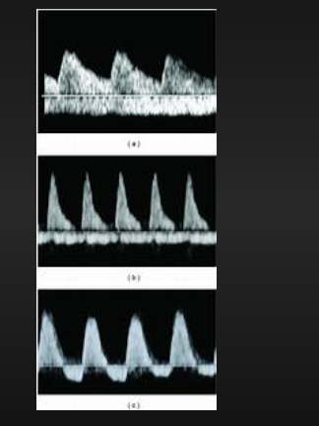
Doppler Ultrasound of Umbilical Artery
Umbilical cord Doppler flow velocimetry is based on the characteristics of the systolic blood flow and the diastolic blood flow. Reversed end-systolic flow can be seen with severe cases of IUGR secondary to uteroplacental insufficiency and may suggest impending fetal demise.

