Slide 1



Slide 2
Infertility

Slide 3
Summary
Definition
Describtion of causes
Basic approach
Initial management
Psychological issues
Ethical issues

Slide 4
Definition:
1year unprotected, regular intercourse
Affect 15% of couples in USA.
In Iran about 11-13% (1380 survey)
Fecundability: achieving pregnancy in one menstrual cycle.
Fecundity: achieving live birth in one mentrual cycle.
Earlier evaluation (after 6 months) when female > 35years

Slide 5
85% of couples will have a child with appropriate treatment

Slide 6

Steps of successful conception

Slide 7
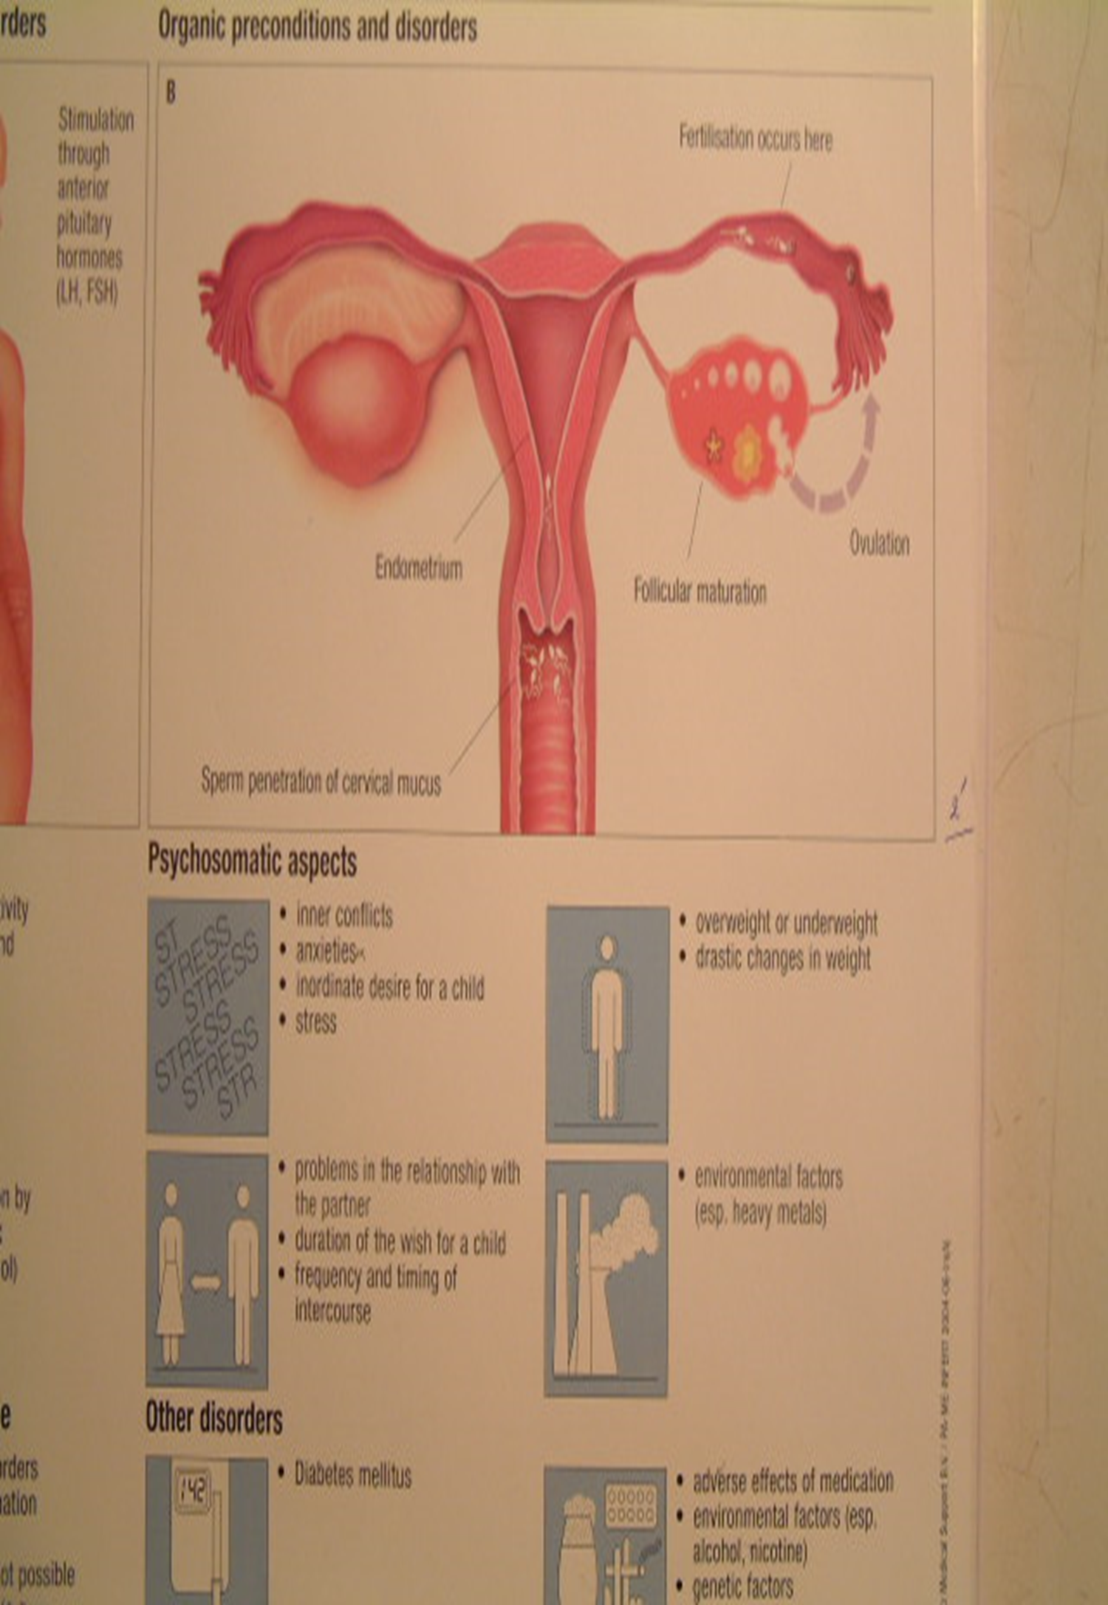

Slide 8
Causes of Infertility:
Female factors (65%)
Male factors (20%)
Unexplained or others (15%)

Slide 9
Evaluation of Infertility

Slide 10
Ovulation:
Regular, cyclic, predictable menses, with PMS (Dysmenorrhea ?) 95% ovulation

Slide 12
In cases of oligomenorrhea or amenorrhea:
BHCG
TFT (TSH)
Prolactin
Testosterone
DHEAS
FSH, LH, E2

Slide 13
Anatomical evaluation:
AUB
Pregnancy losses
Previous genital surgeries

Slide 15
3D ultrasound

Slide 16
HSG

Slide 17
Laparoscopy and Hysteroscopy
In cases of abnormal HSG
To diagnosis of adhesions and endometriosis

Slide 18
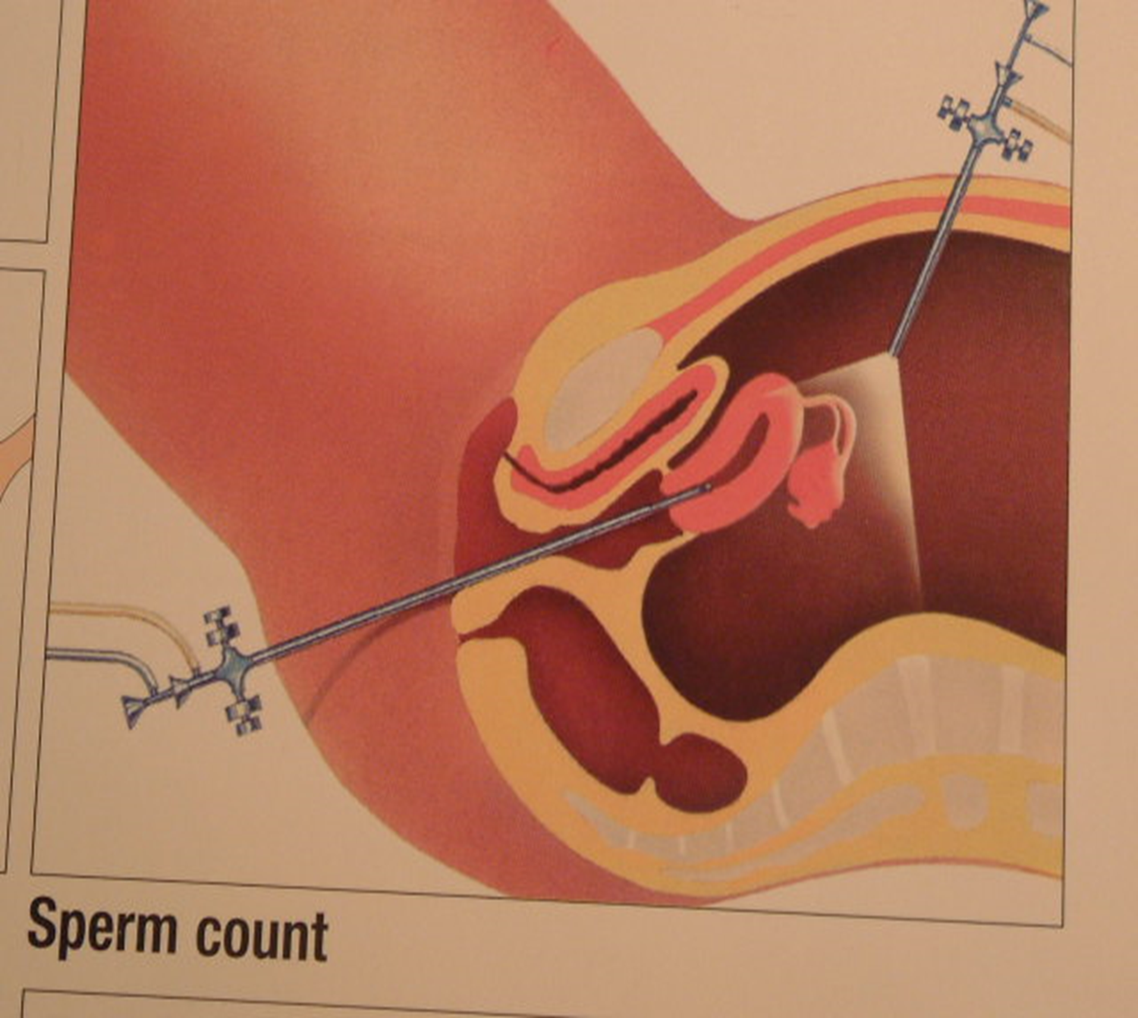

Slide 19
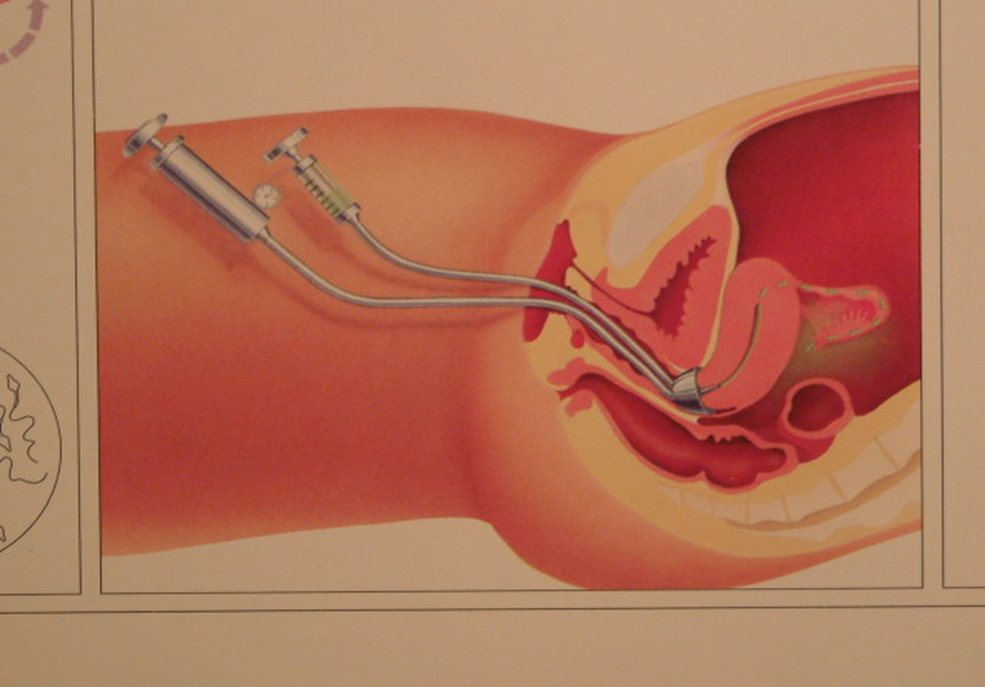

Slide 20
Semen analysis:
Seminal fluid
Count
Motility
Morphology

Slide 24
Causes of Male Infertility:
Hypothalamo-pituitary (1-2 %)
Testicular (30%)
Post testicular (20%)
Unexplained (50%)

Slide 25
Azoospermia:
CFTR
Y chromosome microdeletions
Klinefelter
Chromosome inversions, translocations

Slide 26
Unexplained infertility:
No male factor
No ovulatory factor
No tubouterine factor

Slide 27
Treatment

Slide 28
Induction ovulation (I O):
(Normal male + Normal Tubouterine)
Clomiphene
Letrozole
Gonadotropins

Slide 29
Intrauterine insemination (IUI)
(Mild male factor – Normal tubouterine)

Slide 30
In vitro fertilization (ART): IVF-ICSI
(Male factor-tubal occlusion-endometriosis-unexplained infertility-failed previous treatments)

Slide 31
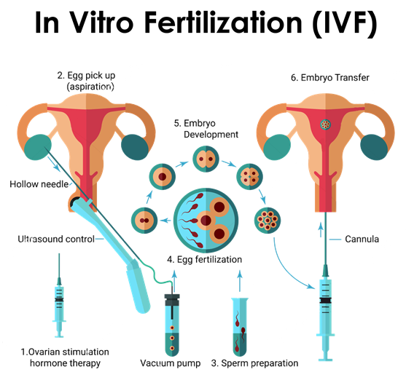

Slide 32
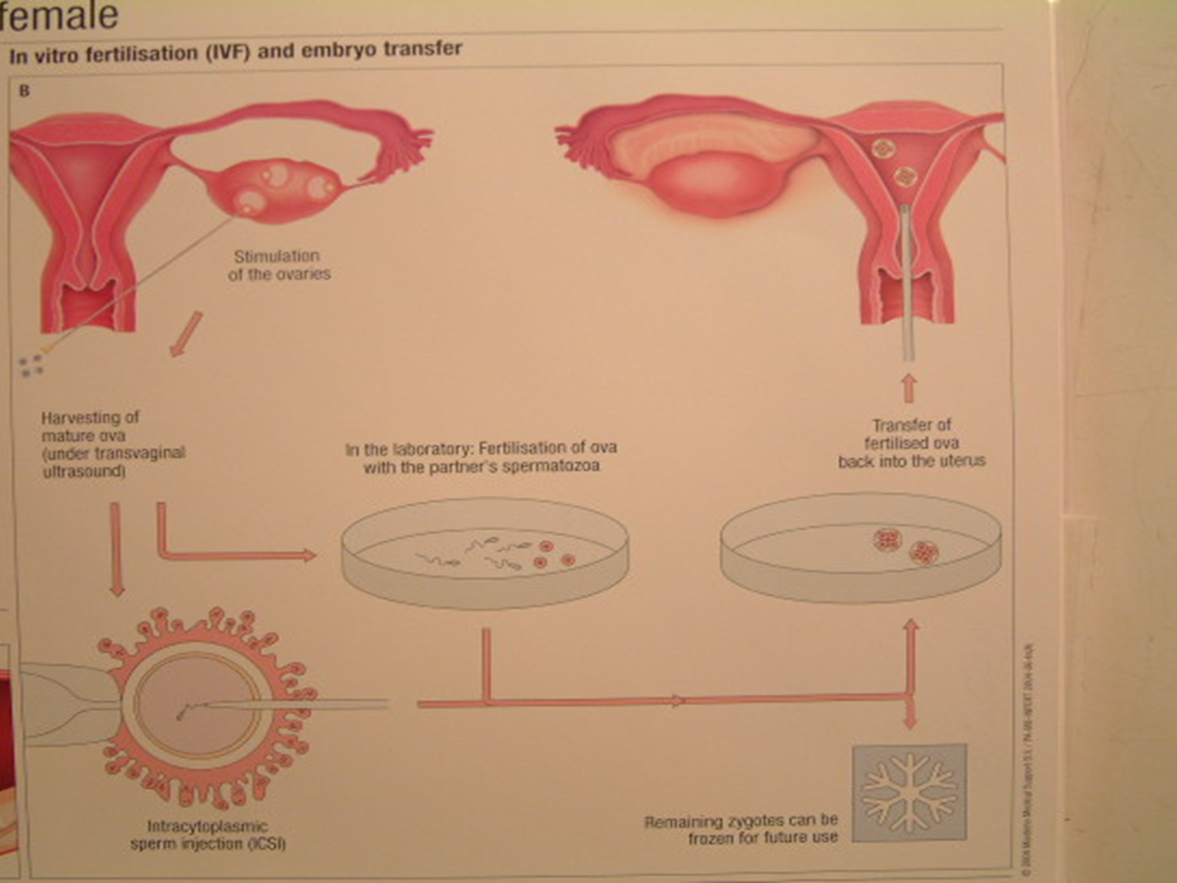

Slide 33
Counselling
Couple interview and treatment is important, concerning ethical issues

