Slide 1

Intrapartum care (chapter 8)
Dr.Behforouz
Assistant professor
SBMU

Slide 2
Goals
Students should know..
management of the laboring patient
appropriate triage and diagnosis
options for pain management
deviations from normal labor
maternal and fetal monitoring
how to perform a vaginal delivery
indications for cesarean delivery

Slide 3
CLINICAL CASE
A healthy, 28-year-old patient presents to labor and delivery at 39 weeks
of gestation complaining of “crampiness” overnight. Her vital signs are
all stable. The fetal heart tracing is reassuring, and there do not appear to
be any regular contractions. What are the next steps in evaluation of this
patient? If it appears she is in labor, how might you manage this patient?

Slide 4
MATERNAL CHANGES BEFORE THE ONSET OF
LABOR
uterine contractions→ Braxton Hicks contractions (false labor): not associated with dilation of the cervix
Lightening→ fetal head descending into the pelvis or baby dropping!!
bloody show→ cervix begins thinning(effacement)

Slide 5
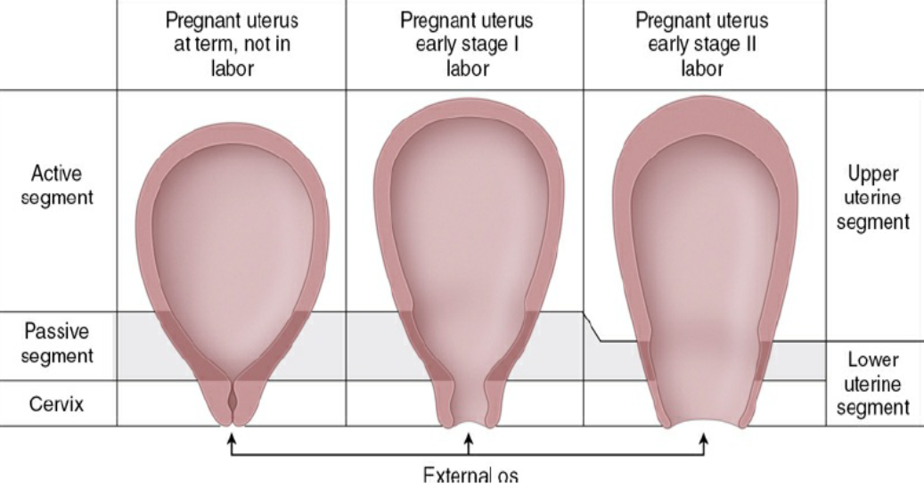
Mechanism of effacement, dilation, and labor

Slide 6
Differences between Braxton hicks & true labor:
Braxton Hicks contractions:
typically shorter in duration
less intense than true labor contractions
less discomfort
In the lower abdomen and groin areas
resolve with ambulation, hydration, or analgesia.
True labor:
feels in the uterine fundus, with radiation of discomfort to the low back and lower abdomen
become increasingly intense and frequent.

Slide 7
EVALUATION FOR LABOR
contact health care provider WHEN:
contractions occur approximately every 5 minutes for at least 1 hour
sudden gush of fluid or a constant leakage of vaginal fluid
any significant vaginal bleeding
significant decrease in fetal movement

Slide 8
Initial Evaluation
REVIEWING the prenatal records
determining the nature and frequency of contractions, possibility of spontaneous ROM or significant bleeding, or changes in maternal or fetal status
focused review of systems
limited general physical examination(special attention to vital signs)
Auscultation of fhr, immediately following a contraction
limited transabdominal ultrasound

Slide 9
Abdominal Examination
Leopold maneuvers(determining fetal lie, presentation, and position)→
Determining what occupies the fundus
Determining location of small parts
Identifying descent of the presenting part
Identifying the cephalic prominence
Palpation of the uterus during a contraction → determining the intensity of that particular contraction

Slide 10
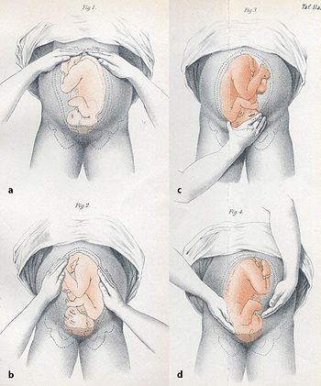

Slide 11
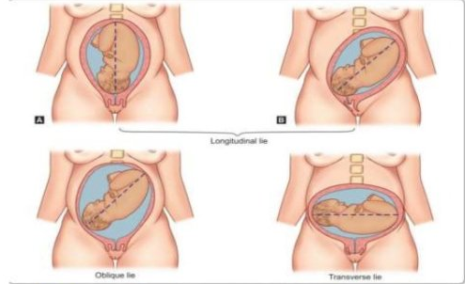

Slide 13
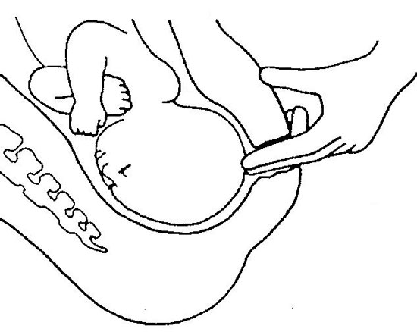
Vaginal Examination
determining the consistency and degree of effacement and degree of dilation
should be avoided IN→
premature ROM
placenta previa,
vaginal bleeding

Slide 14
Effacement: shortening of the cervical canal from a length of about 2 cm to a mere circular orifice with almost paper-thin edges (expressed as a percent)

Slide 15
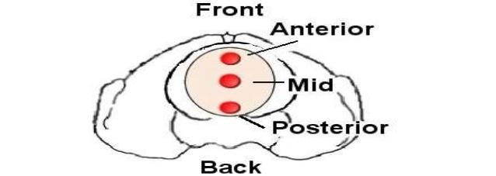
POSITION OF CERVIX→
anterior, mid-position, or posterior in the vagina

Slide 16
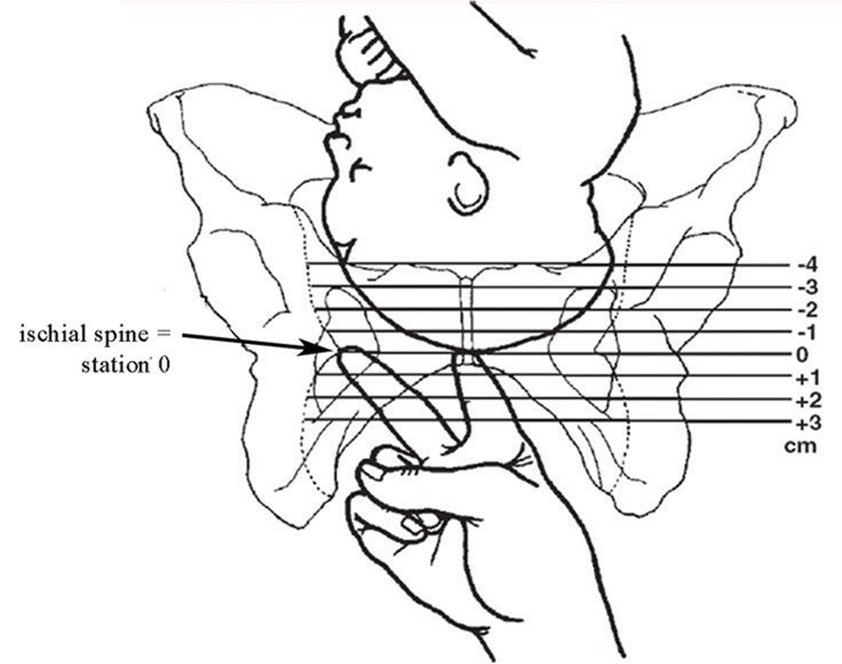
Fetal station→ the level of the fetal presenting part in the birth canal in relation to the ischial spines (located approximately halfway between the pelvic inlet and the pelvic outlet)
the presenting part AT the level of the ischial spines→ zero station→IT MEANS that the biparietal diameter of the fetal head (greatest transverse diameter) is assumed to have negotiated the pelvic inlet.

Slide 18
STAGES OF LABOR
first stage of labor→ interval between the onset of labor and full cervical dilation (10 cm):
The latent phase of labor: cervical effacement & early dilation
the active phase of labor: more rapid cervical dilation occurs, usually beginning at approximately 5 to 6 cm.
second stage of labor→ FROM complete cervical dilation through the delivery of the infant

Slide 19
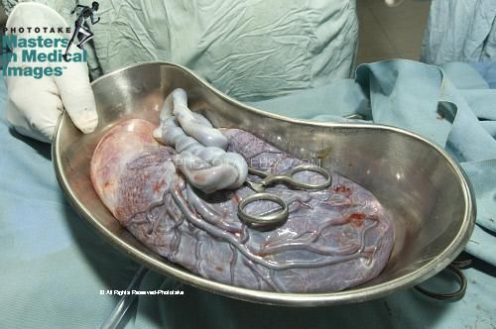
third stage of labor→ begins immediately after delivery of the infant and ends with the delivery of the placenta
fourth stage of labor→ immediate postpartum period (approximately 2 hours after delivery of the placenta) during which time the patient undergoes significant physiologic adjustment.

Slide 20
Friedman curve

Slide 21
contemporary duration of the various stages of labor:

Slide 22
MECHANISM OF LABOR
cardinal movements of labor→ refer to the changes of the position of the fetus as it passes through the birth canal:
1. Engagement
2. Flexion
3. Descent
4. Internal rotation
5. Extension
6. External rotation or restitution
7. Expulsion

Slide 23
Engagement→ descent of bpd below the plane of the pelvic inlet, [palpation of the presenting part below the level of ischial spines (0 station)]
occurs days to weeks prior to labor in nulligravida women
happens at the onset of active labor in multipara women
Flexion of the fetal head→ allows for the smaller diameters of the fetal head to present to the maternal pelvis
Descent of the presenting part→ necessary for the successful completion of passage through the birth canal
greatest rate of descent: latter portions of the first stage & during the second stage

Slide 24

Internal rotation→ facilitates presentation of the optimal diameters of the fetal head to the bony pelvis (most commonly from transverse to either anterior or posterior)
Extension of the fetal head→ occurs as it reaches the introitus
External rotation→ after delivery of the head as the head rotates to “face forward” relative to its shoulders
expulsion

Slide 25
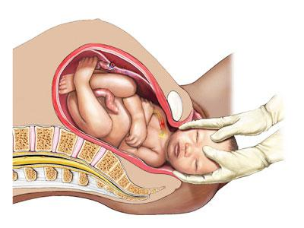
NORMAL LABOR AND DELIVERY

Slide 26
General Management
Ambulation and Position in Labor and at Delivery→
Walking may be more comfortable
Supine labor→ obstructs venous return, thence cardiac output, leading to hypotension (supine hypotensive syndrome)
supine left lateral position→ improving cardiac output
dorsal lithotomy position
Other laboring positions→ sitting or crouching, use of special “birthing chairs,” labor balls, variously configured tubs of warm water

Slide 27

Fluid Management and Oral Intake→
avoid oral ingestion of anything except moderate intake of clear fluids, occasional ice chips, and preparations for moistening the mouth and lips.
If oral intake is not possible→ IV with 1/2 N/s or D5 1/2 N/s
If increased oncotic pressure is desired→ Normal saline can be used
lactated fluids are generally contraindicated

Slide 28
Evaluation of Fetal Well-Being→ Measurement of the fetal heart rate and its changes during labor:
** Risk factors→
vaginal bleeding,
acute abdominal pain
temperature >100.4°F
preterm labor or ROM,
Hypertension
Non-reassuring fetal heart rate pattern

Slide 29
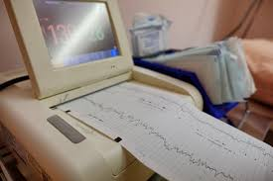
In the absence of risk factors on admission→
FHR every 30 minutes in the active phase in the first stage of labor
FHR every 15 minutes in the second stage
In the presence of risk factors→
- FHR every 15 minutes in the active phase in the first stage of labor, preferably before, during, or after a contraction
- FHR every 5 minutes During the second stage of labor

Slide 30
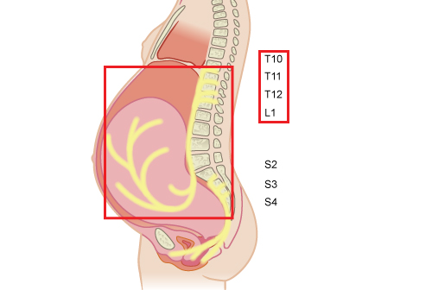
Pain Control:
During the first stage of labor, pain results from the contraction of the uterus and dilation of the cervix→ T10–T12 and L1
distension of the lower birth canal and perineum with decent of fetal head→ S2–S4

Slide 31
methods of anesthesia and analgesia
Epidural block: The most effective form→ used in vaginal or abdominal deliveries & in postpartum procedures such as tubal ligation
Spinal anesthesia→ anesthesia for approximately two hours
Combined spinal–epidural
Local block→ injection into the perineum or vagina (pudendal block)
General anesthesia→ Inhaled or intravenous

Slide 32
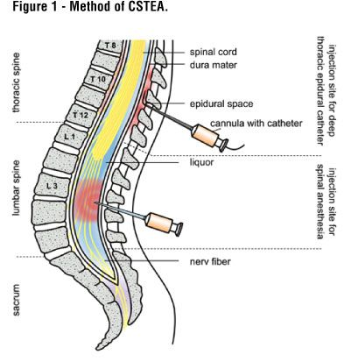
advantages of epidural technique→
provide analgesia during labor as well as excellent anesthesia for delivery
titrated to maintain the patient’s sense of touch and motor ability
facilitate participation in the birth process

Slide 33
advantages of Spinal anesthesia→
good pain relief for procedures of limited duration
advantages of Combined spinal–epidural anesthesia→
ability to titrate medications throughout labor with the epidural catheter and the rapid onset associated with spinal techniques
decreases the risk of spinal headache
Less motor blockade
All of these types of regional anesthesia have the complication of→ postdural puncture headache

Slide 34
Advantages of Local block→
provide anesthesia for episiotomy and repair of vaginal and perineal lacerations
Complication of local block: paracervical block may result in fetal bradycardia
Complications of GA→
maternal aspiration- neonatal depression

Slide 35
Management of Labor
First stage→
series of pelvic examinations
Pushing should be discouraged During the latter portions of the 1st stage of labor → to avoid traumatic swelling of the cervix
More frequent vaginal examinations in:
latter portions of the first stage
significant fetal heart rate decelerations (probability of umbilical cord prolapse or imminent delivery)
- Routine amniotomy is unnecessary.

Slide 36
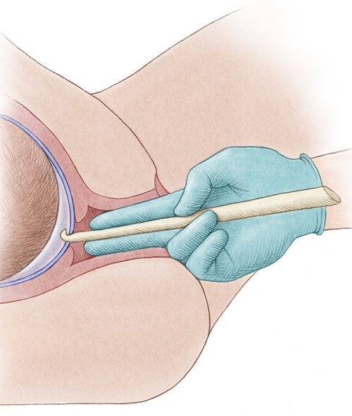
Artificial ROM if→
Need to insert an intrauterine pressure catheter or a fetal scalp monitor
Need to identify presence or absence of meconium
labor is progressing abnormally
Risks of AROM→
infection may be increased if labor is prolonged
umbilical cord prolapse
Fetal heart tones should be assessed after membranes spontaneously rupture.

Slide 37
Management of Labor
Second Stage→
the mother should be encouraged to either use open glottis pushing, or perform an extended Valsalva maneuver
a rest period of 1 to 2 hours may be offered at the onset of the second stage of labor.
fetal head may undergo further alterations→ molding
Caput succedaneum

Slide 38
Molding and caput succedaneum are the two most common causes of overestimation of the amount of descent .
Both caput and molding resolve in the first few days of life.

Slide 39
An extended second stage may last as long as 2 to 3 hours
Restricted use of episiotomy unless→
cases of instrumental delivery and/or protracted or arrested descent
Routine use of episiotomy may lead to an increase in the risk of third-degree and fourth-degree perineal lacerations and a delay in the patient’s resumption of sexual activity
control the fetal head and body at delivery→ decreased the risk of obstetric laceration

Slide 40
episiotomy
When? after the perineum has been thinned considerably by the descending fetal head
how? incision should be somewhat longer on the mucosal surface when compared with the perineal surface of the incision
Median episiotomy is associated with higher rates of injury to the anal sphincter and rectum

Slide 41
fetal head crowns
Head extension
modified Ritgen maneuver→ To support the perineal tissues and facilitate extension of the head
delivery of the head…

Slide 42
the shoulders descend and rotate to a position in the anteroposterior diameter of the pelvis
The attendant’s hands are placed on either side of the fetal head, applying gentle downward pressure, thus delivering the anterior shoulder.
To avoid injury to the brachial plexus, care is taken not to put excessive force on the neck.
The posterior shoulder is then delivered by upward traction on the fetal head

Slide 43
Management of Labor
Third Stage→
Delivery of the placenta when: - the uterus rises in the abdomen,
- becoming globular in configuration,
- a gush of blood and/or
- “lengthening” of the umbilical cord
Avoid to Pull the placenta from the uterus by excessive traction→ inversion of the uterus
wait for spontaneous extrusion of the placenta→ up to 30 minutes

Slide 44
As the placenta passes into the lower uterine segment→ gentle downward traction to the umbilical cord
abdominal hand applies gentle suprapubic counterpressure (posterior and cephalad) to secure the uterine fundus and prevent uterine inversion

Slide 45
Manual removal of placenta→ If necessary
passing a hand into the uterine cavity and using the side of the hand to develop a cleavage plane between the placenta and the uterine wall.
Anesthesia may be required.
After the placenta has been removed, the uterus should be palpated to ensure that it has reduced in size and become firmly contracted→ atony evaluations

Slide 46
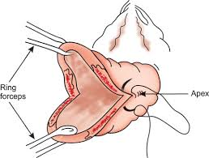
If excessive postpartum blood loss+ :
uterine massage
oxytocic agents, such as oxytocin
methylergonovine maleate (methergine)
Prostaglandins (carboprost or misoprostol)
Inspection of the birth canal should be performed in a systematic fashion.
Cervical lacerations→ most commonly found at the 3 o’clock and 9 o’clock positions of the cervix.

Slide 47
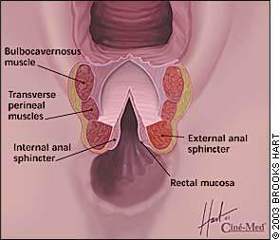
CLASSIFICATION OF OBSTETRIC LACERATIONS

Slide 48
Management of Labor
Fourth Stage→
For the first hour after delivery, the likelihood of serious postpartum complications is at its greatest
Postpartum uterine hemorrhage occurs in cases of:
Rapid labor
protracted labor
uterine enlargement (such as from a large fetus, polyhydramnios, and multiple gestation)
intrapartum chorioamnionitis.

Slide 49
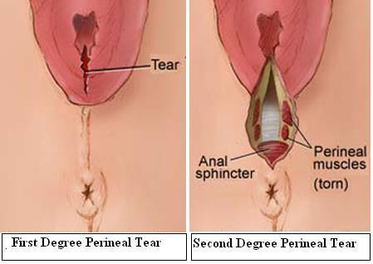
Cares of 4th stage:
Uterine palpation
Perineal pads and the amount of blood
maternal pulse and blood pressure are monitored closely
And perineal lacerations repair

Slide 50
LABOR INDUCTION
Oxytocin Administration with Various regimens:
Lower and less frequent dosage increases→ lower incidence of uterine hyperstimulation
Higher and more frequent dosage increases→ shorter time in labor- reduce chorioamnionitis- reduce number of cesarean deliveries (due to abnormal labor)- increased rates of uterine hyperstimulation.

Slide 51
Cervical Ripening:
if the cervix is unfavorable for induction
Techniques:
Misoprostol(prostaglandin E)→ administered vaginally
Prostaglandin E2→ administered vaginally or intracervically
both drugs are contraindicated in patients who have had a previous cesarean delivery or previous uterine surgery→ uterine hyperstimulation
mechanical dilation: laminaria→ inserted into the internal os
placement of a 30 mL Foley catheter in the cervical canal→ lower in cost & reduced risk of uterine tachysystole.

Slide 52
* Risks of laminaria:
failure to dilate the cervix
cervical laceration
inadvertent ROM
and infection

Slide 53
Membrane Manipulation→ “stripping” or “sweeping” the amniotic membranes:
Risks: infection, bleeding from an undiagnosed placenta previa or low-lying placenta, and accidental ROM
Artificial ROM→ another method of labor induction(when the cervix is favorable)
Routine early amniotomy risks: increased rate of intra-amniotic infection, umbilical cord prolapse, rupture of vasa previa, vertical transmission of HIV in HIV positive women, and cesarean delivery for fetal heart rate abnormalities

Slide 54
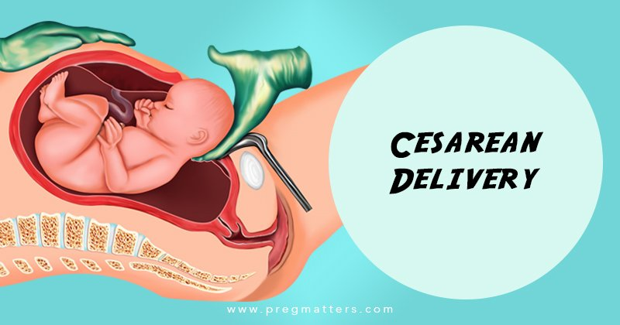
CESAREAN DELIVERY
Reasons for the increase of cesarean delivery from less than 5% in 1965 to 32% in 2015:
labor dystocia
nonmedically indicated early term births (37 0/7 to 38 6/7 weeks)
use in breech deliveries
use in situations in which fetal monitoring is nonreassuring
No improvement in maternal or neonatal outcomes

Slide 55
Decision Making: Mode of Delivery
Advantages of a successful vaginal delivery→
reduced risks of hemorrhage and infection
Shorter postpartum hospital stay
less painful
more rapid recovery
indications for cesarean delivery→
hemorrhage from placenta previa
Abruptio placentae
prolapse of the umbilical cord
uterine rupture, because these conditions require prompt delivery.

Slide 56
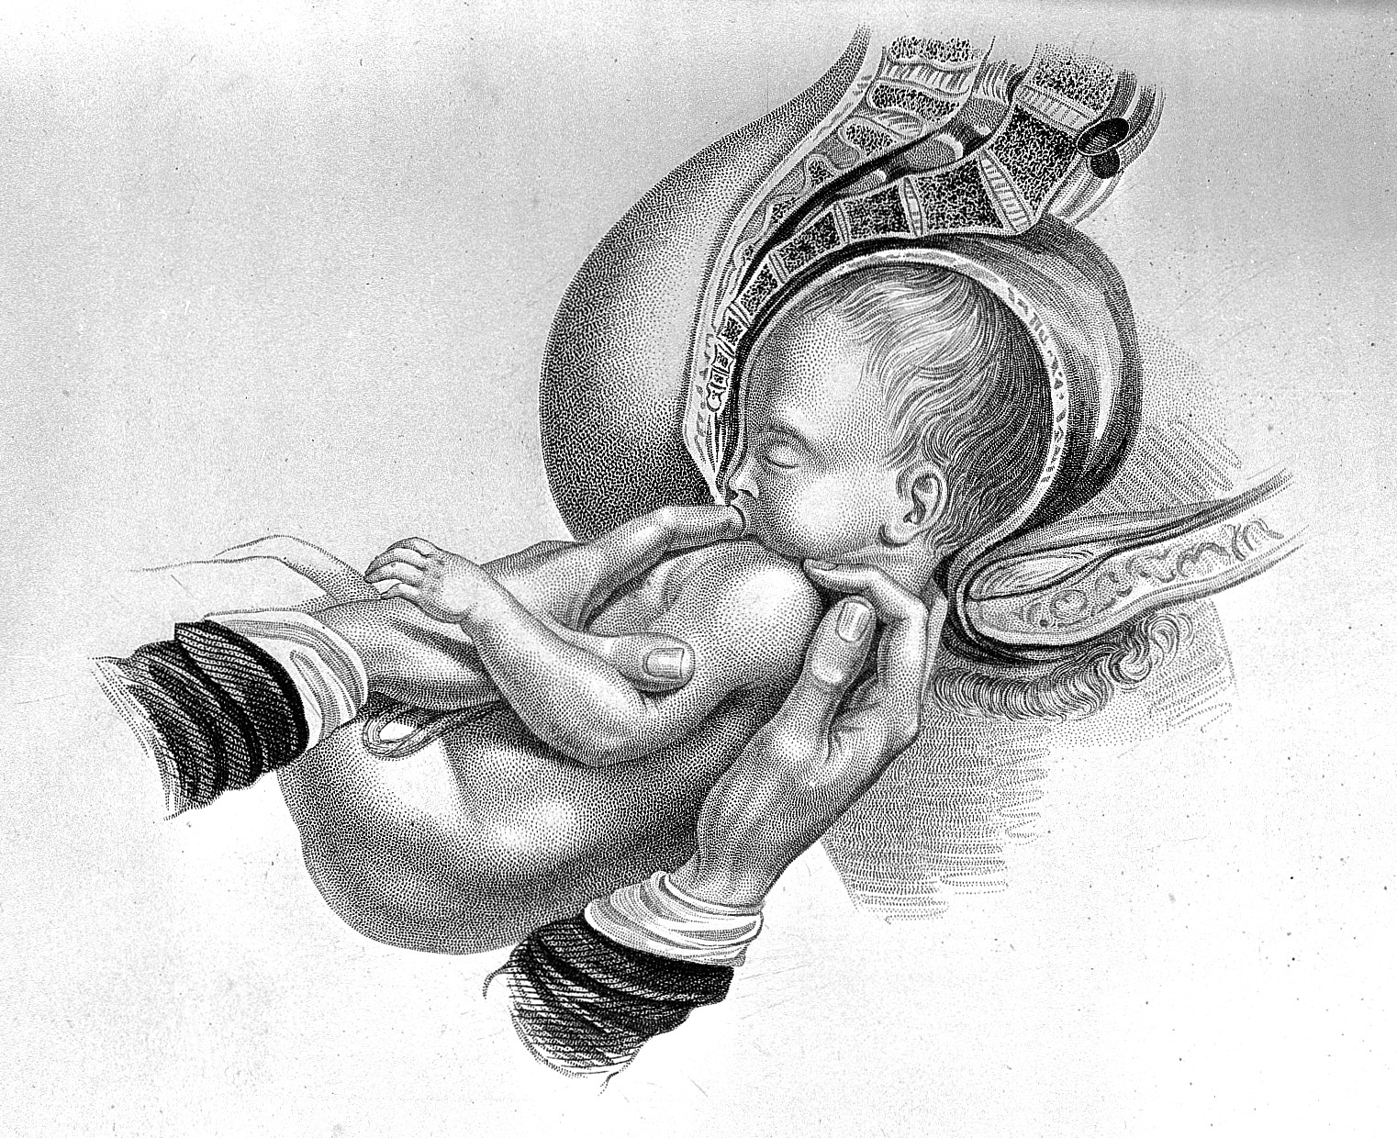
Planned vaginal delivery may be a reasonable approach for a fetus in breech presentation→ depends on the experience of the health care provider
informed consent should be documented→ perinatal and neonatal mortality & morbidity may be higher with a vaginal delivery(in breech)

Slide 57
Cesarean by Maternal Request→
should not be performed before 39 weeks of gestation
not recommended for women desiring several children
Cesarean delivery can be performed through various incisions in the uterus
An incision through the thin, lower uterine segment allows for subsequent trials of labor after cesarean (TOLAC) delivery if the patient has had one to two prior cesarean delivery.
classical cesarean section→ An incision through the thick, muscular upper portion of the uterus

Slide 58
TRIAL OF LABOR AFTER CESAREAN DELIVERY
TOLAC = vaginal birth after cesarean (VBAC)
Success rates of VBAC were found to be 60% to 80%
uterine rupture does occur more often with TOLAC (less than 1%)
guidelines for TOLAC→
availability of a 24-hour blood bank and capability for massive transfusion
continuous electronic fetal heart rate monitoring
a physician and hospital capable of performing an emergency cesarean delivery
emergently available support services such as anesthesia.

Slide 60


