Slide 3
INTRAPARTUM FETAL SURVEILLANCE

Slide 4
INTRAPARTUM FETAL SURVEILLANCE
The goal of intrapartum fetal surveillance is to recognize changes in fetal oxygenation that could result in serious complications.
Evidence suggesting a nonreassuring fetal status during labor occurs in 5% to 10% of pregnancies.
It is now recognized that many neurologic conditions previously attributed to birth asphyxia are in fact attributable to other causes not associated with labor, such as maternal infection, coagulation disorders, autoimmune disorders, genetic causes, and low birthweight.

Slide 5
Pathophysiology
The uteroplacental unit provides oxygen and nutrients to the fetus while receiving carbon dioxide and wastes, the products of the normal aerobic fetal metabolism.
Uteroplacental insufficiency occurs when the uteroplacental unit is compromised. Initial fetal responses include fetal hypoxia (decreased blood oxygen levels); shunting of blood flow to the fetal brain, heart, and adrenal glands; and transient, repetitive, late decelerations of the FHR.

Slide 6
Pathophysiology
If hypoxia continues, the fetus will eventually switch over to anaerobic glycolysis and develop metabolic acidosis.
Lactic acid accumulates, and progressive damage to vital organs occurs, especially the fetal brain and myocardium.
If intervention is not timely, serious and possibly permanent damage and sometimes death can result.

Slide 7
Fetal responses to hypoxia

Slide 8
Neonatal Encephalopathy
Neonatal encephalopathy is a clinically defined syndrome of disturbed neurologic function in the earliest days of life in the term and near-term infants , manifested by difficulty with initiating and maintaining respiration, depression of tone and reflexes, subnormal level of consciousness, and sometimes seizures.
Neonatal encephalopathy is not always associated with permanent neonatal neurologic impairment.

Slide 9
Hypoxic-ischemic encephalopathy
HIE is a subtype of neonatal encephalopathy for which the cause is considered to be the limitation of oxygen and blood flow near the time of birth.
Historically, it has been assumed that most cases of neonatal encephalopathy were HIE, but epidemiologic studies have established that this assumption is incorrect.

Slide 10
Neonatal Encephalopathy
It is estimated that the incidence of neonatal encephalopathy caused by intrapartum hypoxia is approximately 1.6 /10,000, in the absence of any other coincident preconceptual or antepartum abnormalities.
Neonatal encephalopathy can result from many conditions, 70% of which are secondary to events arising before the onset of labour; prenatal stroke, infection, cerebral malformation, genetic disorders, and other unknown factors.
Asphyxia may occur at any point in the infant’s antepartum, intrapartum, or postpartum life.

Slide 11
Neonatal Encephalopathy
Ultimately, sustained hypoxia leading to severe metabolic acidosis and cardiovascular decompensation with systemic hypotension may lead to cerebral ischemia and brain damage.

Slide 12
Cerebral Palsy
Cerebral palsy is a chronic disability of the central nervous system (CNS) characterized by aberrant control of movement and posture appearing early in life and not as a result of progressive neurologic disease.
Only one type of cerebral palsy, spastic quadriplegia, is associated with antepartum or intrapartum interruption of the fetal blood supply.

Slide 13
Cerebral Palsy
Disorders not associated with intrapartum or peripartum asphyxia include dyskinetic or ataxic cerebral palsy (which commonly has a genetic origin) and epilepsy, mental retardation, or attention-deficit hyperactivity disorders.

Slide 14
Criteria to Define an Acute Intrapartum Hypoxic Event as Sufficient to Cause Cerebral Palsy
Essential criteria (must meet all four) are as follows:
Fetal metabolic acidosis demonstrated from umbilical cord arterial blood gas measurement (pH < 7 and base deficit ≥12 mmol/L)
Early-onset severe or moderate neonatal encephalopathy in newborn of ≥34 weeks of gestational age
Spastic or, less commonly, dyskinetic cerebral palsy
Exclusion of other identifiable causes (trauma, coagulopathy, infection, or genetic anomaly)

Slide 15
Criteria nonspecific to asphyxial insult, but suggestive of intrapartum timing (close proximity to labor and delivery, within 48 hours)
Sentinel hypoxic event immediately before or during labor
Fetal heart rate monitor patterns consistent with an acute peripartum or intrapartum event
Apgar scores of 0 to 4 at five and ten minutes
Onset of multisystem illness (e.g., acute bowel injury, renal failure, hepatic failure, cardiac damage, and hematologic abnormalities) within 72 hours of birth consistent with hypoxicischemic encephalopathy
5. Early cerebral imaging with evidence of acute brain injury on brain magnetic resonance imaging or magnetic resonance spectroscopy consistent with hypoxia–ischemia
No evidence of other proximal or distal contributing factors

Slide 16
Why Perform Fetal Monitoring?
The primary goal of FHR monitoring is to identify hypoxemic and acidotic fetuses in whom timely intervention will prevent death.
A secondary goal is to avoid fetal neurologic injury, if possible.

Slide 17
How Do We Monitor?
Two commonly used modalities for intrapartum FHR monitoring are:
Continuous electronic FHR monitoring
Intermittent auscultation

Slide 18
Guidelines for Methods of Intrapartum Fetal Heart Rate Monitoring ( ACOG )
Either electronic FHR monitoring or intermittent auscultation are acceptable in low and high risk pregnancies during labor.

Slide 19
GUIDELINES FOR INTRAPARTUM FETAL MONITORING
Intermittent auscultation or Continuous Electronic Monitoring | Low-Risk Pregnancies | High-Risk Pregnancies
First-stage labor (active) | 30 min | 15 min
Second-stage labor | 15 min | 5 min

Slide 20
Intermittent auscultation
Fetuses with abnormal FHR patterns on auscultation should have electronic monitoring to define the pattern and monitor for progression to worsening or non-reassuring patterns.

Slide 21
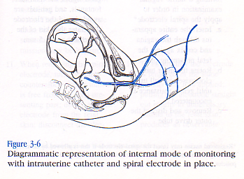
Electronic fetal heart monitoring ( EFM )
developed in the 1960s.
Internal or Direct monitoring
External or Indirect monitoring

Slide 22
Direct monitoring of fetal heart rate and uterine contractions
Uterine contractions are assessed with an intrauterine pressure catheter connected to a pressure transducer. This signal is then amplified and recorded.
The fetal electrocardiogram is obtained by direct application of the scalp electrode, which is then attached to a leg plate on the mother’s thigh. The signal is transmitted to the monitor, where it is amplified, counted by the cardiotachometer, and then recorded.

Slide 23
External monitoring
Contractions are detected by the pressure-sensitive tocodynamometer, amplified, and then recorded.
Fetal heart rate is monitored using the Doppler ultrasound transducer, which both emits and receives the reflected ultrasound signal that is then counted and recorded.

Slide 24
Equipment
The fetal monitor tracing is a continuous paper strip composed of two cartesian graphs.
The FHR tracing is displayed on the upper graph, with time on the x-axis and heart rate on the y-axis (range 30 to 240 beats per minute).

Slide 25
Equipment
Uterine activity is displayed on the lower graph, with time on the x-axis and pressure on the y-axis (range 0 to 100 mm Hg).
On both grids, fine vertical lines represent 10-second intervals, and heavy lines denote 1-minute intervals.
In the United States, the standard paper speed is 3 cm per minute.

Slide 26
standard 3 cm/min

Slide 27
Interpretation of the Fetal Monitor Tracing
FHR assessment
Baseline rate Tachycardia Bradycardia Sinusoidal pattern
Variability Increased variability Average or normal variability Decreased variability Absent variability
Periodic patterns Accelerations
Decelerations Early decelerations Variable decelerations Late decelerations
Uterine activity assessment
Contraction frequency Contraction duration Baseline uterine tone Contraction strength

Slide 28
Baseline rate
The baseline rate is the mean bpm (rounded to 0 or 5) over a 10 minute interval, excluding periodic changes, periods of marked variability, and segments that differ by more than 25 bpm.
The baseline must be identifiable for 2 minutes during the interval (but not necessarily a contiguous 2 minutes)
Normal = 110 to 160 bpm
Bradycardia = below 110 bpm
Tachycardia = over 160 bpm

Slide 29
Fetal bradycardia
Maternal B-blocker therapy
hypothermia
Hypoglycemia
Hypothyroidism
fetal cardiac conduction defects (congenital atrioventricular block)

Slide 30
Fetal bradycardia
Fetal bradycardia between 100 and 110 bpm can usually be tolerated for long periods when it is accompanied by normal FHR variability.
An FHR between 80 and 100 bpm is nonreassuring.
An FHR that persists below 80 bpm is an ominous sign and may presage fetal death.

Slide 31
Fetal tachycardia
Fetal tachycardia is defined as a baseline fetal heart rate of greater than 160 bpm for at least 10 minutes.

Slide 32
Fetal tachycardia
The most common cause of fetal tachycardia is chorioamnionitis, but it may also be due to maternal fever, thyrotoxicosis, medication, and fetal cardiac arrhythmias.
Fetal tachycardia between 160 and 200 bpm without any other abnormalities in FHR is usually well tolerated when accompanied by normal FHR variability.

Slide 33
Interpretation of fetal tachycardia
Fetal tachycardia less than 200 bpm alone has not been strongly associated with fetal acidemia, unless associated with either of :
Recurrent decelerations
Absent accelerations
Minimal/absent variability

Slide 34
Sinusoidal pattern
The sinusoidal FHR pattern is an uncommon FHR baseline abnormality.
It has the appearance of a smooth sine wave with an amplitude of 5 to 15 beats per minute and a frequency of 3 to 5 cycles per minute which persists for 20 minutes or more.There is little beat-to-beat variability, and accelerations are absent.

Slide 35
Sinusoidal heart rate pattern
The mechanism for the sinusoidal pattern is believed to be a response to moderate fetal hypoxemia, often secondary to fetal anemia.
Additionally, it has been reported in association with fetomaternal hemorrhage, chorioamnionitis, fetal sepsis, and administration of narcotic analgesics.
A persistent sinusoidal pattern that is not attributable to medications is a concerning finding that demands immediate evaluation.

Slide 38
Baseline variability
Fluctuations in the baseline FHR that are irregular in amplitude and frequency.
FHR variability refers to the fluctuations in the FHR of two cycles or more, visually quantified as the amplitude of peak to trough in bpm.

Slide 39
Variability
Absent = amplitude undetectable
Minimal = amplitude 0 to 5 bpm
Moderate = amplitude 6 to 25 bpm
Marked = amplitude over 25 bpm

Slide 41
Fetal Heart Rate Variability
Moderate variability is a reassuring sign that reflects adequate fetal oxygenation and normal brain function.
In the presence of normal FHR variability, regardless of what other FHR patterns exist, the fetus is not experiencing cerebral tissue asphyxia.

Slide 42
Fetal Heart Rate Variability
FHR variability results from oscillatory input by the parasympathetic nervous system.
Good FHR variability is strongly associated ( 98 percent ) with an umbilical pH >7.15

Slide 43
Decreased variability
Decreased variability is associated with :
fetal hypoxia, acidemia
drugs that may depress the fetal CNS (e.g., opiates, magnesium sulfate
, atropine benzodiazepines, phenothiazines)
fetal tachycardia
fetal CNS and cardiac anomalies
prolonged uterine contractions (uterine hypertonus)
Prematurity
fetal sleep

Slide 44
Periodic fetal heart rate change

Slide 45
PERIODIC CHANGES
Periodic changes of the FHR include decelerations and accelerations.
In labor, these usually occur in response to uterine contractions but may also occur with fetal movement.

Slide 46
Acceleration
A visually apparent abrupt increase (onset to peak in less than 30 seconds) in the FHR.
Before 32 weeks of gestation, accelerations should last 10 sec and peak 10 bpm above baseline.
As of 32 weeks gestation, accelerations should last 15 sec and peak 15 bpm above baseline.
A prolonged acceleration is 2 minutes but less than 10 minutes.
If an acceleration lasts 10 minutes or longer, it is a baseline change .

Slide 47
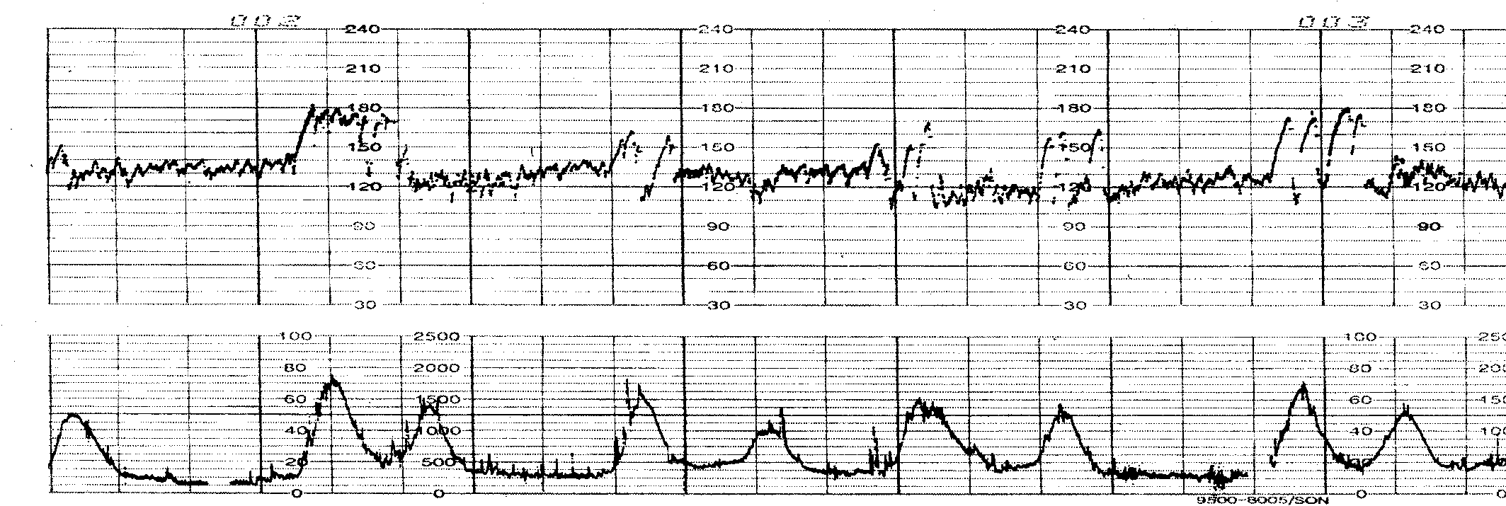

Slide 48
Acceleration
Not always present in the intrapartum pattern.
A reassuring feature of an intrapartum pattern
Spontaneous acceleration = pH >7.2
An acceleration in response to some scalp stimulation during a VE or vibroacoustic stimulation is a REASSURING sign.

Slide 49
The frequency and amplitude of accelerations may be diminished by :
Fetal sleep states
Medications (narcotics, magnesium sulfate, atropine)
Prematurity
Fetal acidosis
Often, fetal scalp stimulation or vibroacoustic stimulation will provoke fetal movement and FHR accelerations.
If these measures fail to induce FHR accelerations, hypoxia should be suspected, particularly if other FHR characteristics are not reassuring.

Slide 50
Decelerations
There are four principal types of decelerations:
Early
Late
Variable
Prolonged
These are named for their timing, relationship to contractions, duration, and shape, but are important distinctions more because they describe the cause of the decelerations.

Slide 51
Early deceleration
A gradual decrease (onset to nadir in 30 seconds or more) and return to baseline of the FHR associated with a uterine contraction. Resulting in a U-shaped deceleration .
Early decelerations are associated with uterine contractions: the nadir of the deceleration occurs at the same time as the peak of the uterine contraction and, thus, is a “mirror image” of the contraction

Slide 52
Early deceleration
Early decelerations are believed to be vagally mediated and due to fetal head compression from the birth canal, digital examination, or forceps application that causes a reflex response through the vagus nerve with acetylcholine release at the fetal sinoatrial node.

Slide 53
Early deceleration

Slide 54
Early deceleration
They do not indicate fetal hypoxia and are only significant in that they may be easily confused with late decelerations because of their similar shape and depth.
They are generally not associated with fetal acidosis or poor neonatal outcome.

Slide 55
Late deceleration
A gradual decrease and return to baseline of the FHR associated with a uterine contraction.
The deceleration is delayed in timing, with the nadir of the deceleration occurring after the peak of the contraction.
The onset, nadir, and recovery usually occur after the onset, peak, and termination of a contraction .

Slide 56
Late deceleration
The magnitude of late decelerations is rarely more than 30 to 40 beats/min below baseline and typically not more than 10 to 20 beats/min.
Late decelerations usually are not accompanied by accelerations ( U-shaped )
late deceleration was the first fetal heart rate consequence of uteroplacental- induced hypoxia.

Slide 57
Late deceleration
A large number of clinical circumstances can result in late decelerations. any process that causes :
Maternal hypotension,(epidural analgesia )
Excessive uterine activity(oxytocin stimulation)
Placental dysfunction (Maternal diseases such as hypertension, diabetes, and collagen-vascular disorders can cause chronic placental dysfunction)
Placental abruption can cause acute late decelerations

Slide 58
Late deceleration
Late decelerations are considered significantly nonreassuring,especially when repetitive and associated with decreased variability.
Repetitive late decelerations are defined as occurring after 50% or more of contractions in a 20-minute period .

Slide 59
Late deceleration

Slide 60
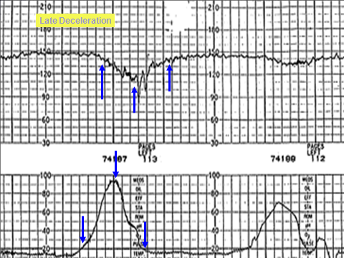

Slide 62
Variable decelerations
The most common type of decelerations seen in the laboring patient are variable decelerations.
Variable decelerations are, in general, synonymous with umbilical cord compression, and anything that results in the interruption of blood flow within the umbilical cord will result in a variable deceleration.
These types of decelerations may occur with (periodic) or without (episodic) uterine contractions.

Slide 63
Variable deceleration
The decrease is 15 bpm, lasting 15 secs and <2 minutes from onset to return to baseline.
Repetitive or intermittent
Often mimic letters of the alphabet U V W M
Rapid sudden fall in FHR
Often rapid recovery
The depth and duration are proportional to the severity and duration of interruption of cord blood flow.
Often seen when liquor volume is ↓

Slide 64
Causes of variable deceleration
Prolapse of the umbilical cord
Nuchal cord
True knot in the cord
Uterine rupture
Placental abruption
Uterine hypertonus, and tachysystole

Slide 65
Variable decelerations are classified as:
Mild : duration less than 30 seconds, depth of deceleration less than 70 beats per minute
Moderate : duration 30 to 60 seconds, depth less than 70 beats per minute
Severe : duration greater than 60 seconds, depth less than 70 beats per minute.

Slide 66
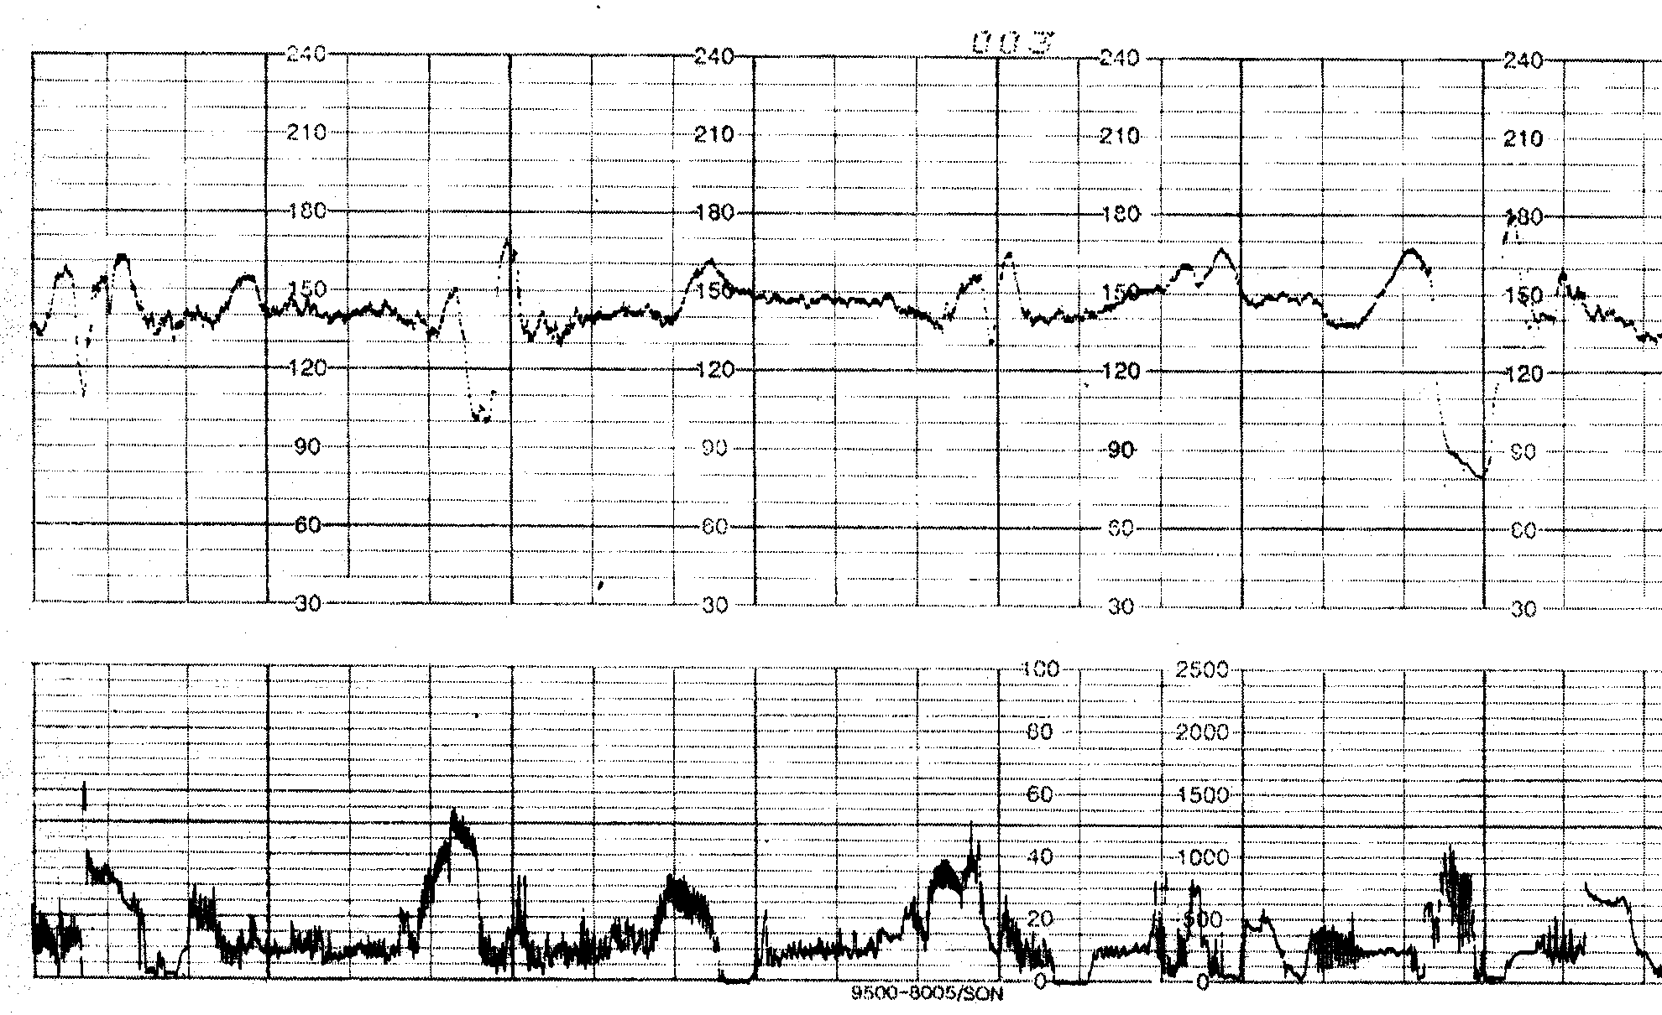
Fig 5 Variable Decelerations

Slide 67
Variable decelerations
They are often correctable by changes in the maternal position to relieve pressure on the umbilical cord.
Infusion of fluid into the amniotic cavity (amnioinfusion) to relieve umbilical cord compression in cases of oligohydramnios or when ROM has occurred has been shown to be effective in decreasing the rate of decelerations and cesarean delivery.

Slide 69
Prolonged deceleration
A decrease in FHR below the baseline of 15 bpm or more, lasting at least 2 minutes but <10 minutes from onset to return to baseline.
Usually associated with an acute insult - VE - ↑Syntocinon
Should be managed vigorously
If a deceleration lasts 10 minutes or longer, it is a baseline change

Slide 70
Prolonged deceleration

Slide 71
Ancillary Tests
Because the rate of false-positive diagnosis of EFM is high, attempts have been made to find ancillary tests that help confirm a nonreassuring FHR tracing.
Fetal Stimulation
In the case of an EFM tracing with decreased or absent variability without spontaneous accelerations, an effort should be made to elicit one.

Slide 72
Fetal Stimulation
Four techniques are available to stimulate the fetus:
1) fetal scalp sampling
2) Allis clamp scalp stimulation
3) digital scalp stimulation
4) vibroacoustic stimulation

Slide 73
Fetal Stimulation
Each of these tests is a reliable method to exclude acidosis if accelerations are noted after stimulation.
Because vibroacoustic stimulation and digital scalp stimulation are less invasive than the other two methods, they are the preferred methods.
When there is an acceleration following stimulation, acidosis is unlikely and labor can continue.

Slide 74
Scalp Stimulation
Scalp stimulation should be performed when the FHR is at its baseline rate.
If a FHR acceleration is elicited (rise of ≥15 bpm above baseline lasting for ≥15 seconds), absence of acidosis (ie, fetal pH greater than 7.20) is likely.

Slide 75
Digital fetal scalp stimulation
Digital fetal scalp stimulation is recommended in response to atypical electronic fetal heart tracings.
In the absence of a positive acceleratory response with digital fetal scalp stimulation→ Fetal scalp blood sampling is recommended when available.
If fetal scalp blood sampling is not available, consideration should be given to prompt delivery, depending upon the overall clinical situation.

Slide 76
Allis clamp scalp stimulation
This proposal was based on the observation that acceleration of the heart rate in response to pinching of the scalp with an Allis clamp just prior to obtaining blood was invariably associated with a normal pH.
If a FHR acceleration is elicited (rise of ≥15 bpm above baseline lasting for ≥15 seconds), absence of acidosis (ie, fetal pH greater than 7.20) is likely.

Slide 77
Vibroacoustic Stimulation
The technique uses an electronic artificial larynx placed approximately 1 centimeter from or directly onto the maternal abdomen. ( 15 sec )
FHR acceleration of 15 beats with VAS, lasting for at least 15 seconds excludes fetal acidosis with 100% accuracy.
These are simple and useful procedures.

Slide 78
Fetal Scalp Blood Sampling
Where facilities and expertise exist, fetal scalp blood sampling for assessment of fetal acid–base status is recommended in women with "atypical/abnormal" fetal heart tracings at gestations > 34 weeks when delivery is not imminent Or if digital fetal scalp stimulation does not result in an acceleratory fetal heart rate response.
However, the use of scalp pH has decreased, and it may not be available at some tertiary hospitals.
Furthermore, the positive predictive value of a low scalp pH to identify a newborn with HIE is only 3%.

Slide 79
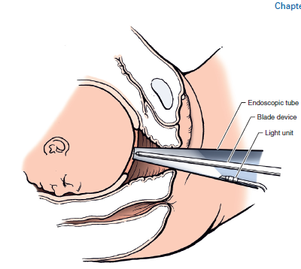

Slide 80
Fetal scalp pH results and apropriate courses of action
Fetal blood sample (FBS) result/pH | Subsequent action
≥7.25 | Repeat FBS if fetal HR abnormalities persist
7.21–7.24 | Repeat FBS within 30 minutes or consider delivery if rapid fall in pH since last sample
≤7.20 | Delivery indicated

Slide 81
Intrapartum Fetal Scalp Lactate Testing
If Lactate → 4.2 - 4.8 → DELIVER.
Lactate increases at approximately 1 mmol every 25 minutes.
Fetal brain injury begins to occur at a lactate level of ≥ 6mmol
Intrapartum scalp lactate testing is not recommended for routine use at this time.

Slide 82
Pulse Oximetry
The use of pulse oximetry has been suggested as a modality to reduce the false-positive diagnosis of a nonreassuring FHR.
However, research has demonstrated that neither the overall rate of cesarean delivery nor the rate of umbilical arterial pH less than 7 decreased when pulse oximetry was used in association with EFM in cases of nonreassuring fetal status.
Because of the uncertain benefit of pulse oximetry and concerns about falsely reassuring fetal oxygenation, use of the fetal pulse oximeter in clinical practice cannot be supported at this time.

Slide 83
Category I
Baseline rate: 110-160 beats per minute (bpm)
Moderate baseline FHR variability
No late or variable decelerations
Early decelerations may be present or absent
Accelerations may be present or absent
This is a normal tracing.
Intermittent or continuous fetal monitoring based on clinical status and underlying risk factors.
Review every 30 minutes in the first stage and every 15 minutes in the second stage of labor.

Slide 84
Category III
Patterns believed to be predictive of current or impending fetal asphyxia include absence of FHR variability and either:
Recurrent late decelerations
Recurrent variable decelerations
sustained Bradycardia
Sinusoidal pattern (Risk of acidemia increased if prolonged or amplitude of 15 beats per minute or more)

Slide 85
category II FHR tracings include any of the following
Baseline Rate
• Bradycardia not accompanied by absent baseline variability
• Tachycardia
Baseline FHR Variability
• Minimal baseline variability
• Absent baseline variability not accompanied by recurrent decelerations
• Marked baseline variability
Accelerations
• Absence of induced accelerations after fetal stimulation
Periodic or Episodic Decelerations
• Recurrent variable decelerations accompanied by minimal or moderate baseline variability
• Prolonged deceleration ≥2 minutes but <10 minutes
• Recurrent late decelerations with moderate baseline variability
• Variable decelerations with other characteristics, such as slow return to baseline, “overshoots,” and “shoulders”

Slide 86
Management of a Persistently Nonreassuring FHR
In the presence of an indeterminate (category II) or nonreassuring (category III) FHR pattern, the etiology should be determined, if possible, and an attempt should be made to correct the pattern by addressing the primary problem.

Slide 87
Management of a Persistently Nonreassuring FHR
If the pattern persists, initial measures include ;
Change maternal position (to left or right lateral)
administering O2 via tight fitting facemask at 8-10L/minute
Correcting maternal hypotension ( Temporarily increase IV rate )
discontinuing oxytocin
Perform vaginal examination to rule out cord prolapse and to relieve pressure from the presenting part on the cord

Slide 88
Management of a Persistently Nonreassuring FHR
Tocolysis in the presence of tachysystole (e.g., nitroglycerin, β-adrenergic drugs) .(Uterine tachysystole : more than 5 contractions in 10 minutes, averaged over 30 minutes)
Amnioinfusion may also be used to prevent umbilical cord compressions.
Modify or pause pushing efforts in the second stage of labour

Slide 89
Management of a Persistently Nonreassuring FHR
Prepare for rapid delivery if required OR determine fetal well-being.
This can be done with fetal scalp stimulation - gently rubbing the fetal head to illicit a response, (remember not to do this while the fetus is experiencing a deceleration), or fetal scalp sampling for either pH or lactate.
The current accepted standard is that expedited delivery should occur within 30 minutes.

Slide 90
Meconium
Meconium is a thick, black, tarry substance that is present in the fetal intestinal tract.
It is composed of amniotic fluid, lanugo (the fine hair that covers the fetus), bile, and fetal skin and intestinal cells.
The neonate’s first stool consists of meconium. However, the fetus may pass the meconium in utero, which is a sign of fetal stress.

Slide 91
Meconium
Meconium-stained amniotic fluid is present in about 10% to 20% of births, and most meconium-stained neonates do not develop problems.

Slide 92
Meconium aspiration syndrome
Meconium aspiration syndrome, a condition caused by inhalation of meconium-stained amniotic fluid by the fetus, occurs in about 6% of births in which meconium is present.
Severe cases of this syndrome may cause pneumonitis, pneumothorax, and pulmonary artery hypertension.
When there is thick meconium at delivery, interventions to prevent or decrease meconium aspiration syndrome should be considered.

Slide 93
Meconium aspiration syndrome
Because meconium passage may predate labor, amnioinfusion should not be used as a preventive measure for meconium aspiration syndrome.
Suctioning of the upper airway on the perineum does not prevent or alter the course of meconium aspiration syndrome.
In the presence of meconium-stained amniotic fluid, routine suctioning or intubation is no longer recommended , however, a credentialed neonatal resuscitation team should be available in case endotracheal intubation is needed.

Slide 94
THANK YOU

Slide 95
