Slide 2
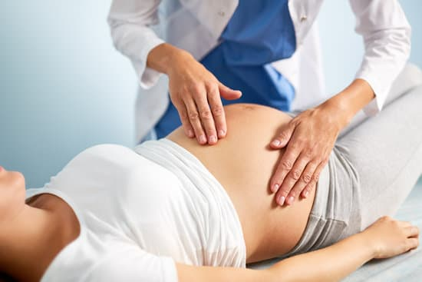
Obstetric examination
فاطمه نوری
استاجر گروه زنان و زایمان
بیمارستان مهدیه

Slide 3
Obstetric examination
The obstetric examination is a type of abdominal examination performed in pregnancy.
It is unique in the fact that the clinician is simultaneously trying to assess the health of two individuals – the mother and the fetus.
This should always be performed after a thorough Obstetric History as this will guide the examination.

Slide 4
Prior to examination
• Need a warm and private environment.
• Check patients ID, consider the need for a Chaperone
• Wash your hands (preferably ensuring they are warm)
• Introduce yourself and say what status you hold
• Stand on right side of the patient.
• Natural and adequate lighting
• If examiner is male a female nurse or colleague should be there too

Slide 5
Explain
Explain The procedure
Tell her if the PE was very uncomfortable at any point she could say
Gain verbal consent
Ensure the patient has emptied her bladder to avoid discomfort

Slide 6
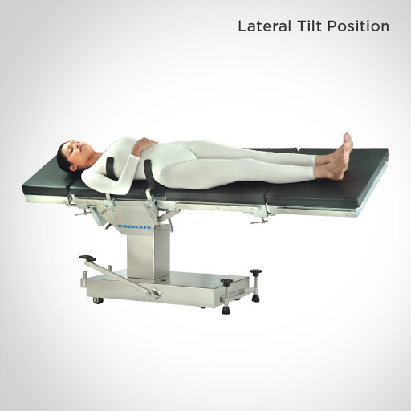
position
supine - head and top of shoulders only supported by pillow - hands by side.
For patients beyond the 20th to 24th week of gestation, the patient should be tilted 15° to the left by placing rolled towels beneath the spinal board. This is completed to prevent supine hypotension syndrome, which occurs when the gravid uterus compresses the inferior vena cava.
Expose from xiphisternum to pubic symphysis.

Slide 7
General inspection
Comfortable at rest
Conscious and oriented
Pain
Examine signs of Anemia or jaundice
Edema

Slide 8
Hands
Pulse rate and rhythm [higher baseline HR during pregnancy (80-90)]
Blood pressure
Capillary refill time [normally less than 2 second]

Slide 9
Obstetric examination
Inspect
Palpate
Auscultate
shape, size, scars, linea nigra, striae, movements, color
Abdomen for - growth (gestational age estimated by fundal height measurement) , movements, Fetal parts, No. of fetus, lie, position, presentation and engagement.
Abdomen for Fetal Heat Rate. Use fetal stethoscope - pinnard or sonicaid.

Slide 10
inspection
Size of the uterus: assess
If the length & breadth are both increased multiple pregnancies, polyhydramnios
If the length is increased only large baby
Shape of the uterus
length should be larger than broad this indicates longitudinal lie. But if the uterus is low and broad indicates transverse fetus lie.
Fetal movement [from 24 weeks gestation onwards]
Contour of the abdomen: full bladder may be visible in late pregnancy. Umbilicus may become everted

Slide 11
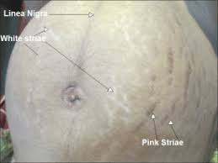
inspection
Skin changes: look for stretch marks, linea nigra, scars that indicates previous surgeries
Abdomen distention: uniform/regular
Flanks: full or not
All quadrants move equally with respiration?
Umbilicus position (central/deviated to up/down)
Umbilicus shape (inverted/ flush to skin/ everted)
Visible pulsation /engorged veins
Hernial orifices

Slide 12
palpation
Maintain your patient’s dignity at all times.
Expose only as much of your patient as is required.
Ensure that your patient is positioned appropriately and that you have warm hands.
Palpate the abdomen using even movements of the flat of the palmar surface of closed fingers.
Aim to maintain hand to skin contact as much as possible rather than taking hands on and off the surface of the abdomen.

Slide 13
palpation
Do not prod the abdomen or use jerky movements as these are likely to irritate the uterus and stimulate a contraction.
Even jewellery should be removed
Before start palpation ask about any pain or tenderness
Monitor the patient`s face for signs of discomfort during the examination.
At first palpated the nine regions of abdomen
Consider any tenderness, rebound, guarding, mass,…
Palpated the uterus and it`s edges and borders

Slide 14
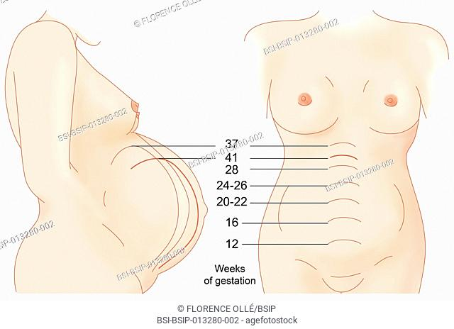
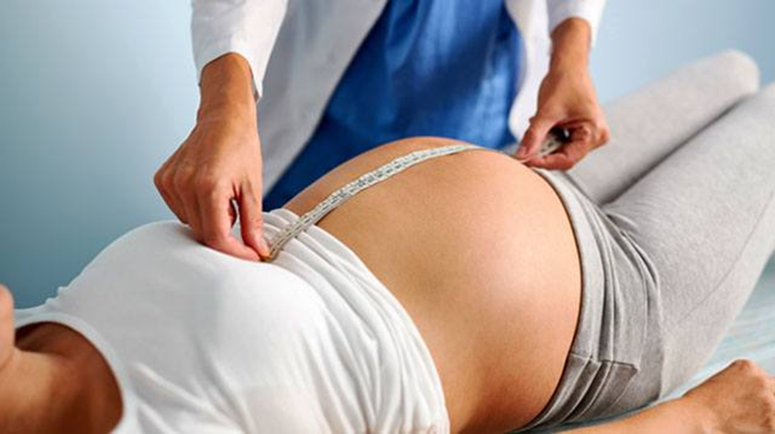
Fundal height
The woman lies supine
Palpate for the fundus first. The fundus is not usually palpated abdominally before 12 weeks gestation.
Apply gentle pressure with the flat palmar surface of your hand moving downwards from the xiphisternum - to palpate the top of the fundus. The fundal height can be measured in CMS from 24 weeks gestation.
Place the zero end of the tape measure at the fundus.
Stretch the tape measure over the abdomen face down so the measurements can not be seen - this avoids observer bias - to the superior border of the symphisis.
Look on the reverse of the tape, and document the measurement in centimeters.

Slide 15
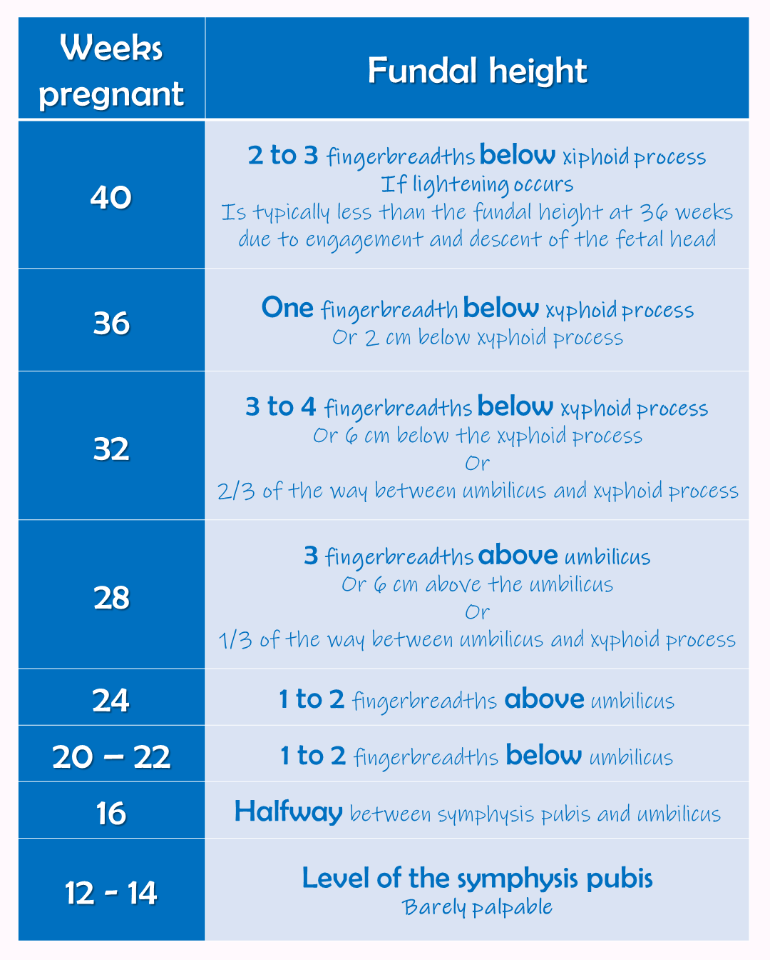

Slide 16
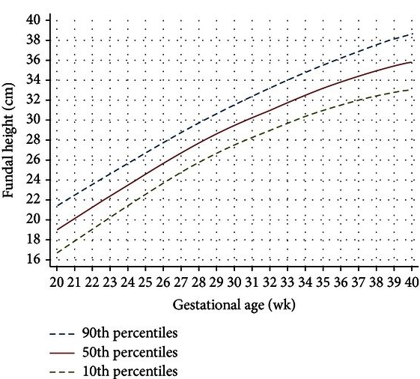
The obtained measurement is then charted.
The height measured is plotted against number of weeks gestation worked out from LMP.
The chart shows the mean height against gestation.
The outer lines represent 1 standard deviation above and below.

Slide 17
The lie
The lie of the fetus refers to its long axis in relation to the long axis of the mother (i.e. spine)
Only LONGITUDINAL lie is normal (This ‘usually’ enables the presenting part to enter the pelvis)

Slide 18
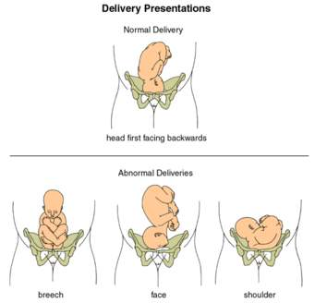
presentation
The presentation is the part of the fetus in the lower pole of the uterus

Slide 19
Cephalic and breech presentation
Cephalic presentation is the presentation of the fetal head. This is the normal and most common presentation. The position is described by the direction in which the occiput faces the mother’s pelvis.
Breech presentation: The position is described by the direction in which the sacrum faces the mother’s pelvis. In a breech presentation legs may be flexed or extended. Breech is not a normal presentation and reasons why the breech is presenting should be considered.

Slide 20
position
The position of the fetus is described by the relationship of the presenting part to the maternal pelvis
The denominator for the presenting part for a Cephalic presentation = occiput and for a Breech presentation = sacrum and shoulder presentation = acromion
The description for a cephalic presentation with the occiput lying directly lateral to the left would be – LEFT OCCIPITO-LATERAL (LOL)

Slide 21
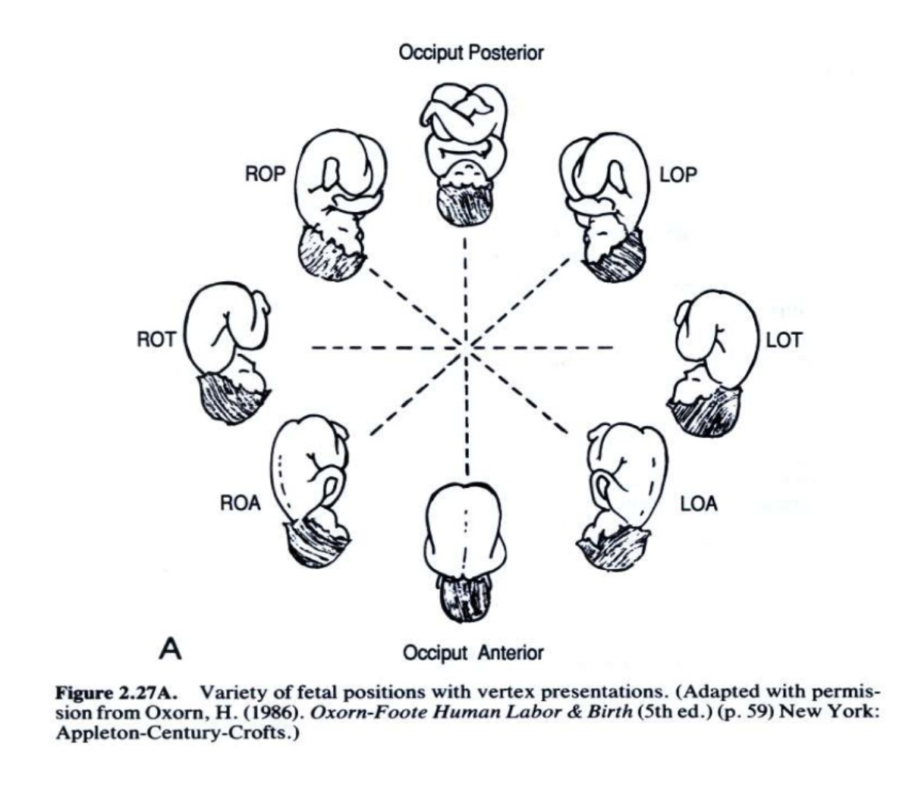
Imagine the mother is lying supine and you are looking through her pelvis facing her feet

Slide 22
Engagement
Refers to the descent of widest transverse diameter of the presenting part (breech or cephalic) through the true pelvic brim. (The widest transverse diameter of the fetal skull is the bi-parietal).
The amount of presenting part palpable is used to describe descent into the pelvis
When 2/5ths or less of the presenting part is palpable abdominally it is engaged

Slide 23
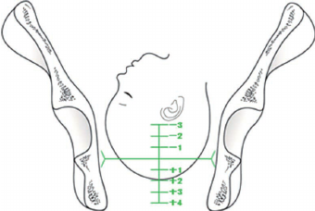
Engagement
Engagement occurs around 36 weeks in a primigravida (first pregnancy) with a cephalic presentation.
In a multigravida (a patient who has had more than 1 pregnancy) engagement may occur after the onset of labor.

Slide 24
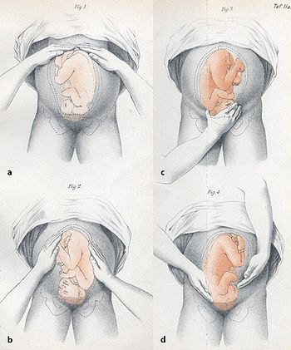
LEOPOLD`S MANEUVER
1884 by Christian Leopold
Systematic way to determine the position and presentation of a fetus inside the woman's uterus.
24 weeks gestation Leopold's Maneuver

Slide 25
Things to remember
Explain procedure to the patient.
Ensure that the pregnant woman has recently emptied her bladder.
Drape properly to maintain privacy.
Place woman in dorsal recumbent position, supine with knees flexed to relax abdominal muscles. Place a small pillow under the head for comfort.
Warms hands prior to palpation rubbing together(Cold hands can stimulate uterine contractions)
Use the palm for palpation not the fingers.

Slide 26
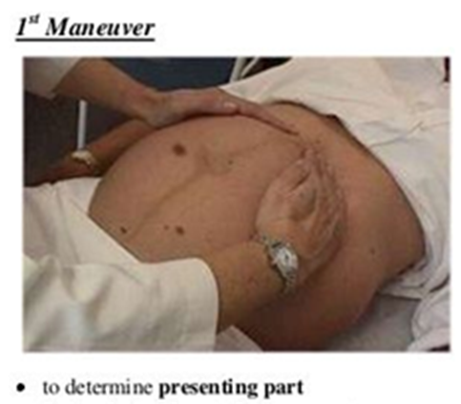
First maneuver ( Fundal Grip)
To determine fetal part lying in the fundus
To determine fetal presentation

Slide 27
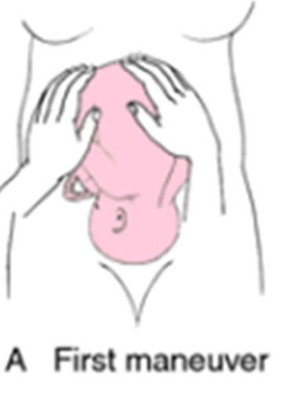
First maneuver ( Fundal Grip)
Stand at the side of the bed facing the client.
Warm hands and feels the upper abdomen (fundus) with the palms of both hands on either side of the fundus, with your fingers quite close together
Decide which pole of the fetus is being held by observing three points.
Relative consistency: head is harder and firmer
Shape: head will be round hard/smooth with transverse groove of the neck
Mobility: head will move independently on the trunk
Determine the fetal parts palpated.

Slide 28
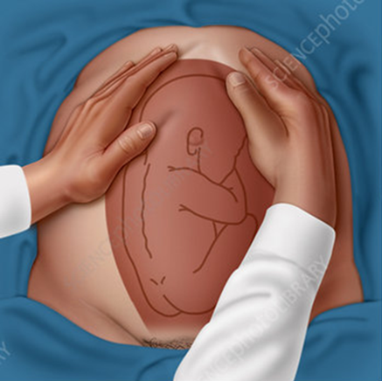
1st Maneuver Findings
Head is more hard and round that moves independently of the body.
Buttock is firm, less well defined that moves only in conjunction with the body and quadrilateral mass.

Slide 29
Second maneuver ( Umbilical Grip)
To identify location of the fetal back
To determine position
To determine fetal lying

Slide 30
Second maneuver ( Umbilical Grip)
Still standing at the side of the bed facing the client.
Place the palm surfaces of both hands on either side of the abdomen
First the right hand remains steady on one side of the abdomen while the left hand explores the right side of the woman's uterus .
By moving from top to the lower segment of the uterus to feel the fetal back and the small fetal parts. This is then repeated using the opposite side and hands. Use gentle but deep pressure

Slide 31
2nd Maneuver/Umbilical Grip Findings
The lateral sides of the fundus are palpated to determine the position of the fetal back and small parts.
The fetal spine will palpate as firm, flat, continuous and linear.
The fetal extremities are palpable by their varying contour and movements and nodular.
The purpose of this maneuver is to determine whether the fetal back is left or right.

Slide 32
Third maneuver (Pawlick's Grip)
To determine engagement of presenting part and to estimate fetal station
To determine presentation.

Slide 33
Third maneuver (Pawlick's Grip)
Standing at the side of the bed facing the client.
Gently grasp the lower portion of the abdomen just above the symphysis pubis, between the thumb and the two fingers of one hand and pressing together.

Slide 34
3rd Maneuver Findings
The presenting part is engaged if it is not movable.
If it is not yet engaged it is still movable
If it is firm and round it must be head
If it is soft, it could be buttock presentation.

Slide 35
Fourth Maneuver ( Pelvic Grip)
To determine the degree of flexion of fetal head.
To determine attitude
To Confirm the finding of Pawlick's Grip

Slide 36
Fourth Maneuver ( Pelvic Grip)
The nurse/student faces the client’s feet.
The nurse/student places the tips of her three fingers at the abdomen above the inguinal ligaments then presses her finger downward and inward.

Slide 37
4th Maneuver Findings
If cephalic prominences or brow of the baby is on the same side of the small fetal parts, the head is flexed
If cephalic prominences is on the same side of the fetal back , the head is extended.
Good attitude - if brow correspond to the side (2nd maneuver) that contained the elbows and knees.
Poor attitude - if examining fingers will meet an obstruction on the same side as fetal back (hyperextended head)
Also palpates infant’s anteroposterior position. If brow is very easily palpated, fetus is at posterior position (occiput pointing towards woman’s back)

Slide 38
LEOPOLD`S MANEUVER

Slide 39
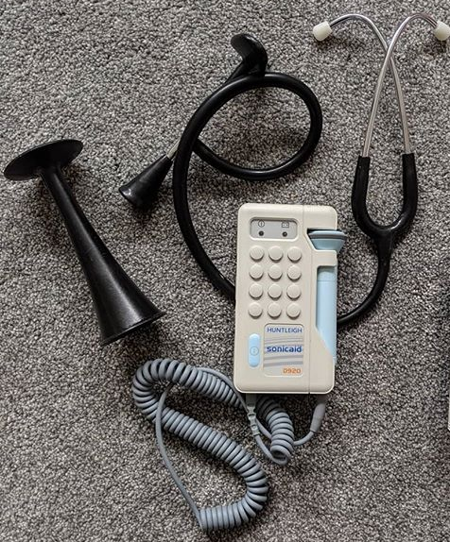
Assessing the fetal heart rate
The Fetal Heart (FH) should be auscultated using a fetal stethoscope known as
1) Pinnard ( a wood metal or plastic device)
2)sonicaid (an electronic device)
The chosen device is placed over the baby’s back (the nearer the shoulder the clearer the FH can be heard)
Location of the fetal heart may help to confirm your findings on palpation

Slide 40
Assessing the fetal heart rate
The fetal heart rate should be counted immediately after a contraction for a full minute at least once every 30 minutes during the active phase first stage of labor and every 5 minutes during the second stage while also palpating the mother’s pulse (allows the examiner to differentiate between maternal and fetal heart rate)
A normal fetal heart rate is between 110 – 160 beats per minute (mother’s pulse should be counted separately).

