Slide 1
PREMENSTRUAL SYNDROME AND PREMENSTRUAL DYSPHORIC DISORDER
Dr. Behnaz Nouri

Slide 2
Goal
Students should be able to list diagnostic criteria and appropriate treatments for
premenstrual syndrome and premenstrual
dysphoric disorder, attuned to differences
between the two.

Slide 3
Premenstrual syndrome (PMS)
A group of physical, mood-related, and behavioral
changes that occur in a regular, cyclic relationship to the luteal phase of the menstrual cycle and that interfere with some aspect of the patient’s life.
Symptoms occur in most cycles resolving usually
with onset of menses but certainly by cessation of menses.
varies both in severity and in the degree of disruption of the patient’s work, home, and/or leisure life

Slide 4
premenstrual dysphoric disorder (PMDD)
The Diagnostic and Statistical Manual of Mental
Disorders, 5th edition (DSM-5) lists the diagnostic
criteria for premenstrual dysphoric disorder (PMDD) as a specific set of at least 5 of 11 possible symptoms with at least 1 core symptom—specifically depressed mood, anxiety or tension, irritability, or decreased interest in
activities (anhedonia).
These symptoms occur regularly during the luteal phase
The pathophysiology of both entities is not well elucidated

Slide 5
Molimina
Normal cyclic symptoms associated with
ovulation, which do not interfere with the patient’s daily routine

Slide 6
Incidence
Premenstrual symptoms occur in approximately 75% to 85% of women.
PMS that causes significant disruption of daily life occurs in approximately 5% to 10%
of women.
PMDD, affects only 3% to 5% of women.
PMS and PMDD can begin with menarche but can also present later in life
Ethnicity and culture
Implying a genetic

Slide 7
SYMPTOMS
More than 200 symptoms have been attributed to PMS.
Somatic symptoms that are most common include abdominal bloating and fatigue
The most common behavioral symptom is emotional lability
The criteria for the diagnosis of PMDD are more rigorous than those of PMS and emphasize the
existence of mood-related symptoms.
PMS can be diagnosed on the basis of either mood or physical symptoms.

Slide 8
Diagnostic Criteria for Premenstrual Syndrome
1. PMS can be diagnosed if the patient reports at least one of the following affective and somatic
symptoms during the 5 days before menses in each of three menstrual cycles:
Affective symptoms
• Depression
• Angry outbursts
• Irritability
• Anxiety
• Confusion
• Social withdrawal
Somatic symptoms
• Breast tenderness
• Abdominal bloating
• Headache
• Swelling of extremities
2. These symptoms are relieved within 4 days of the onset of menses, without recurrence until at least
cycle day 13. The symptoms are present in the absence of any pharmacologic therapy, hormone ingestion
or drug or alcohol use. The symptoms occur reproducibly during two cycles of prospective recording.

Slide 9
Diagnostic Criteria for Premenstrual Dysphoric disorder
A. In the majority of menstrual cycles, at least five symptoms must be present in the final week before onset of menses, start
to improve within a few days the onset of menses, and become
minimal or absent in the week post menses
B. One (or more) of the following symptoms must be present:
1. Marked affective lability (e.g., mood swings, feeling suddenly sad or tearful, or increased sensitivity to rejection)
2. Marked irritability or anger or increased interpersonal conflicts
3. Marked depressed mood, feelings of hopelessness, or self-
deprecating thoughts
4. Marked anxiety, tension, and/or feelings of being keyed up or on edge

Slide 10
Diagnostic Criteria for Premenstrual Dysphoric disorder
C. One (or more) of the following symptoms must additionally be
present, to reach a total of five symptoms when combined with
symptoms from Criterion B above.
1. Decreased interest in usual activities (e.g., work, school, friends,
hobbies)
2. Subjective difficulty in concentration
3. Lethargy, easy fatigability, or marked lack of energy
4. Marked change in appetite; overeating; and/or specific food
cravings
5. Hypersomnia or insomnia
6. A sense of being overwhelmed or out of control
7. Physical symptoms such as breast tenderness or swelling,
headaches, joint or muscle pain, a sensation of “bloating,” or
weight gain

Slide 11
Diagnostic Criteria for Premenstrual Dysphoric disorder
Note: The symptoms in Criteria A to C must have been met for most menstrual
cycles that occurred in the preceding year.
D. The symptoms are associated with clinically significant distress or interfere
with work, school, usual social activities, or relationships with others
others (e.g., avoidance of social activities; decreased productivity and efficiency
at work, school, or home).
E. The disturbance is not merely an exacerbation of the symptoms of another
disorder, such as major depressive disorder (MDD), panic disorder , persistent
depressive disorder (dysthymia), or a personal disorder (although it may co-occur
with any of these disorders).
F. Criterion A should be confirmed by prospective daily ratings during at least
two consecutive symptomatic cycles. (Note: The diagnosis may be made
provisionally prior to this confirmation.)
G. The symptoms are not attributable to the physiologic effects of a
substance (e.g., a drug of abuse, a medication, other treatment) or other medical condition (e.g., hyperthyroidism)

Slide 12
Etiology
Many theories have been proposed to explain PMS, including altered levels of estrogen, progesterone, endorphins, catecholamines,
vitamins, and minerals, but none provides a single, unified
explanation that accounts for all the variations that are seen.
Currently, the data support a theory of serotoninergic dysregulation as the basis for PMDD
Monoamine oxidase reduces serotonin availability, progesterone
potentiates monoamine oxidase, and estrogen potentiates
potentiates monoamine oxidase inhibitors.
The availability of serotonin is decreased in the progesterone-
dominant luteal phase.
γ-aminobutyricacid as an important factor in decreasing levels of allopregnanolone, a progesterone metabolite.

Slide 13
Differential Diagnosis of Premenstrual Syndrome
Allergy
Breast disorders (fibrocystic change)
Chronic fatigue states
Anemia
Chronic cytomegalovirus infection
Lyme disease
Connective tissue disease (lupus erythematosus)
Drug and substance abuse
Endocrinology disorders
• Adrenal disorders (Cushing syndrome and hypoadrenalism)
• Adrenocorticotropic hormone–mediated disorders
• Hyperandrogenism
• Hyperprolactinemia
• Panhypopituitarism
• Pheochromocytoma
• Thyroid disorders (hypothyroidism and hyperthyroidism) Family, marital, and social stress
• Physical or sexual abuse
Gastrointestinal conditions
Inflammatory bowel disease
• Crohn disease
• Ulcerative colitis
Irritable bowel syndrome

Slide 14
Differential Diagnosis of Premenstrual Syndrome
Gynecologic disorders
• Dysmenorrhea
• Endometriosis
• Pelvic inflammatory disease
• Perimenopause
• Uterine leiomyomata
Idiopathic edema
Neurologic disorders
• Migraine
• Seizure disorders
Psychiatric and psychological disorders
• Anxiety neurosis
• Bulimia
• Personality disorders
• Psychosis
• Somatoform disorders
• Unipolar and bipolar affective disorders

Slide 15
Menstrual Diary
No definitive physical examination or laboratory markers are available to aid
in diagnosis.
The definitive diagnosis of PMS and PMDD based on the relationship of the patient’s symptoms to the luteal phase
Using a menstrual diary in two or more consecutive menstrual cycles
Many physical and psychiatric disorders are known to worsen in the luteal phase, including irritable bowel syndrome and MDD
Patients with PMDD should be evaluated to rule out specific pathology, although it is also important to understand that no specific physical finings
are diagnostic of PMDD
perform a complete blood count and evaluate the TSH

Slide 16
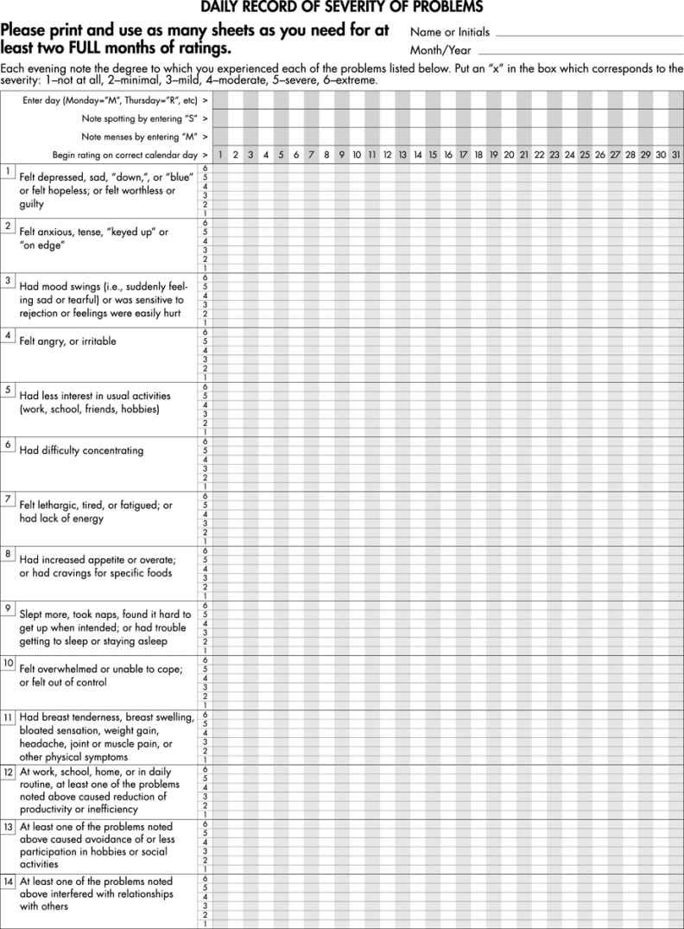

Slide 17
TREATMENT
The prospective charting of symptoms not only documents the cyclic or non cyclic
nature of the patient’s symptoms but also allows her to play a key role in the diagnostic
and management team.
This will allow her to regain some control of her symptoms

Slide 18
Non pharmacologic Treatment
Diet :
Eating fresh rather than processed foods
More fruits and vegetables and minimize
the intake of refined sugars and fats.
Minimizing salt intake may help with bloating
Eliminating caffeine and alcohol from the diet can reduce nervousness and anxiety
None of these therapies have shown statistically
significant improvements

Slide 19
Non pharmacologic Treatment
Lifestyle interventions :
Aerobic exercise by increasing endogenous production of endorphins
Calcium carbonate ,magnesium supplementation
Calcium decreases water retention, food cravings, pain
Vitamins E and D
Relaxation therapy
Cognitive therapy
Light therapy
Vitamin B6
Evening primrose oil demonstrate no benefit

Slide 20
Pharmacologic Treatment
NSIDS were useful in PMS patients with dysmenorrhea, breast pain, and leg edema but not useful in treating other aspects of PMS.
Spironolactone decreases bloating but does not relieve other symptoms

Slide 21
Ovulation Suppression
Because the underlying mechanism appears to be normal hormone fluctuations triggering an abnormal
serotonin response, it would it seem that ,medications to induce anovulation should be beneficial in the treatment of PMS/PMDD
Oral contraceptives are first choice for patients
who also require contraception.
Some patients, however, find that their symptoms worsen when taking oral contraceptives.

Slide 22
Selective Serotonin Reuptake Inhibitors
The medical treatment of PMDD differs from that of PMS.
In PMDD patients ,the gold standard of treatment is the selective serotonin reuptake inhibitors (SSRIs).
In a Cochrane Review, demonstrated benefit with SSRIs
SSRIs are effective when dosed continuously (daily dosage ) or intermittently (taken only during the does
luteal phase [14 days prior to the onset of menses]).
Patients with PMDD often report improvement with their first cycle of use

Slide 23
Side effects SSRIs
Gastrointestinal upset
Insomnia
Sexual dysfunction
Weight gain
Anxiety
Hot flushes
Nervousness

Slide 24
Other Treatments
The use of danazol and gonadotropin-releasing hormone (GnRH) agonists was beneficial in short-term studies, but long-term effects
of such drugs for PMDD have not been fully evaluated
These medications are associated with significant, often prohibitive, side effects.
The use of either constitutes a “medical oophorectomy” and may be used as a trial before surgical oophorectomy is undertaken.
Oophorectomy;
should be used only for those severely affected patients who meet diagnostic criteria for PMDD and who do not respond to any potentially effective therapy

Slide 25
THANK YOU

