Slide 1
Preterm Labor
DR.Behnaz Nouri

Slide 2
Goal
Students should be able to list risk factors, possible
etiologies, and complications of preterm labor.
They should be able to outline a basic approach to
evaluation and management, including appropriate medications and their contraindications.
They should be able to counsel a patient on risk
reduction for preterm birth.

Slide 3
Definition
Preterm labor is defined as the presence of regular uterine contractions that occur
before 37 completed weeks of gestation and are associated with cervical changes.
It is often difficult to diagnose preterm labor because of the absence of definitive
measurements.

Slide 4
Complications of Preterm Birth
Perinatal death
Respiratory distress syndrome
Intraventricular hemorrhage
Necrotizing enterocolitis
Sepsis
Neurologic impairment
Seizures

Slide 5
Long-term morbidity
Bronchopulmonary dysplasia
Developmental abnormalities (cerebral palsy)

Slide 6
Classification
Spontaneous :
40% to 50% with intact membranes
25% to 40% with PPROM
Indicated:
20% to 30% occur following deliberate
intervention for a variety of maternal or obstetric complications (e.g., eclampsia).

Slide 7
Causes of Preterm Labor
The four main processes include
(1) activation of the maternal or fetal hypothalamic–pituitary–adrenal axis due to
maternal or fetal stress
(2) decidual–chorioamniotic or systemic inflammation caused by infection
(3) decidual hemorrhage
(4) pathologic uterine distention
The strongest risk factors are multifetal gestation and prior preterm birth
Subclinical intra-amniotic infection
In most cases, however, no cause or risk factorcan be identified

Slide 8
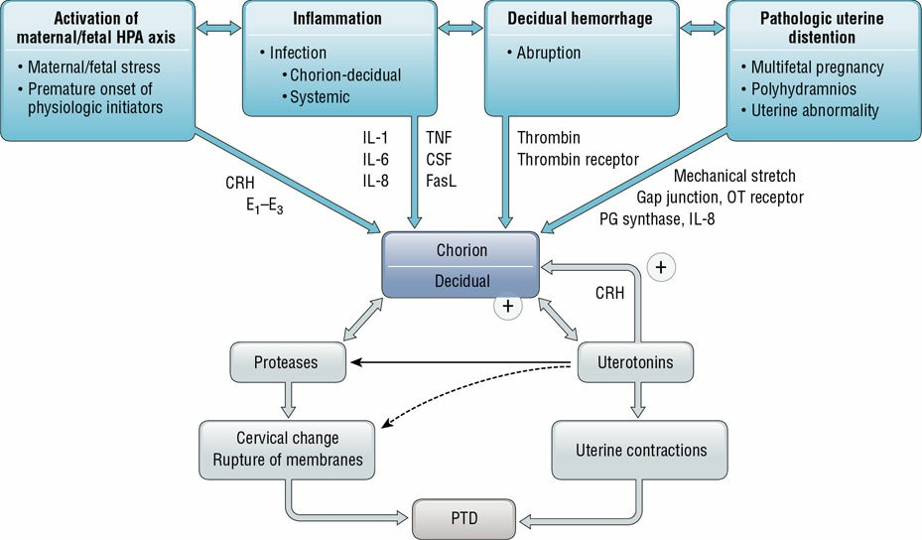

Slide 9
Factors Associated with Preterm Labor
• Prior history of preterm birth
• Preterm uterine contractions
• Premature rupture of membranes
• Behavorial risk factors:
Low maternal prepregnancy weight
Smoking
Substance abuse
Short interpregnancy interval
• Current pregnancy factors:
Short cervical length
Multifetal gestation
Vaginal bleeding
Urinary tract infections
Genital tract infection
Periodontal disease

Slide 10
Factors Improving Outcomes
First, neonatal intensive care management of preterm infants has greatly improved outcomes
Second, the use of corticosteroids administered to a mother at immediate risk for preterm birth
A major goal of (tocolytic therapy) is to prolong pregnancy for up to 48 hours in order to allow time to administer corticosteroids
Third, magnesium sulfate administered prior to a preterm birth has been
shown to decrease the rate of cerebral palsy in infants
Finally, prophylaxis against perinatal infection with group B
streptococcus (GBS) in women with preterm labor or PPROM has
decreased infant morbidity and mortality

Slide 11
Prediction of Preterm Labor
Patient and physician education has focused on recognition of the signs and symptoms
that suggest preterm labor
Patients with symptoms are counseled to
seek prompt medical attention
Modalities in asymptomatic women, such as fetal fibronectin, bacterial vaginosis screening
and home uterine contraction monitoring are not recommended as screening test

Slide 12
Signs and Symptoms of Preterm Labor
Menstrual-like cramps
Low, dull backache
Abdominal pressure
Pelvic pressure
Abdominal cramping (with or without diarrhea)
Increase or change in vaginal discharge (mucous, watery, light bloody discharge)
Uterine contractions, often painless

Slide 13
Cervical Changes
Cervical length can be used as a diagnostic factor
Transvaginal ultrasound examination of the
cervix is a reliable and reproducible method to assess cervical length.
women at high risk for recurrent preterm birth
uterine anomalies
prior cervical cone biopsy or multiple dilation and curettage/evacuation procedures

Slide 14
Screening Modalities
Early asymptomatic dilation and effacement of the cervix (cervical insufficiency) may be associated with an increased likelihood of preterm labor and delivery
Prophylactic cervical cerclage on TVS
recognition of a shortened cervical length (less than 2.5 cm) in low-risk women have not improved outcomes
In high-risk women (e.g., history of prior
preterm birth) with a shortened cervix may be beneficial

Slide 15
Prevention
There are currently no uniformly effective interventions to prevent preterm labor, regardless of risk factors.
Prophylactic therapy not be effective
weekly intramuscular injections of progesterone
(17-α-hydroxyprogesterone caproate) starting at 16 to 20 weeks of gestation and continuing until 36 weeks of
gestation appears to reduce spontaneous preterm birth
Vaginal progesterone supplementation in women with
shortened cervical length has some benefit

Slide 16
EVALUATION OF A PATIENT IN SUSPECTED PRETERM LABOR
Prompt evaluation is critical :
external electronic fetal monitor (tocodynamometer)
Determination of the status of the cervix by visualization with a speculum or by gentle digital examination
Digital examination may increase the risk of infection in the setting of PPROM
Subtle changes are often of great clinical importance,
so serial examinations by the same examiner

Slide 17
Laboratory Tests
urinalysis and urine culture
A vaginal/rectal culture for GBS
cultures for Chlamydia trachomatis and Neisseria gonorrhoeae

Slide 18
Ultrasound
Assessing the gestational age
Estimation of the amniotic fluid volume
Fetal presentation
Placental location
Fetal congenital anomalies
Monitored for bleeding due to placental abruption and placenta previa
The length of the cervix

Slide 19
Amniocentesis
Amniocentesis may be performed to assess for intra-amniotic infection
Evidence of WBCs in the amniotic fluid, decreased glucose, or elevated LDH may indicate infection
The presence of bacteria
Additional amniotic fluid may be obtained for fetal pulmonary maturity

Slide 20
MANAGEMENT OF PRETERM LABOR
The purpose in treating preterm labor is to delay delivery, if possible, untils fetal maturity is attained
Management involves two broad goals:
1) the detection and treatment of disorders
associated with preterm labor
2) therapy for the preterm labor itself
More than 50% spontaneous resolution of abnormal uterine activity

Slide 21
Tocolytics
Typically, patients with a diagnosis of preterm labor receive one form of tocolytic therapy
with the addition or substitution of other medications if the initial treatment is unsuccessful.
Magnesium sulfate, administered antenatally to
has a neuroprotective effect on the fetus,
appearing to lower the risk of developing cerebral palsy

Slide 22
COMMON TOCOLYTIC AGENT
Calcium channel blockers (Nifedipine)
Nonsteroidal anti inflammatory drugs
β-Adrenergic receptor agonists
Magnesium sulfate

Slide 23
Calcium channel blockers
Prevents calcium entry into muscle cells
Maternal side effects:
Dizziness
Flushing
hypotension;
suppression of heart rate, contractility, left ventricular systolic pressure
When used with magnesium sulfate
elevation of hepatic transaminases
Fetal side effect: No known
Contraindications: hypotension ,preload depresion, cardiac lesions

Slide 24
NSAIDS
Decreases PG production by blocking conversion of free arachidonic acid to PG
Side effects:
Nausea
Esophageal reflux
Gastritis
emesis
Platelet dysfunction
Fetal adverse effects:
In utero constriction ofductus arteriosus
Oligohydramnios
Necrotizing enterocolitis
patent ductus arteriosus in new born
Contraindications:
Platelet dysfunction
Hepatic dysfunction
Renal dysfunction
Ulcerative colitis
Asthma
hypertension

Slide 25
B Adrenergic receptor agonists
Increases cAMP concentration in cells which decreases free calcium
Maternal side effects:
Tachycardia
hypotension
tremor
palpitations
shortness of breath
Chest discomfort
Pulmonary edema
hypokalemia
Hyperglycemia
Fetal side effects : fetal tachycardia
Contraindications :
Tachycardia
Cardiac diseases
Diabetes

Slide 26
Magnesium sulfate
Competes with calcium for entry into cells
Maternal side effects:
flushing
diaphoresis
nausea
Loos of deep tendon reflexes
Respiratory depression
Cardiac arrest
Suppresses heart rate contractility
Left ventricular systolic pressure used with calcium channel blockers and produces neuromuscular blockade when used with calcium channel blockers
Fetal side effects: Neonatal depression
Contraindication: Myasthenia Gravis

Slide 27
Contraindications
Intrauterine fetal demise
Lethal fetal anomaly
Nonreassuring fetal status
Severe preeclampsia or eclampsia
Maternal bleeding with hemodynamic instability
Intra-amniotic infection
PPROM
Maternal contraindications to tocolysis
Advanced cervical dilation
Placenta abruption
Evidence of fetal compromise

Slide 28
Corticosteroids
A single course of corticosteroids should be given to pregnant women between 24-34
weeks of gestation who are at risk for preterm delivery within 7 days
Routine weekly courses of therapy are not recommended
Antenatal steroids may be considered as early as 23 weeks
Asingle rescue dose of steroids may be offered to a patient who previously received a full course of steroids
(≥ two weeks previously) and is now deemed likely to deliver within a week
A course of antenatal steroids for late preterm patients at 34 0/7
to 36 6/7 weeks who are at risk of delivering within a week

Slide 29
CLINICAL CASE
A 34-year-old patient was admitted to your antepartum service for
advanced cervical dilation at 24 weeks of gestation. She had one other
preterm delivery at 33 weeks of gestation. She was placed on
progesterone for prevention of preterm delivery. She has intermittently
had light vaginal bleeding. Today, at 27 weeks, the patient has another
episode of bleeding and begins contracting regularly. She is very worried
about her baby being delivered so early. What are the next steps in her
evaluation and management? What can you do to prevent the sequelae of
prematurity in the neonate?

Slide 30
THANK YOU

