Slide 1
Sterilization
Dr. Z. Heidar
Associated Prof.
SBMU

Slide 2
Study Guide
Students should be able to give appropriate consultancy about different type of contraception methods
Students should be able to compare common methods of permanent sterilization.
They should be able to describe the risks and benefits and adverse effect of these methods.

Slide 3
Permanent sterilization
All available surgical methods of sterilization prevent the union of sperm and egg, either by preventing the passage of sperm into the jaculate (male sterilization:vasectomy) or by permanently occluding the fallopian tube (female sterilization: tubal ligation and hysteroscopic sterilization).

Slide 4
Although it is possible to reverse some forms of surgical sterilization, because of difficulty, cost, side effect,.. demands that consider the decision for surgical sterilization to be permanent.
Sterilization is the leading contraceptive method for couples in whom the wife is older than 30 years and who have been married more than 10 years.

Slide 5
STERILIZATION OF MEN
The technique for vasectomy varies and includes excision and ligation, electrocautery, and mechanical or chemical occlusion of the vas deferens. Because vasectomy is performed outside the abdominal cavity, the procedure is safer, more easily performed in most cases, less
expensive, and generally more effective than procedures done on women. Vasectomy is also more easily reversed than most female sterilization procedures

Slide 6
Minor postoperative complications occur in 5% to 10% of cases and include bleeding, hematomas, acute and chronic pain, and local skin infections.
Vasectomy is not immediately effective.
Some authors report a greater incidence of depression and change in body image.
formation of sperm antibodies in approximately 50% of patients, but no adverse long-term effects of vasectomy have been identified.

Slide 7
Complete azoospermia is usually not obtained until 10 weeks after vasectomy.

Slide 8
STERILIZATION OF WOMEN
Surgical sterilization techniques:
laparoscopy, minilaparotomy, hysteroscopy, postpartum procedure, at the time of cesarean or interval procedure, after a spontaneous or elective abortion.
Some nonsurgical methods as well as sclerosing agents are under investigation.
patients should be counseled about the various components of the procedure, effectiveness rates, and possible complications.

Slide 9
patient understands that the procedure
should be considered as a permanent decision.
Patients should understand that reversal is sometimes possible, but at a high cost and usually with low success rates.
Pregnancy should also be ruled out prior to performing any sterilization procedure.

Slide 10
Laparoscopy
Occlusion of the fallopian tubes may be accomplished through the use of electrocautery (unipolar or bipolar) or the application of a plastic and spring clip (Filshie clip) or silastic band.
Total salpingectomy can also be done through laparoscopy and is being revisited as an ovarian cancer reduction procedure.

Slide 11
Bipolar cautery is safer than unipolar one; Unipolar cautery, however, has a lower failure rate than bipolar.
Which one is better

Slide 12
Minilaparotomy
Minilaparotomy is the most common surgical approach for tubal ligation throughout the world.
A common method of tubal interruption utilized in minilaparotomy is Pomeroy tubal ligation.
complications

Slide 13
Hysteroscopy
Transcervical approaches to sterilization include hysteroscopy and involve gaining access to the fallopian tubes through the cervix. Essure system involves the introduction of a 3.6-cm stainless steel inner coil and a nickel titanium outer coil into each fallopian tube.
Patients are instructed to use an additional form of contraception for 3 months after the procedure, until the efficacy of the device can be proven
with hysterosalpingography.

Slide 14
Contraindications include contrast allergies,
active pelvic infection, and suspected pregnancy
. These procedures can be used for obese patients who may otherwise not be suitable candidates for laparoscopic tubal ligation due to their body habitus. The efficacy of this procedure has been reported to be as high as 99.8%.

Slide 15
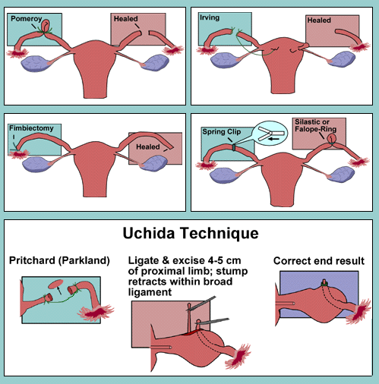

Slide 16
FAILURE RATES (10-YEAR) PER 1,000 PROCEDURES AND COMPLICATIONS FOR STERILIZATION METHODS
Tubal Ligation | 10-Year Failure Rates per 1,000 Procedures | Complications
Bipolar coagulation | 24.8 | Injury to gastrointestinal and urinary systems, anesthesia-associated complications, hemorrhage, infection, and ectopicpregnancy
Silicone band methods | 17.7
Spring clip Ligation methods | 36.5
Postpartum | 7.5
Interval | 20.1
Hysteroscopy | 1.6 for Essure in 5 years | Uterine perforation, bleeding, and infection

Slide 17
Noncontraceptive Benefits
Patients who undergo tubal ligation not only gain effective contraception but also benefit from a decreased lifetime risk of ovarian cancer.
Although tubal sterilization has not been shown to protect against sexually transmitted
diseases, it may offer some protection against pelvic inflammatory disease.

Slide 18
REVERSAL OF TUBAL LIGATION
is most successful when minimal damage is done to the smallest length of the fallopian tube (e.g., Hulka clip, Filshie clip, and Falope ring).and after that is a high risk of ectopic pregnancy. therefore, many specialists in infertility recommend the use of assisted reproductive technology

