Slide 1



Slide 2
Multifetal Gestation
Dr .Mirzamoradi

Slide 3
Multifetal Gestation
The overall incidence of multiple gestations in the United States is 3.5%, but these pregnancies account for a disproportionate share of perinatal morbidity and mortality.
The natural rate of twinning is approximately 1 in 80 and is slightly higher in African Americans than in whites.
The incidence of multifetal gestations in the United States has increased dramatically over the past several decades.
The multiple birth rate is rising as a result of an increase in maternal age and the more frequent use of assisted reproductive technologies (ARTs) and ovulation induction agents.

Slide 4
Multifetal Gestation
From 1980 to 2009, the twin birth rate rose 76%; since 2009 there has been a more modest increase of 2% to 3%.
The triplet and higher-order birth rate rose 400% from 1980 to 1998.
It is estimated that 43% of triplet and higher order gestations result from ART procedures and 38% from ovulation induction; spontaneous conception accounts for the remainder.
Since 1998, the triplet and higher-order birth rate has decreased by more than 40%, with an average annual decrease of approximately 4%.
This decline in triplet and higher-order births is linked to changes in ART procedures and guidelines .

Slide 5
Twin pregnancy
Zygosity refers to the genetic make-up of the pregnancy .
Twin gestations can be characterized as ;
Dizygotic (fraternal)
Monozygotic (identical)

Slide 6
Twin pregnancy
Dizygotic or "fraternal" twins occur from ovulation and fertilization of two oocytes, which results in dichorionic/diamniotic placentation and two separate placentas.
Monozygotic or "identical" twins result from ovulation and fertilization of a single oocyte, with subsequent division of the zygote.Timing of egg division generally determines placentation.

Slide 7
PREVALENCE AND EPIDEMIOLOGY
Dizygotic twins are more common than monozygotic twins, approximately 70 and 30 percent of twins, respectively (in the absence of use of assisted reproductive technology [ART]) .
There is a marked difference in the incidence of twinning in various populations, almost exclusively the result of the incidence of dizygotic twinning.
The incidence of monozygotic twinning is fairly constant around the world, at approximately 1 in 250 pregnancies.

Slide 8
The major factors influencing the prevalence of dizygotic twins are:
Maternal age
Parity
Race/geographic area
Family history
Maternal weight and height
Diet
Use of fertility stimulating drugs and ART
Although the exact mechanism is not known, monozygotic twinning is also higher in pregnancies conceived using ART.

Slide 9
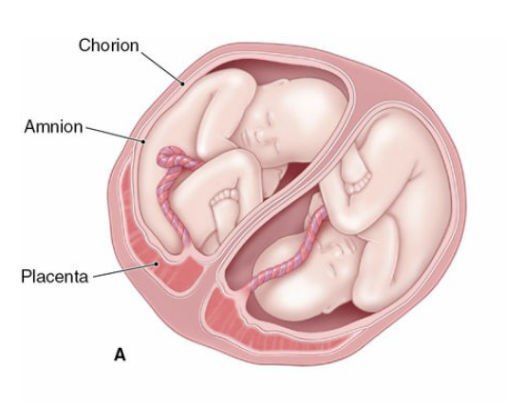
Chorionicity
Chorionicity refers to the placental make-up of the pregnancy.
Since dizygotic twins are formed from two separate ova and two separate sperms, they always have two separate placentas (although they can appear “fused” on late-trimester ultrasound if close to each other).

Slide 10
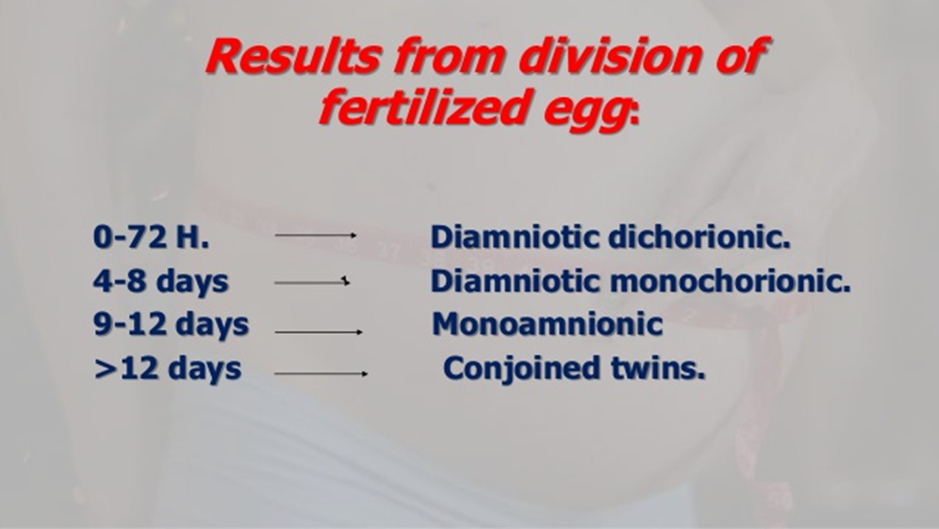
Monozygotic or "identical" twins

Slide 11
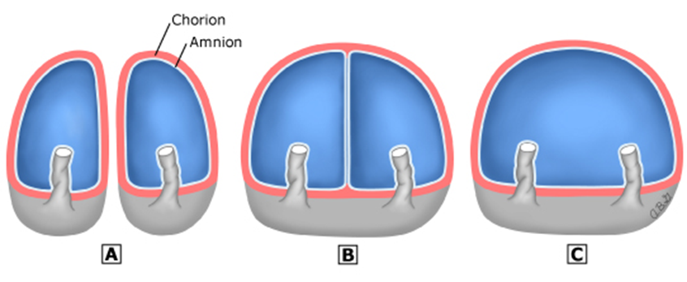
Monozygotic or "identical" twins
(A) Two placentas, 2 amnions, 2 chorions (from either dizygotic twins or monozygotic twins with cleavage of zygote during first 3 days after fertilization).
(B) One placenta, 1 chorion, 2 amnions (monozygotic twins with cleavage of zygote from the fourth to the eighth day after fertilization).
(C) One placenta, 1 chorion, 1 amnion (monozygotic twins with cleavage of zygote from the 8th to the 12th day after fertilization).

Slide 12
Chorionicity
During routine prenatal evaluation, it is not possible to distinguish dizygotic twins of the same gender from diamnionic/dichorionic monozygotic twins.

Slide 13
Assessment of chorionicity and amnionicity in twin pregnancies
During the first ultrasonographic examination that confirms a twin gestation, chorionicity should be determined because, the potential morbidity and mortality associated with a monochorionic gestation is different from that of a dichorionic gestation.

Slide 14
Assessment of chorionicity and amnionicity in twin pregnancy
The optimal timing for determination of chorionicity is in the first trimester or early second trimester.
Chorionicity can be determined by ultrasound with almost 100% certainty as early as 8 to 9 weeks of gestational age.
Findings that indicate dichorionic twins include the twin peak (or lambda) sign , a thick dividing membrane (>2 mm), and discordant genders.

Slide 15
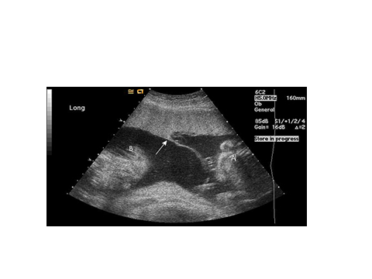
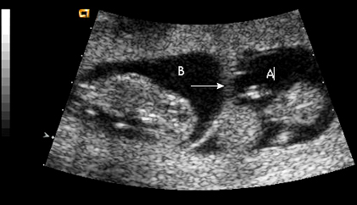
Assessment of chorionicity and amnionicity in twin pregnancy
Thick intertwin membrane
Twin peak or lambda sign

Slide 16
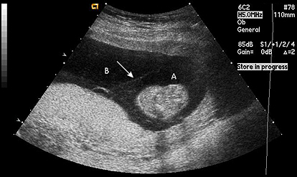
Monochorionic diamniotic pregnancy : T sign

Slide 17
Screening and diagnosis
An increased likelihood of twin pregnancy may be suspected based on :
use of assisted reproductive technology to conceive
uterine size that is large for dates (A difference of 4 cm or more between the weeks of gestation and the measured fundal height should prompt evaluation with ultrasound to detect the cause (e.g., inaccurate gestational age, multiple gestation, hydramnios, gestational trophoblastic disease, and pelvic tumor).
family history of fraternal twins
hyperemesis gravidarum

Slide 18
Diagnosis
Twin pregnancies are usually first identified when an ultrasound examination is performed in early pregnancy for indications such as determination of gestational age or viability, measurement of nuchal translucency, or fetal anatomic survey .

Slide 19
Screening and diagnosis
Serial ultrasound assessments have shown that only 50% of twin pregnancies detected in the first trimester result in the delivery of viable twins.
The other 50% of cases deliver a single fetus because of intrauterine demise and ultimate resorption of one embryo/fetus (vanishing twin syndrome).

Slide 20
RISKS OF MULTIFETAL GESTATION
Twin pregnancy is associated with higher rates of almost every potential complication of pregnancy, with the exceptions of postterm pregnancy and macrosomia.
The most serious risk is preterm delivery, which plays a major role in the increased perinatal mortality and short-term and long-term morbidity observed in these infants.
Women with multifetal gestations are 6 times more likely to give birth preterm and 13 times more likely to give birth before 32 weeks of gestation than women with singleton gestations.

Slide 21
RISKS OF MULTIFETAL GESTATION
Compared with singleton pregnancies, which are delivered at an average gestational age of 39 weeks, twins are delivered at an average of 35 weeks, triplets at 32 weeks, and quadruplets at an average of 30 weeks.
Thus, with each additional fetus, the length of gestation is decreased by approximately 2 to 3 weeks.

Slide 22
RISKS OF MULTIFETAL GESTATION
Both spontaneous abortions and congenital anomalies are approximately twice as common in multiple gestations.
There is an approximate fivefold increased risk of stillbirth and a sevenfold increased risk of neonatal death, which primarily is due to complications of prematurity.
Neonatal death and neurodevelopmental impairments including cerebral palsy are also more common in multiple gestations when compared to singletons

Slide 23
Other associated maternal and fetal/neonatal morbidities include;
hyperemesis
Anemia
intrauterine growth restriction
preeclampsia (three times more frequent in twin gestations)
gestational diabetes mellitus
cesarean delivery
postpartum hemorrhage
placental abruption
umbilical cord accidents
hydramnios (inapproximately 10% of multiple gestations, predominantly monochorionic gestations)
postpartum depression

Slide 24
RISKS OF MULTIFETAL GESTATION
Monochorionic twins are at risk for complications unique to these pregnancies, such as twin-twin transfusion syndrome (TTTS), which can be lethal or associated with serious morbidity.

Slide 25
Twin-Twin Transfusion Syndrome
This condition complicates approximately 10% to 15% of monochorionic diamnotic pregnancies.
Through arteriovenous anastomoses, there is net flow from one twin to another, often with untoward pregnancy outcomes.

Slide 26
Twin-Twin Transfusion Syndrome
The so-called donor twin can have impaired growth, anemia, hypovolemia, and other problems.
The recipient twin can develop hypervolemia, hypertension, polycythemia, and congestive heart failure as a result of this preferential transfusion.

Slide 27
Twin-Twin Transfusion Syndrome
A secondary manifestation involves amniotic fluid dynamics.
The hypervolemia in the recipient twin leads to an increase in urinary output and, in turn, to an increase in amniotic fluid volumes (hydramnios).
The opposite effect may occur in the donor twin— hypovolemia leads to decreased urinary output and, possibly, a decrease in amniotic fluid volume (oligohydramnios).
Hydramnios in the one twin compounds the risk of preterm labor already present for multifetal pregnancies.

Slide 28
Diagnosis of TTTS
The cardinal prenatal finding is MC placentation with discordant amniotic fluid volumes (maximum vertical pocket <2 cm in one amniotic sac and >8 cm in the other amniotic sac).
Severe oligohydramnios results in the "stuck twin" appearance.

Slide 29
Twin-Twin Transfusion Syndrome
Traditionally, serial removal of amniotic fluid from the sac of the recipient twin has been the only treatment option associated with improved survival.
However, endoscopic intrauterine laser ablation of the vascular anastomoses has met with greater success in treating this difficult problem, especially in more severe cases.
When available, fetoscopic laser photocoagulation has largely replaced serial amnioreduction as first-line therapy for TTTS.

Slide 30
Other vascular abnormalities include the absence of one umbilical artery, which may be associated in 30% of cases with other congenital problems, especially renal agenesis.
A single umbilical artery is seen in approximately 3% to 4% of twins, compared with 0.5% to 1% of singletons.

Slide 31
Monoamniotic Twins
In 1% of monozygotic twins, division occurs between 9 and 12 days following fertilization, resulting in both fetuses occupying a single sac composed of inner amnion and outer chorion.
The risk of entanglement of the umbilical cords, with subsequent fetal death, is considerable.
Traditionally, arbitrary cesarean delivery (after steroids) at approximately 32 weeks of gestation was the usual management.

Slide 32
Monoamniotic Twins
Recent management, involving hospitalization at 24 to 26 weeks, steroid administration, and fetal heart rate monitoring several times daily, has allowed for the prediction of impending difficulty with cord entanglement.
Delivery is still recommended early, at 32 to 34 weeks (after steroids), by cesarean delivery.
The historic perinatal mortality rate for monoamniotic twins was >50%.
Although the optimal management of these complicated pregnancies is not certain, the perinatal mortality rate (excluding pregnancies with congenital anomalies) is now <10% with current management .

Slide 33
Death of One Fetus
Multiple gestations, especially high-order gestations, are at increased risk for losing one or more fetuses remote from delivery.
Single fetal death after 20 weeks of gestation occurs in approximately 5 percent of twin pregnancies.
As summarized by the American College of Obstetricians and Gynecologists, no fetal monitoring protocol has been shown to predict most of these losses.

Slide 34
Death of One Fetus
Consensus about the preferred antepartum surveillance method and management once demise has occurred has not been reached.
Whereas some advocate immediate delivery of the remaining fetus(es), if the death was the result of an abnormality of the fetus itself (i.e., rather than maternal or uteroplacental pathology) and the pregnancy is remote from term, expectant management may be appropriate.

Slide 35
Death of One Fetus
The most difficult cases are those in which the fetal demise occurs in one fetus of a monochorionic twin pair.
Because virtually 100% of monochorionic placentas contain vascular anastomoses that link the circulations of the two fetuses, the surviving fetus is at significant risk for sustaining damage caused by the sudden, severe, and prolonged hypotension that occurs at the time of the demise or by embolic phenomena that occur later.

Slide 36
Death of One Fetus
By the time the demise is discovered, the greatest harm has most likely already been done, and there may not be any benefit in immediate delivery, especially if the surviving fetus(es) are very preterm and otherwise healthy.
In such cases, allowing the pregnancy to continue may provide the most beneficial outcome.

Slide 37
Death of One Fetus
For this reason, if fetal assessment after 26 weeks of gestation suggests impending death of one twin, we suggest prompt delivery of monochorionic twins rather than expectant management .
Prompt delivery is unlikely to benefit the survivor after death of one twin of a dichorionic or monochorionic gestation.

Slide 38
ANTENATAL MANAGEMENT
Once the diagnosis of twin pregnancy has been made, and chorionicity has been assigned, subsequent antenatal care addresses each of the potential concerns for mother and fetus.
Although the maternal blood volume is greater with a twin gestation than with a singleton pregnancy, the anticipated blood loss at delivery is likewise also greater.
Anemia is more common in these patients, and a balanced diet during pregnancy, which includes increased intake of iron, folate, and other micronutrients, is important.

Slide 39
ANTENATAL MANAGEMENT
The maternal resting energy expenditure (an indicator of basal metabolic rate) is increased in multiple gestations and results in an increased need for caloric intake.

Slide 40
Need for daily caloric intake
Although there are no established nutritional guidelines for mothers carrying twins, the Society for Maternal- Fetal Medicine recommends increased daily caloric consumption based on pre-pregnancy body mass index (BMI):
4000 kcal/day for underweight women (BMI <19.8 kg/m2)
3000 to 3500 kcal/day for normal weight women (BMI 19.8 to 26 kg/m2)
3250 kcal/day for overweight women (BMI 26.1 to 29 kg/m2)
2700 to 3000 kcal/day for obese women (BMI >29 kg/m2)
The dietary intake should be derived from 20% protein, 40% from low-glycemic index carbohydrates, and 40% from fat.

Slide 42
Preterm labor and delivery
Because of the increased risk of preterm labor in multiple gestations, careful attention to detection of uterine contractions is important, and the patient should be cautioned about signs and symptoms of preterm labor, such as abdominal pain, low back pain, a thin or increase in vaginal discharge, and vaginal bleeding.
If there are symptoms of preterm labor, cervical examination should be performed.

Slide 43
Screening of Preterm labor and delivery
The use of transvaginal ultrasound assessment for cervical length screening in multiple gestations is controversial, largely due to the lack of proven interventions to prevent preterm birth if a short cervix is found.
Cervical cerclage for short cervix in twins has been associated with an increased risk for preterm birth and is not recommended.
Progesterone treatment does not appear to reduce the risk for preterm birth in unselected women with twin or triplet gestations and is not recommended.

Slide 44
Screening of preterm labor and delivery
The finding of a short cervix may be an indication for work or activity modification (not complete bed rest).
There are ongoing studies of pessary placement to reduce the risk of preterm birth in women with twins and a short cervix.
Based on available evidence, the use of prophylactic cervical pessary is not recommended in multifetal pregnancies.

Slide 45
Screening of preterm labor and delivery
There is no role for the prophylactic administration of tocolytics in women with multifetal gestations, including the prolonged use of betamimetics for this indication.
Likewise, in women with uncomplicated multifetal pregnancies, there is no evidence of benefit with routine bed rest with or without hospitalization; this is not recommended and may be associated with harm including increased risk of thrombosis and deconditioning.

Slide 46
Screening of preterm labor and delivery
Although assessment of fetal fibronectin may aid in predicting preterm delivery in women, it has limited predictive value and is not recommended in multifetal gestations.

Slide 47
ANTENATAL MANAGEMENT
At each visit, blood pressure should be evaluated, and, if elevated, urine protein should be assessed.
Beginning at 30 to 32 weeks, daily fetal kick counts are usually begun to help assess fetal wellbeing.

Slide 48
ULTRASONOGRAPHY
At the initial evaluation, special attention is given to identification of fetal anomalies, and this is especially so in monochorionic gestations, among which such abnormalities are more frequently seen.
A careful ultrasound examination to identify fetal anomalies is performed at 16 to 20 weeks, at which time fetal size permits such diagnoses.
At each subsequent examination, growth of each fetus is assessed, and an estimate of amniotic fluid volume is made.

Slide 49
ULTRASONOGRAPHY
With dichorionic twin gestations, there are no evidence-based recommendations regarding the frequency of fetal growth scans after 20 weeks of gestation.
However, it is reasonable to perform periodic ultrasonographic examination every 4 to 6 weeks after 20 weeks.
If there is evidence of fetal growth restriction or other pregnancy complications, the frequency should be increased appropriately.

Slide 50
ULTRASONOGRAPHY
Due to the increased risk for the complication of TTTS, monochorionic pregnancies should be monitored earlier and more frequently (every 2 weeks from 16 to 28 weeks, if normal growth and no evidence TTTS, every 3 to 4 weeks thereafter).

Slide 51
Evaluation of fetal growth and growth discordance
Discordant growth is defined as a 20% or greater difference in the estimated fetal weight between the larger and smaller fetus (ratio calculated by determining the difference in the estimated fetal weight between the two fetuses, divided by the weight of the larger fetus).
Additional antenatal surveillance, such as the nonstress test or biophysical profile, is often used when there is growth restriction of one or more fetuses, discordant growth, or another high-risk situation such as maternal medical comorbidity.

Slide 52
TIMING OF DELIVERY
Uncomplicated twin pregnancies — The optimum time to deliver uncomplicated twin pregnancies depends on chorionicity and amnionicity.
Dichorionic/diamniotic — For uncomplicated dichorionic/diamniotic twin pregnancies, we suggest planned delivery at 38+0 to 38+6 weeks of gestation.
Induction of labor or cesarean delivery is usually scheduled because the risk of perinatal mortality increases at 39 weeks and beyond.

Slide 53
TIMING OF DELIVERY
Women with uncomplicated monochorionic-diamniotic twins are typically delivered between 34.0 weeks and 37.6 weeks.
Women with uncomplicated monochorionic-monoamniotic twins are typically delivered between 32– 34 weeks.

Slide 54
CHOOSING THE ROUTE OF DELIVERY
Approaches to the delivery of twins vary, depending on amnionicity , gestational age or estimated fetal weight, presentation of the twins, and the experience of the attending physician.
At the onset of labor, approximately 80 percent of first twins are cephalic (40percent cephalic/cephalic, 40 percent cephalic/noncephalic), and 20 percent are noncephalic (7 percent noncephalic/cephalic, 13 percent noncephalic/noncephalic) .

Slide 55
CHOOSING THE ROUTE OF DELIVERY
Monochorionic-monoamniotic twins should be delivered by cesarean due to the risk for umbilical cord complications.
When the first twin is not in cephalic presentation, we suggest cesarean delivery .
For patients with three or more fetuses, because of the potential for presentation of different fetal parts, delivery is accomplished by planned cesarean delivery in most cases.

Slide 56
CHOOSING THE ROUTE OF DELIVERY
For cephalic/cephalic diamniotic twins, we suggest vaginal delivery in the absence of standard indications for cesarean delivery .
For cephalic/non cephalic diamniotic twins , (40% of all twin deliveries), we suggest a trial of labore of the second twin only if the obstetrician has the requisite experience and if the patient provides informed consent.

Slide 57
CHOOSING THE ROUTE OF DELIVERY
About 40% of all twin pairs enter labor with both in the cephalic presentation.
After delivery of the first twin, if the second fetus remains cephalic, vaginal delivery of the second twin generally proceeds smoothly.
With proper monitoring of the second twin, there is no urgency in accomplishing the second delivery.

Slide 58
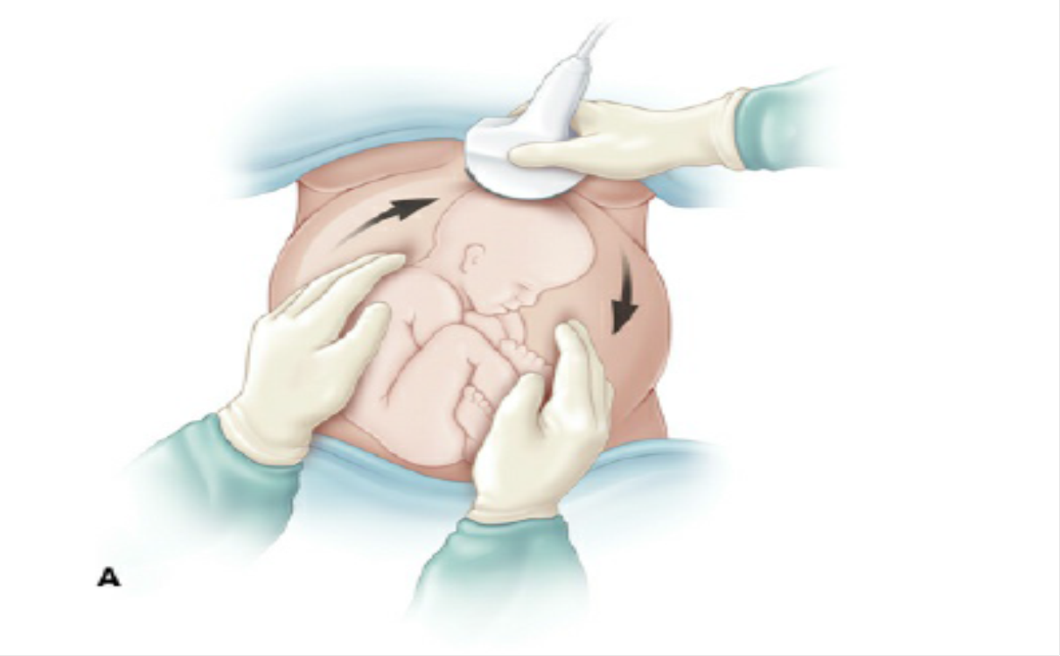
Delivery Maneuvers
If the second twin is presenting in any way other than cephalic, there are two primary manipulations that may affect vaginal delivery.
The first is external cephalic version ,Using ultrasonographic visualization, the fetus is gently guided into the cephalic presentation by abdominal massage and pressure .

Slide 59
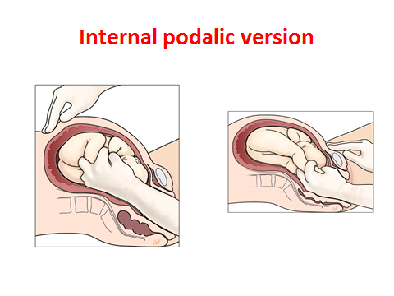
Delivery Maneuvers
The second maneuver is breech extraction, in which the physician reaches a hand into the uterine cavity, grasps the lower extremities of the fetus, and gently delivers the infant via breech delivery.

Slide 60
CHOOSING THE ROUTE OF DELIVERY
Delivering the second twin via cesarean delivery is another management option but is usually reserved for cases in which there is an inability to safely deliver the second twin vaginally (including an obstetrician without experience in vaginal breech extraction).

Slide 61
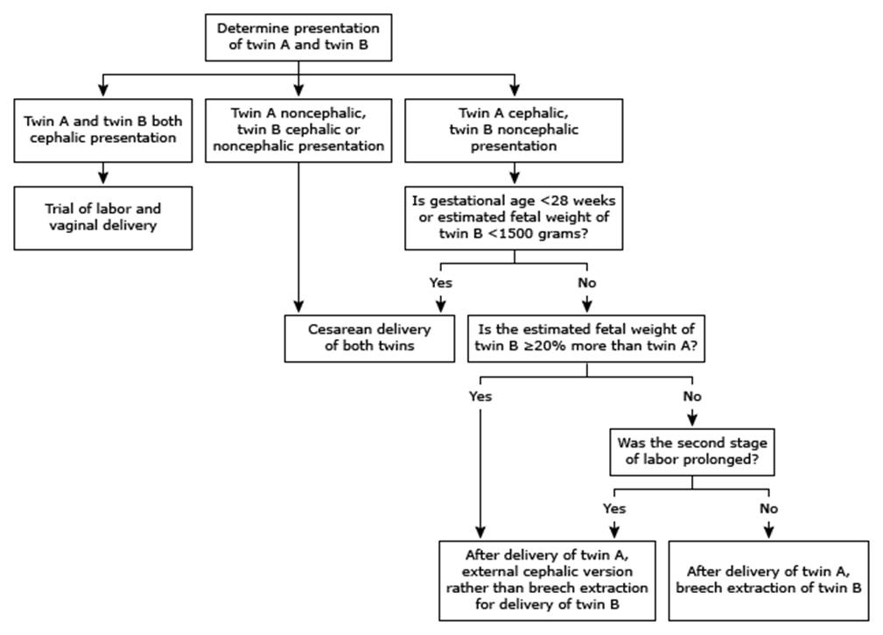
CHOOSING THE ROUTE OF DELIVERY

Slide 62
Complications
The possibility of a prolapsed umbilical cord must always be borne in mind when delivery of twins is to be accomplished.
Postpartum, the overdistended uterus may not contract normally, leading to uterine atony and postpartum hemorrhage.

Slide 63

THANK YOU

