Slide 1
Vulvovaginitis
Dr. Minoo Yaghmaei

Slide 2

Reference:
Beckmann and Ling's Obstetrics and Gynecology, eight edition, pages: 606-617.
To read more:
Berek & Novak's Gynecology, sixteenth edition, pages: 369-373.

Slide 3
اهداف یادگیری، در پایان دانشجو باید بتواند:
1- منشا و مشخصات ترشح طبیعی واژن را بیان کند.
2- ولوواژینیت را تعریف کرده و علل و سمپتوم‌های آن را بیان کند.
3- علایم و نشانه‌های واژینوز باکتریال را شرح دهد.
4- روش‌های تشخیص واژینوز باکتریال را شرح دهد.
5- درمان واژینوز باکتریال را در خانم‌های باردار و غیرباردار شرح دهد.
6- علایم و نشانه‌های ولوواژینیت کاندیدیایی را شرح دهد.
7- روش‌های تشخیصی ولوواژینیت کاندیدیایی را شرح دهد.
8- درمان ولوواژینیت کاندیدیایی را شرح دهد.
9- طبقه بندی ولوواژینیت کاندیدیایی را بیان کند.
10- علایم و نشانه‌های واژینیت تریکومونایی را شرح دهد.
11- روش‌های تشخیصی واژینیت تریکومونایی را شرح دهد.
12- درمان واژینیت تریکومونایی را شرح دهد.
13- علایم و نشانه‌های واژینیت آتروفیک را شرح دهد.
14- درمان واژینیت آتروفیک را بیان کند.

Slide 4
Vulvovaginitis
spectrum of conditions that cause vaginal or vulvar symptoms such as
itching
burning
irritation
abnormal discharge
Symptoms may be acute, subacute, or chronic
mild to severe

Slide 5
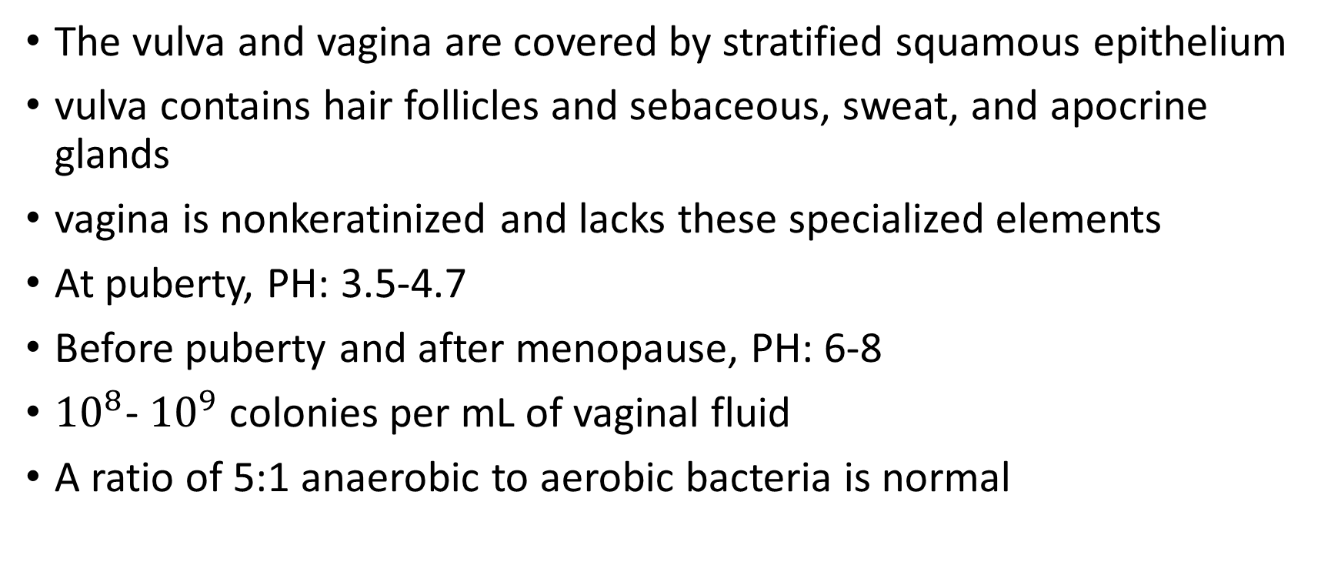
Normal Vulvovaginal Ecosystem
The vulva and vagina are covered by stratified squamous epithelium
vulva contains hair follicles and sebaceous, sweat, and apocrine glands
vagina is nonkeratinized and lacks these specialized elements
At puberty, PH: 3.5-4.7
Before puberty and after menopause, PH: 6-8
${10}^{8}$- ${10}^{9}$ colonies per mL of vaginal fluid
A ratio of 5:1 anaerobic to aerobic bacteria is normal

Slide 6
Sources of normal vaginal secretions
mucus from the cervix
endometrial fluid
exudates from accessory glands, such as the Skene and Bartholin glands
from vaginal transudate
Exfoliated squamous cells of the indigenous vaginal flora

Slide 7
Most common causes
bacterial vaginosis [BV] (22% – 50%)
vulvovaginal candidiasis (17% – 39%)
trichomoniasis (4% – 35%)

Slide 8
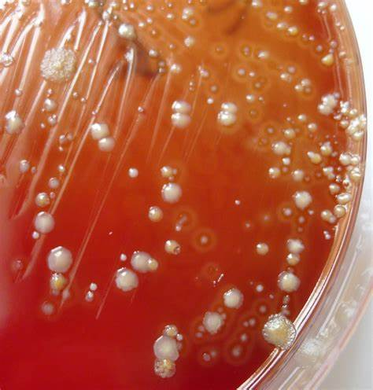
Bacterial vaginosis
lack of normal hydrogen peroxide–producing lactobacilli
And
an overgrowth of facultative anaerobic organisms including
G. vaginalis
Mycoplasma hominis
Bacteroides species
Peptostreptococcus species
Fusobacterium species
Prevotella species
Atopobium vaginae

Slide 9
Bacterial vaginosis
a “musty” or “fishy” odor
increased thin gray-white to yellow discharge
mildly adherent to the vaginal wall
pH greater than 4.5
KOH + the vaginal discharge : “amine” or “fishy” odor, “positive whiff test”
Saline: slight increase in white blood cells
clumps of bacteria
loss of normal lactobacilli
characteristic “clue cells”

Slide 10
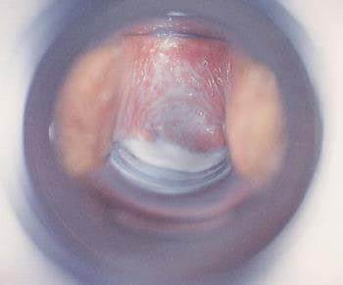
Bacterial vaginosis

Slide 11
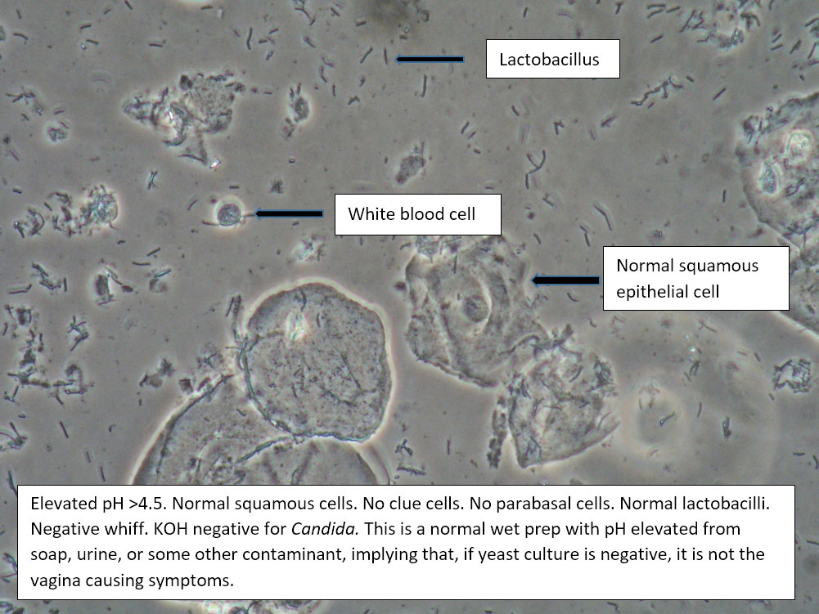
Normal wet prep

Slide 12
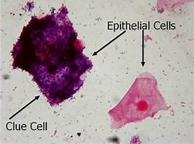
Clue cell

Slide 13
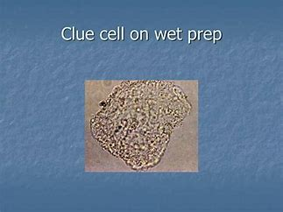

Slide 14
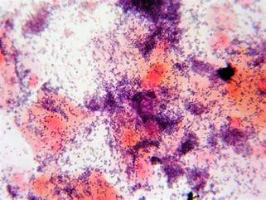
Bacterial vaginosis

Slide 15
Diagnosis of BV
The “gold standard” for laboratory diagnosis of BV is the Gram stain
but, more commonly, the diagnosis is made clinically By any three of the following four criteria (Amsel criteria):
abnormal gray discharge
pH greater than 4.5
positive whiff test
the presence of clue cells

Slide 16
Treatment of BV
oral or topical metronidazole
Topical clindamycin, oral clindamycin, or clindamycin intravaginal ovules
oral tinidazole

Slide 17
Treatment of BV in pregnancy
Symptomatic pregnant women?
asymptomatic pregnant women?
universal BV screening of asymptomatic pregnant women?

Slide 18
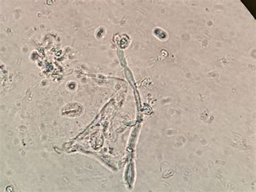
Vulvovaginal candidiasis
90% by Candida albicans
Candida species typically require estrogenized tissue

Slide 19
Vulvovaginal candidiasis, risk factors
in women who are
pregnant
diabetic
obese
immunosuppressed
on oral contraceptives or corticosteroids, or have had broad-spectrum antibiotic therapy
warm and moist vaginal area

Slide 20
Signs and Symptoms of Vulvovaginal candidiasis
The most common :itching
up to 20%: asymptomatic
Burning,
external dysuria
dyspareunia
vulva and vaginal :bright red in color
excoriation
A thick, odorless, adherent “cottage cheese” discharge
pH: 4 to 5

Slide 21
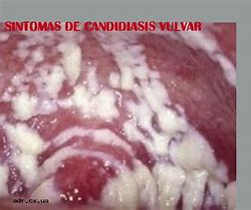
Vulvovaginal candidisis

Slide 22
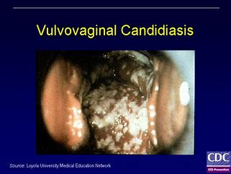

Slide 23
Diagnosis of Vulvovaginal candidiasis
cannot be made on the basis of history and physical examination
Diagnosis requires:
visualization of either blastospores or pseudohyphae on saline or 10% KOH microscopy
or
a positive culture
Latex agglutination tests for non–C. albicans strains

Slide 24
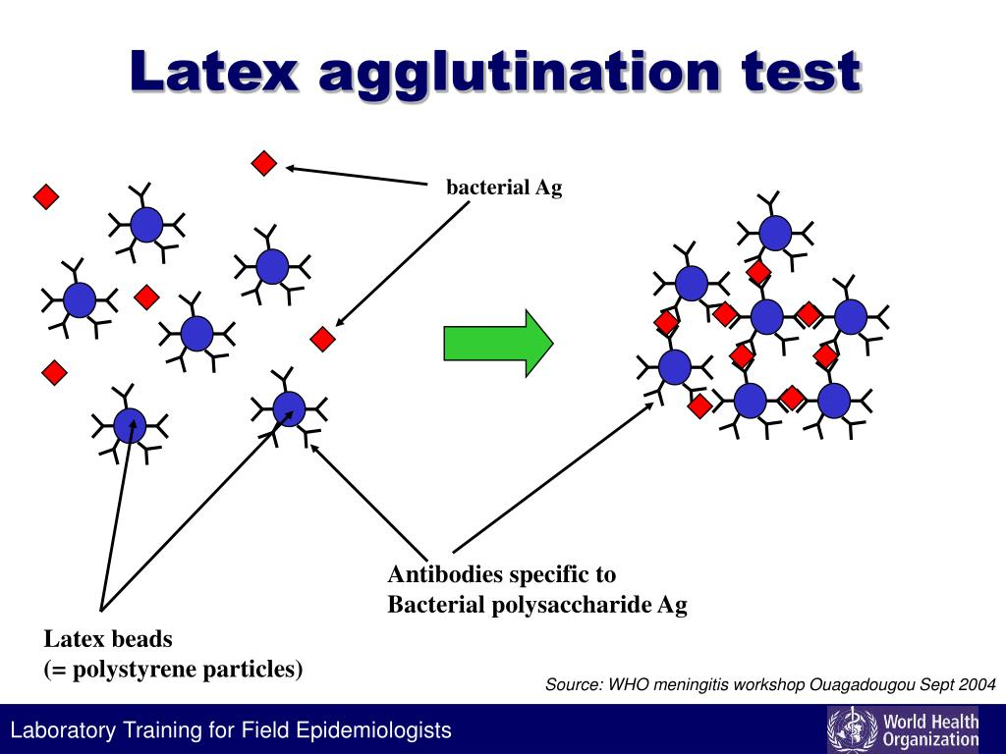

Slide 25
uncomplicated or complicated vulvovaginal candidiasis
Uncomplicated
Sporadic or infrequent episodes or
• Mild to moderate symptoms or findings or
• Likely instead of suspected C. albicans infection or
• Nonimmunocompromised women

Slide 26
uncomplicated or complicated vulvovaginal candidiasis
Complicated
• Recurrent episodes (four or more per year) or
• Severe symptoms or findings or
• Suspected or proven non–C. albicans infection or
• Women with diabetes, severe medical illness, or immunosuppression

Slide 27
Treatment of Vulvovaginal candidiasis
Uncomplicated:
Topically applied azole drugs are the most commonly available treatment for VVC , such as miconazole, clotrimazole, butoconazole, tioconazole, and terconazole in cream or suppository for 3 days
Single-dose oral therapy with fluconazole 150 mg
In pregnant women
Topically applied azole for 7 days
Single-dose oral therapy with fluconazole 150 mg

Slide 28
Treatment of Vulvovaginal candidiasis
Treatment of complicated Vulvovaginal candidiasis?
Prevention of recurrent candidiasis?
routine treatment of sexual partners?

Slide 29
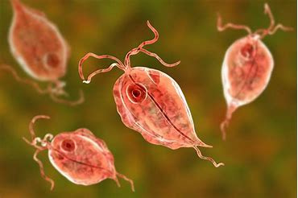
Trichomonal Vulvovaginitis
T. vaginalis
is a flagellate protozoan
transmitted by sexual contact but can also occur via fomites
survive in swimming pools and hot tubs

Slide 30
Symptoms of Trichomonal Vulvovaginitis
Asymptomatic, mild to severe
vulvar itching or burning
copious discharge with rancid odor
dysuria, dyspareunia, and postcoital bleeding
discharge is generally “frothy,” thin, and yellow-green to gray in color
pH above 4.5
edema or erythema of the vulva
Petechiae, or strawberry patches (10 %)

Slide 31


Slide 32
Diagnosis of Trichomonal Vulvovaginitis
microscopic examination of vaginal secretions suspended in normal saline.
large numbers of mature epithelial cells, WBCs, and the Trichomonas organism
Other tests?
Women diagnosed with trichomoniasis should also undergo screening for other STDs, especially gonorrhea and chlamydia

Slide 33
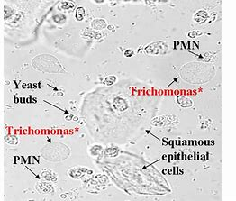
Trichomonal Vulvovaginitis

Slide 34
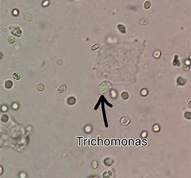
Trichomonas

Slide 35
Treatment of Trichomonal Vulvovaginitis
Oral metronidazole or tinidazole
Treating sexual partners
avoid intercourse until she and her partner have completed the
prescribed medication and are asymptomatic

Slide 36
Treatment of Trichomonal Vulvovaginitis
Pregnant patients
should be treated
metronidazole
Infections with metronidazole-resistant T. vaginalis
High doses of tinidazole

Slide 37
Atrophic Vaginitis
atrophy of the vaginal epithelium due to diminished estrogen levels
more common in postmenopausal women
Thin vaginal epithelium
the pH: 4.7 or greater
Loss of elasticity in the connective tissue, resulting in shortening and narrowing of the vagina
The urinary tract may demonstrate atrophic changes

Slide 38
Atrophic vaginitis
abnormal (decreased) vaginal discharge
dryness
itching
burning
dyspareunia
urgency
frequency
recurrent urinary tract infections
incontinence

Slide 39
Diagnosis of atrophic vaginitis
elevated vaginal pH
and
presence of parabasal or intermediate cells on microscopy.
An amine test result will be negative

Slide 40
Treatment of atrophic vaginitis
local water-based moisturizing preparations
or
topical or oral estrogen therapy

Slide 41
Evaluation of Vulvovaginitis
focused history
Physical examination
Easily performed office tests
Laboratory tests

Slide 42
Focused history
change in discharge
Vaginal malodor
itching, irritation, burning, swelling
dyspareunia, and dysuria
location of symptoms (vulva, vagina, and anus)
duration
the relation to the menstrual cycle
the response to prior treatment including self-treatment and douching
sexual history

Slide 43
Evaluation of Vulvovaginitis
focused history
Physical examination
Easily performed office tests
Laboratory tests

Slide 44
Evaluation of Vulvovaginitis
vaginal pH testing
the amine (“whiff”) test
microscopic examination of discharge mixed in
normal saline or
10% potassium hydroxide

