Slide 2
Abnormal Labor
Dr Soraya Saleh Gargari
Fellowship feto- maternal medicine
Shahid Beheshti university

Slide 3
At end of this lecture you should be able to : distinguish characteristics of normal and abnormal labor using the physical examination.
You should understand the indications and options for operative vaginal delivery

Slide 4
CLINICAL CASE
After walking for 2 hours, your patient returns to Labor and Delivery, where she is reexamined and found to be 5 cm dilated with regular uterine contractions. She is admitted, given an epidural for pain management, and, after 6 hours, has not progressed past 6 cm dilated.
How will you manage her labor at this time? What further evaluation of the patient and fetus might assist in determining the proper management of her labor?

Slide 5
ABNORMAL LABOR
Abnormal labor, or labor dystocia is characterized by the abnormal progression of labor.
Dystocia is the leading indication for primary cesarean delivery in the United States.

Slide 6
Failure to progress
Because dystocia can rarely be diagnosed with certainty, the relatively imprecise term “failure to progress” has been used.
Failure to progress includes:
lack of progressive cervical dilation
or lack of descent of the fetal head
or both.

Slide 7
Factors That Contribute to Normal Labor—the Three Ps.
Dystocia results from abnormalities of:
“power” (uterine contractions or maternal expulsive forces)
“passenger” (position, size, or presentation of the fetus), “passageway” (pelvis or soft tissues).

Slide 8
Uterine Contractions: “Power”
Uterine activity can be monitored by palpation, by external tocodynamometry, or by using intrauterine pressure catheters [IUPCs]
A tocodynamometer is an external strain gauge that is placed on
the maternal abdomen.
It records the frequency of uterine contractions and relaxations as well as the duration of each contraction.
An IUPC, in addition to recording contraction frequency and duration, also directly measures the pressure generated by uterine contractions via a catheter inserted into the uterine cavity.
The catheter is attached to a gauge that measures intrauterine pressure in mmHg.

Slide 9
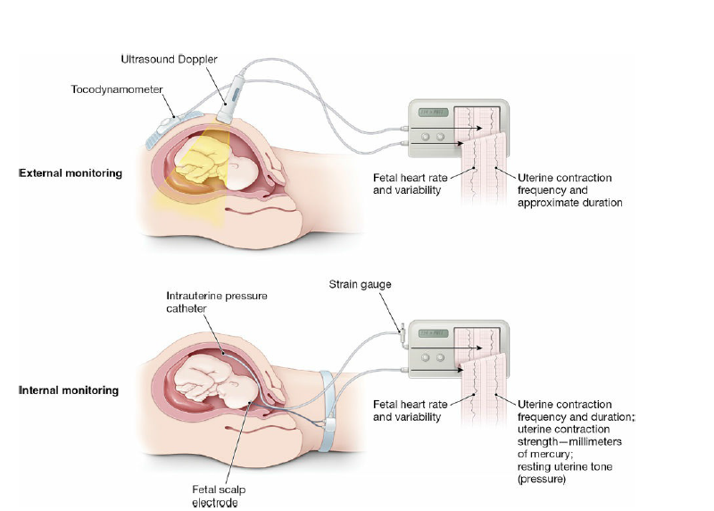

Slide 10
Recent studies suggest that the use of an IUPC instead of external tocodynamometry does not affect the outcome in cases of abnormal labor.
However, an IUPC may be useful in specific situations, such as maternal obesity and other factors that may prevent accurate clinical evaluation of uterine contractions.

Slide 11
Characteristics Uterine contraction in normal labore:
*The peak pressure:
At least 25 mmHg of peak pressure.
Optimal intrauterine pressure is 50 to 60 mm Hg.
*The frequency of uterine contractions
A minimum of three contractions in a 10-minute interval
a maximum of five contractions in a 10-minute period

Slide 12
Montevideo unit (MVU) commonly used to assess contractile strange.
This unit is the number of uterine contractions in 10 minutes times the average intensity.
Normal progress of labor is usually associated with 200 or more MVU.

Slide 13
Fetal Factors: “Passenger”
Evaluation of the passenger includes clinical estimation of fetal weight and clinical evaluation of fetal lie, presentation, position, and attitude.
If a fetus has an estimated weight greater than 4,000 to 4,500 g, the risk of dystocia, including shoulder dystocia and fetopelvic disproportion, is greater.
Because ultrasound estimation of fetal weight is often inaccurate by as much as 500 to 1,000 g when the fetus is near term (40 weeks of gestational age), this information must be used in conjunction with other parameters when making management decisions.

Slide 14
Fetal attitude, presentation, and lie also play a role in the progress of labor.
If the fetal head is turned to one side (asynclitism) or
extended (extension), a larger cephalic diameter is presented to the pelvis, thereby increasing the possibility of dystocia.

Slide 15
brow presentation (about 1 in 3,000 deliveries) typically converts to either a vertex or face presentation, but, if persistent, may cause dystocia requiring cesarean delivery.
Face presentation (about 1 in 600–1,000 deliveries)
requires cesarean delivery in most cases.
However, a mentum anterior face presentation (chin toward mother’s abdomen) may be delivered vaginally if the fetal head undergoes flexion, rather than the normal extension.

Slide 16
compound presentations (about 1 in 700 deliveries), the extremity usually retracts as labor continues.
When it does not, or in the 15% to 20% of compound presentations associated with umbilical cord prolapse, cesarean delivery is required.

Slide 17
Fetal anomalies, such as hydrocephaly and soft tissue tumors, may also cause dystocia.
The routine use of prenatal ultrasound has allowed identification of these situations, significantly reducing the incidence of unexpected dystocia of this kind.

Slide 18
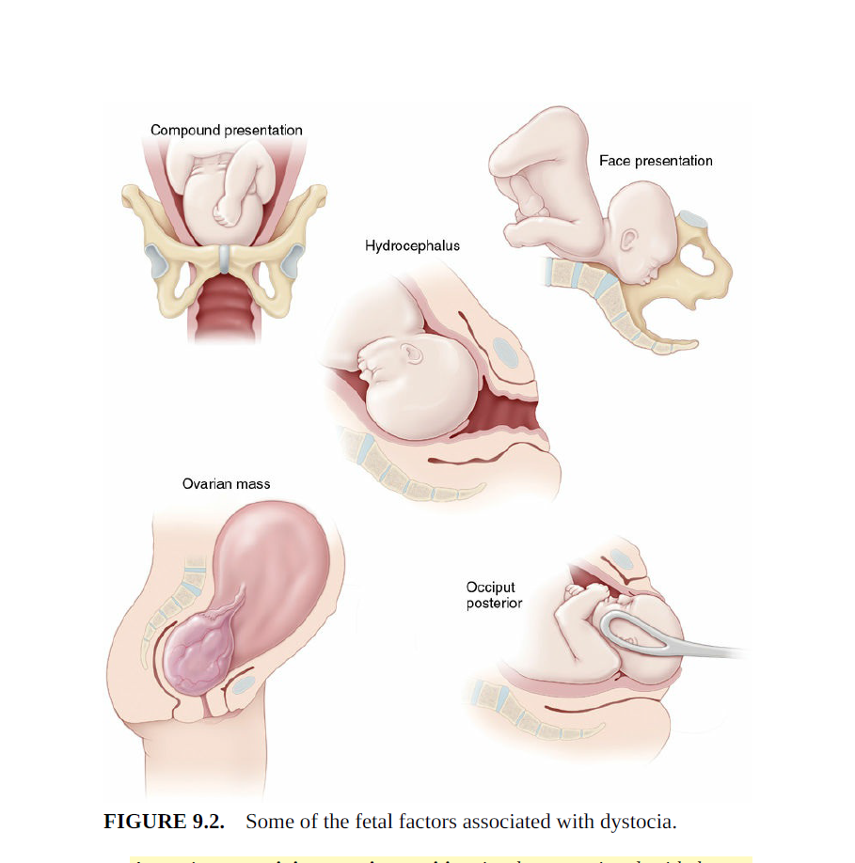

Slide 19
Maternal Factors: “Passage”
Dystocia can result from maternal skeletal or soft tissue anomalies that obstruct the birth canal.

Slide 20
Cephalopelvic disproportion:
in which the size of the maternal pelvis is inadequate to the size of the presenting part of the fetus, may impede fetal descent into the birth canal.
.

Slide 21
Cephalopelvic disproportion (CPD)assessment:
*Clinical pelvimetry
the manual evaluation of the diameters of the pelvis, is also a poor predictor of successful vaginal birth, except in rare circumstances when the pelvic diameters are so small as to render the pelvis “completely contracted.”
*Radiographic and CT pelvimetry can be helpful in some cases
*The progress of descent of the presenting part in labor is the best test of pelvic adequacy.
.

Slide 22
Soft tissue causes of dystocia include abnormalities of the cervix, tumors or other lesions of the colon or adnexa, distended bladder, uterine fibroids, an accessory uterine horn, and morbid obesity.
Epidural anesthesia may contribute to dystocia by decreasing the tone of the pelvic floor musculature

Slide 23
Risks of Dystocia:
* Maternal infection (chorioamnionitis) especially in the setting of ruptured membranes.
* Fetal infection and bacteremia, including pneumonia caused by aspiration of infected amniotic fluid
*Cesarean or operative delivery
* maternal soft tissue injury to the lower genital tract
* and fetal trauma.

Slide 24
Diagnosis of Abnormal Labor
Graphic documentation of progressive cervical dilation and effacement facilitates assessing a patient’s progress in labor and identifying abnormal labor patterns.
The Friedman curve is commonly used for this purpose.

Slide 25
Labor abnormalities include two types:
protraction disorders (latent and active phases of labor)
arrest disorders (active phase)

Slide 26
Definition of the latent phase of labor is defined as the phase in which the cervix effaces but undergoes minimal dilation.

Slide 27
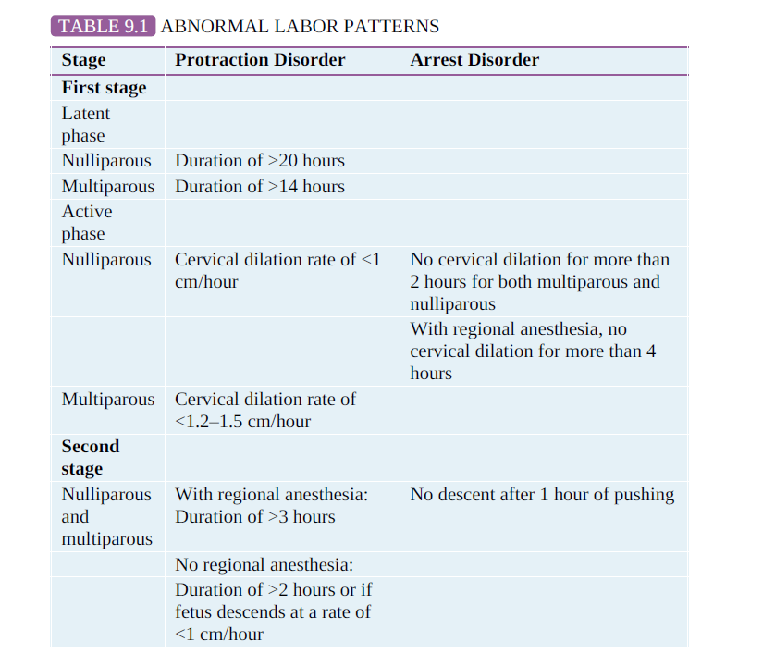

Slide 28
Management of abnormal labor encompasses:
a wide range of options, from observation to operative or cesarean delivery.
Management choice depends on several factors:
• Adequacy of uterine contractions
• Fetal malposition or cephalopelvic disproportion
• Other clinical conditions, such as nonreassuring fetal status or chorioamnionitis

Slide 29
First-Stage Disorders
A prolonged latent phase is one that exceeds 20 hours in a nulliparous patient or 14 hours in a multiparous patient.
A prolonged latent phase does not in itself pose a danger to the mother or fetus

Slide 30
Options for management of women with a prolonged latent phase of labor include:
observation and sedation
With either of these options, the patient may stop having contractions, in which case she is not in labor;
may go into active labor;
or may continue experiencing prolonged labor into the active phase.

Slide 31
Management options for a prolonged labor in active phase of first stage include: observation,augmentation by amniotomy or oxytocin, and continuous support.
Cesarean delivery is usually warranted if maternal or fetal status becomes nonreassuring.

Slide 32
Augmentation
Augmentation refers to stimulation of uterine contractions when spontaneous contractions have failed to result in progressive cervical dilation or descent of the fetus.
Augmentation can be achieved with amniotomy (artificial rupture of membranes [ROM]) and oxytocin administration.

Slide 33
Augmentation should be considered if the frequency of
contractions is less than 3 contractions per 10 minutes, the intensity of contractions is less than 25 mmHg above the baseline, or both.
Before augmentation, the passenger and passageway and feto-matenal well-being should be assessed.
Contraindications to augmentation are similar to those for labor induction.

Slide 34
ROM :
If the membranes have not ruptured, amniotomy may enhance progress in the active phase and negate the need for oxytocin augmentation.
Amniotomy allows the fetal head, rather than the otherwise intact amniotic sac, to be the dilating force.
It may also stimulate the release of prostaglandins.
Risks of amniotomy include FHR decelerations due to cord compression and an increased incidence of chorioamnionitis.
For these reasons, amniotomy should not be routine and should be used for women with prolonged labor.
The FHR should be evaluated both before and immediately after ROM.

Slide 35
The goal of oxytocin administration is to effect uterine
activity sufficient to produce cervical change and fetal descent while avoiding uterine tachysystole (defined as more than five contractions in a 10-minute period, averaged over 30 minutes).
Typically, a goal of a maximum of five contractions in a 10-minute period with resultant cervical dilation is considered adequate.
Uterine activity >200 MVUs may also be defined as adequate .

Slide 36
Continuous Labor Support
Continuous support during labor from caregivers (e.g., nurses, midwives, and doulas) may have a number of benefits for women and their newborns.
Continuous care has been associated with:
reduced need for pain relief and oxytocin administration, lower rates of cesarean and operative deliveries, decreased incidence of 5-minute Apgar scores lower than 7, and increased patient satisfaction with the labor experience.
However, there are insufficient data comparing differences in benefits on the basis of level of training of support personnel—that is, whether the caregivers are nurses, midwives, or doulas.
There is no evidence of harmful effects from continuous support during labor

Slide 37
Management :Second-Stage Disorders
In the past, the fetus was thought to be at increased risk for
morbidity and mortality when the second stage exceeded 2 hours.
Currently, more intensive intrapartum surveillance provides the ability to identify the fetus that may not be tolerating labor well.
Thus, the length of the second stage of labor is not in itself an absolute to immediately proceed with an operative or cesarean delivery; however, prolonged second stage may be considered an indiction for an operative delivery.
As long as heart tones continue to be reassuring and cephalopelvic
disproportion has been ruled out, it is considered safe to allow the second stage to continue.
If uterine contractions are inadequate, oxytocin administration can be initiated or the dosage increased if already in place.

Slide 38
Manegement second stage disorders:
Labor positions other than the dorsal lithotomy position (e.g., knee–chest, sitting, squatting, and sitting in a birthing chair) may bring about subtle changes in fetal presentation and facilitate vaginal delivery.
The absence of epidural analgesia may increase the tone of the pelvic floor muscles, thereby facilitating the cardinal movements of labor and restoring the urge to push.
In some cases of fetal malpresentation, manual techniques can facilitate delivery.

Slide 39
OPERATIVE DELIVERY
The decision to perform an operative delivery in the second stage versus continued observation should be made on the basis of clinical assessment of the woman and the fetus and the skill and training of the obstetrician.
Nonreassuring status of the fetus or mother is an indication for operative or cesarean delivery.

Slide 40
OPERATIVE DELIVERY
Operative vaginal deliveries are accomplished by forceps or a vacuum extractor.
The prevalence of operative vaginal delivery in the United States in 2015 was approximately 3%.
Although considered safe in appropriate circumstances, operative vaginal delivery has the potential for maternal and neonatal complications.

Slide 41
Operative vaginal delivery should be performed only by experienced individuals with privileges for such procedures and in settings in which personnel are readily available to perform a cesarean delivery in the event the operative vaginal delivery is unsuccessful.

Slide 42
Classification
For both forceps and vacuum extraction deliveries, the type of delivery depends on the fetal station
Outlet operative vaginal delivery is the application of forceps or vacuum under
the following conditions:
1. The scalp is visible at the introitus without separating labia.
2. The fetal skull has reached pelvic floor.
3. The sagittal suture is in anteroposterior diameter or right or left occiput anterior or posterior position.
4. The fetal head is at or on the perineum.
5. Rotation does not exceed 45°.

Slide 43
Low operative vaginal delivery is the application of forceps or vacuum (when the leading point of the fetal skull is at station +2 or more and is not on the pelvic floor).
This type of operative vaginal delivery has two subtypes:
1. Rotation of 45° or less (left or right occiput anterior to occiput anterior, or left or right occiput posterior to occiput posterior)
2. Rotation greater than 45°

Slide 44
Midpelvis operative vaginal delivery is the application of forceps or vacuum (when the fetal head is engaged but the leading point of the skull is above station +2).
Under very unusual circumstances, such as the sudden
onset of severe fetal or maternal compromise, application of forceps or vacuum above station +2 may be attempted while simultaneously initiating preparation for a cesarean delivery in the event that the operative vaginal delivery is unsuccessful.

Slide 45
Indications operative vaginal delivery
No indication for operative vaginal delivery is absolute.
• Prolonged or arrested second stage of labor
• Suspicion of immediate or potential fetal compromise
• Shortening of the second stage for maternal benefit

Slide 46
Contraindications operative vaginal delivery:
*Vacuum extraction in gestational age less than 34 weeks(IVH)
* live fetus is with a bone demineralization condition (e.g., osteogenesis imperfecta) or a bleeding disorder (e.g., alloimmune thrombocytopenia, hemophilia, and von Willebrand disease),
*the fetal head is unengaged or the position of the fetal head is unknown

Slide 47
Forceps and vacuum extractors are acceptable for operative vaginal delivery.
The choice of whether to use vacuum or forceps are defined by the clinical circumstances and operator preference based on experience and training.

Slide 48
Forceps
Forceps are primarily used to
Augment the expulsive force
Rotate the fetal head
Control delivery of the fetal head

Slide 49
Complications of forceps delivery include:
Maternal ( perineal trauma, hematoma, and pelvic floor injury).
Neonatal (injuries to the brain and spine, musculoskeletal injury, and corneal abrasion if the forceps are mistakenly applied over the neonates eyes.
The risk of shoulder dystociais increased in forceps deliveries of infants weighing over 4,000 g.

Slide 50
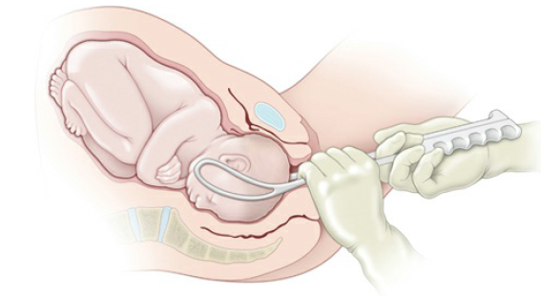

Slide 51
Vacuum Extraction
Vacuum extraction is associated with less maternal trauma than forceps but as with forceps delivery carries potential neonatal risks.

Slide 52
Neonatal risks include:
intracranial hemorrhage, subgaleal hematomas, scalp lacerations, hyperbilirubinemia, and cephalohematoma.
Neonatal care providers should be made aware of the mode of delivery in order to observe for potential complications associated with operative vaginal delivery.

Slide 53
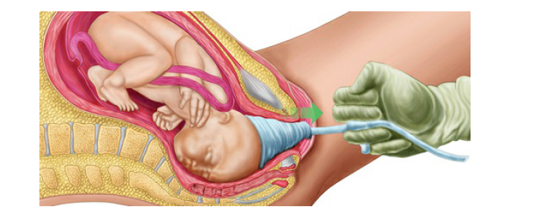

Slide 54
BREECH PRESENTATION
Breech presentation occurs in about 3% to 4% of singleton deliveries at term.
conditions associated with breech presentation include: preterm birth, multiple pregnancy, polyhydramnios, hydrocephaly, anencephaly, aneuploidy, uterine anomalies, and uterine tumors.
The three kinds of breech presentation
frank, complete, and incomplete (footling)

Slide 55
Diagnosis of breech:
by a combination of Leopold maneuvers, pelvic examination, ultrasonography, and other imaging techniques

Slide 56
The morbidity and mortality rates for mother and fetus, regardless of gestational age or mode of delivery, are higher in the breech than in the cephalic presentation.
.

Slide 57
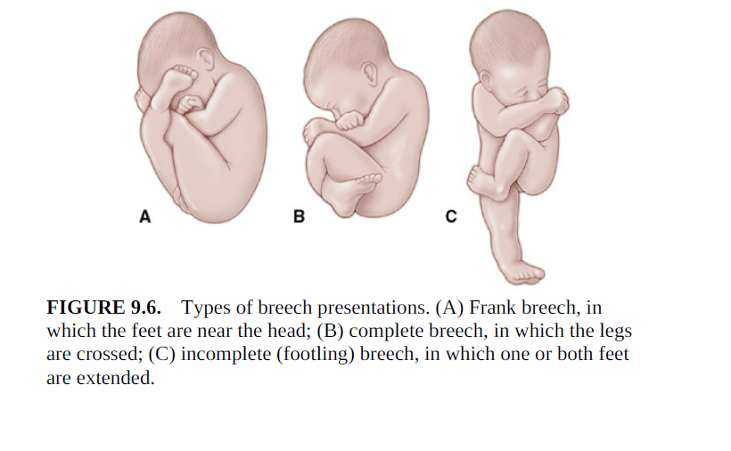

Slide 58
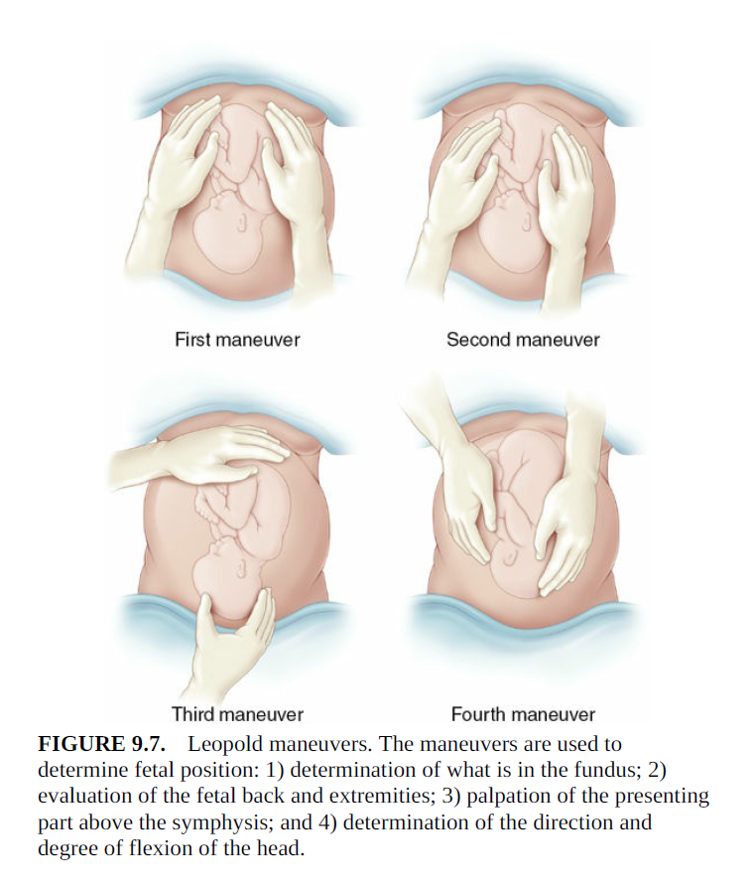

Slide 59
External cephalic version (ECV)
involves applying pressure to the mother’s abdomen to turn the fetus in either a forward or backward somersault to achieve a vertex presentation prior to labor.
The goal of ECV is to increase the proportion of vertex presentations among fetuses that were formerly in the breech position near term.
Once a vertex presentation is achieved, the chances for a vaginal delivery increase.
This maneuver is successful in approximately half of the properly selected cases..

Slide 60
Selection criteria of ECV include:
*Patients who have completed 36 weeks of gestation (if spontaneous version is going to occur, it is likely to have taken place AND the risk of a spontaneous reversion is decreased )
*a normal fetus with reassuring fetal heart tracing,
*adequate amniotic fluid
*presenting part not having descended into the birth canal
* absence of mullerian duct anomalies, placental abruption, or previa
The risks of ECV include :
premature ROM,
placental abruption
cord accident
uterine rupture

Slide 61
External version is more often successful in parous women.
Existing evidence may support the use of a tocolytic agent during ECV attempts, particularly in nulliparous patients.
Administration of anti-D immunoglobulin to Rh-negative women is recommended.

Slide 62
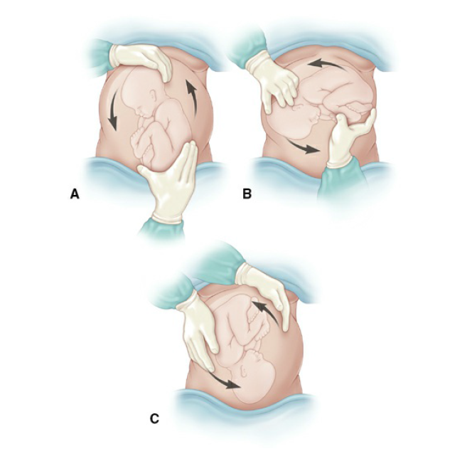

Slide 63
The decision regarding the mode of delivery BREECH should depend on the experience of the health care provider.
Cesarean delivery will be the preferred and safest mode for most, in part due to diminishing expertise in vaginal breech delivery.

Slide 64
The following criteria have been suggested for vaginal breech delivery:
• Normal labor curve
• Gestational age greater than 37 weeks
• Frank or complete breech
• Absence of fetal anomalies on u/s examination
• Adequate maternal pelvis
• Estimated fetal weight between 2,500 and 4,000 g
• Documentation of fetal head flexion.
• Adequate amniotic fluid volume
• Availability of anesthesia and neonatal support

Slide 65
If a vaginal breech delivery is planned, the woman should be informed that the risk of perinatal or neonatal mortality or short-term serious neonatal morbidity may be higher than in a cesarean delivery, and the patient’s informed consent should be documented.

Slide 66
SHOULDER DYSTOCIA
Shoulder dystocia may sometimes arrest expulsion.
Shoulder dystocia cannot be predicted or prevented
Antepartum risk factors of shoulder dystocia include
increased birth weight
maternal diabetes
and a previous history of shoulder dystocia.

Slide 67
Definition:
Shoulder dystocia is defined when the fetal head has delivered but the shoulder do not deliver spontaneously or with normal amount of gentle down ward traction.
Diagnosis of shoulder dystocia:
Is subjective especially in less severe forms.
The delivered fetal head may retract against the maternal perineum (turtle sign) may assist in the diagnosis.

Slide 68
Management of shoulder dystocia:
McRoberts maneuver
Episiotomy (clinical assessment)
Direct fetal manipulation(Rotational maneuvers or delivery of the posterior arm)
Zavanelli maneuver
Intentional fracture of the fetal clavicle

Slide 69
Brachial plexus injury is associated with shoulder dystocia; incidence ranges from 10% to 20%.
However, most cases resolve without permanent disability.
Fewer than 10% of all cases of shoulder dystocia result in a persistent brachial plexus injury.

Slide 70
