Slide 1

Ectopic pregnancy
DR .Taheripanah
Infertility Fellowship
Imam Hossein Hospital
Shahid Beheshti Medical Sciences

Slide 2
هدف از آموزش حاملگی خارج رحمی
دانشجویان باید بتوانند توانمندی چگونگی برخورد و درمان با خونریزی های سه مه ماه اول بارداری را پیدا کنند
دانشجویان باید قادر باشند که تشخیصهای افتراقی، عوامل خطر، اتیولوژی و عوارض بیماری را بطور کامل توضیح داده و بحث نمایند.
دانشجویان باید بتوانند با یک بیمار در مورد روشهای ختم بارداری طبی یا جراحی و عوارض هر روش مشاوره کرده و او را راهنمایی نمایند.
دانشجویان باید تاثیر حاملگی خارج رحمی روی سلامت باروری را نیز توجیه نمایند.

Slide 3
CLINICAL CASE
A 25-year-old woman reports that she had a positive home pregnancy test last week and now has spotting and low abdominal pain of 2 days’ duration. Her last menstrual period was 6 weeks ago. Her abdomen is minimally tender in the left lower quadrant with no rebound tenderness.
The pelvic examination is normal except for tenderness and a 4 cm mass in the left adnexa.
Pelvic ultrasound shows an Empty uterine cavity and mild fluid in the cul-de-sac . There is a simple left ovarian cyst.

Slide 4
Ectopic pregnancy definition
Implantation of the blastocyst anywhere except the endometrium in the uterine cavity
Incidence :1.5 %
98% in the fallopian tube
Other places : as the map

Slide 5
Outcome of tubal pregnancy
Tubal rupture
Tubal abortion
Spontaneous absorption

Slide 6
Pathophysiology and risk factor of EP
Infection :
  Salpingitis : chlamydia trachomatous and induce fibrosis and scar in the tube ( even with persistent chlamydia ag + )
  Salipigitis isthmica nodosa
Advanced age
Smoking
Induction ovulation and infertility
Previous surgery
Pervious EP
IUD
Failure Tubal ligation
Dietylstillbestrol exposure

Slide 7
Symptoms
Amenorrhea following vaginal bleeding (little or none to heavy )
Abdominal pain
Breast tenderness/ nausea/ urinary frequency
Shoulder pain due to hemoperitoneum
Hypovolemia shock
Decidual cast expulsion ( like as abortion)
  but no histologic confirmation of placenta villi

Slide 8
Clinical findings of EP
Abdominal and pelvic pain :50-90%
Cervical motion pain
Pelvic mass : 20%( EP: soft and elastic / Hemorrhagic : firmer consistency )
  The role of technology is higher than physical exam
Fever is uncommon
  ( may be mild elevation on response to intraperitoneal blood
  Temperature more than 40 is due to infection cause
Intra-abdominal bleeding: abdominal distension/tenderness/ with or without rebound/ rigidity /;low bowel sounds/
Uterus may be larger and soft like as IUP
Cervix: may be open with blood

Slide 9
Differential diagnosis
Early pregnancy complication :
  Abortion /Threatened/Incomplete or missed abortion
Placental POLYP
Hemorrhagic corpus luteal cyst
Appendicitis
Renal calculi
Diagnosis should be as soon as possible
In reproductive age women: pain irregular bleeding / amenorrhea/ should be ectopic pregnancy

Slide 10
Diagnosis
The first step in stable woman:
Pregnancy test
Urinary hCG ( to 20 Iu/L 14 days after fertilization ( + in more than 90% of EP)
Serum BHCG : 5 days after fertilization is +)
Serial B-hCG
53% or more increase every 48 hrs till 60-80 days after LMP and when reach 100,000
The main problem: 15% of normal IUP has less than 53% increase
Or 17% of EP has higher rate of increase the BHCG

Slide 11
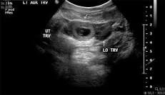
TVS
Gestational sac 4.5 – 5 weeks
Fetal pole and cardiac activity 5.5- 6 weeks
T.A.S is seen slightly later
Discriminatory zone : the level of B-HCG that TVS shown IUP
IUP in TVS 1000-2000
TAS 5000-6000
Abescence of IUP with B-HCG level above the discriminatory value”
Incomplete abortion/resolving complete abortion /EP
Notice to pseudogestational sac: 1 layer sac

Slide 12
Other diagnostic methods
Serum progesterone level:
  Minimal level 5-10 weeks :
  <5 ng/ml: nonviable pregnancy ( 98% specificity , 75% sensitivity)
  >20 NG /ML : healthy pregnancy (40% specificity , 95% sensitivity)
Serum progesterone cannot differentiate the EP and IUP
Endometrial curettage:
may be useful : cannot R/O interrupted of intact pregnancy/ heterotope pregnancy
Arria –Stella reaction : hypersecretoy endometrium that seen in EP

Slide 13
Other diagnostic methods
Culdecentesis:
  Clear fluid: no hemorrhage
  Blood and clot : vessel rupture or rapid bleeding in abdomen
  Non clot blood : hemoperitoneum(Rupture EP / Rupture Corpus luteum cyst)
  No aspiration : no information
  Purulent fluid : infection related causes ( Salipigitis and appendicitis )
Limited used in EP diagnosis and can diagnose hemoperitoneum
Ultrasound and other diagnosis are very accurate and no need to Culdecentesis

Slide 14
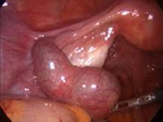
Laparoscopy
The most accurate technique with direct visualization
2-5% misdiagnosis rate
  False negative : Due to no distention of fallopian tube
  False positive : hematosalpinx

Slide 15
Management
Medical
  May be preferred in appropriate patient
Surgical
Depends on:
  Location
  Rupture or not rupture
  Gestational age
  Patient desire

Slide 16
Medical treatment
Methotrexate ;
Folic acid antagonist that competitively inhibits the binding of dihydrofolic acid to dihydrofolate reductase
Stop the growth of rapidly dividing placental embryonic and fetal cells,
Indication :
  Asymptomatic
  Motivated
  Come for follow up

Slide 17
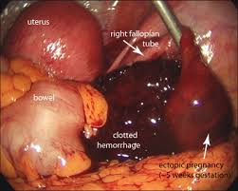
Contraindications of Methotrexate for EP
Absolute
  Breast feeding
  Overt or lab evidence if immunodeficiency
  Known sensitivity to MTX
  Active pulmonary disease
  Peptic ulcer disease
  Hepatic/ renal/ pulmonary or hemorrhagic dysfunction
  Heterotopic pregnancy with viable IUP
  Unable to comply with management protocol
Relative
  Gestational sac greater than 3.5 cm
  Embryonic cardiac motion
  Free peritoneal fluid ( possible hemoperitoneum )

Slide 18
Indications of Medical Treatment
Initial B-HCG level ( best prognostic indicator)
  <5000 success rate 92%
  >15000 success rate : 68%
Size of ectopic pregnancy(TVS)
  <3.5 cm 93% success rate
  >3.5 cm relative contraindication
Presence or absence of fetal cardiac activity
  + cardiac activity relative contraindication

Slide 19
MTX protocols :
Single dose of MTX
DOSE : 1 MG /M2 im
BHCG before -4 -7 ( rise till 4th day and then 15% decrease on the day 7) , then weekly measure
  No decrease : second dose or surgery
Multiple dose
  But higher complications and achieving similar success rate
MTX : local or systematic
  Stomatitis

Slide 20
Medical Treatments
Side effected of MTX
After MTX ;
Abdominal pain due to Tubal distention/ Tubal abortion/ Hemtoma formation .
Brufen administration
  Nausea
  Vomiting
  Diarrhea
  Gastric distress
  Dizziness
Other medication:
  Hyperosmolar glucose
  KCL
  Prostaglindins
  Mifepristone ( antagonist Pr receptor)

Slide 21
Surgical management
Laparoscopy :
Linear salpigostomy (A & B)
Segmental salpingectomy (C & D)
Notice :
RH immunoglobulin :
  RH negative mothers
Follow up :
  conservative surgery of medical treatment
  Platoue or rising B-HCG (need to subsequent surgery of repeated MTX)

Slide 22
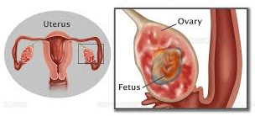
Non- fallopian tube Ectopic pregnancy
Ovarian EP :
Rare
Risk factor: like tubal pregnancy except the Salpingitis
Diagnosis: classic sono and a cyst with wide echogenic vascular outer ring located on or within the ovary
Treatment: medical or surgical

Slide 23
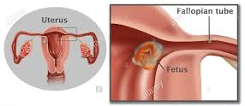
Non- fallopian tube Ectopic pregnancy
Interstitial( corneal) pregnancy:
Implant in proximal of tune within the intramuscular uterine wall
Diagnosis : later due to growth 8-16 th weeks of Pg .
Mortality :
  High due to high bleeding / need to hysterectomy / corneal resection

Slide 24
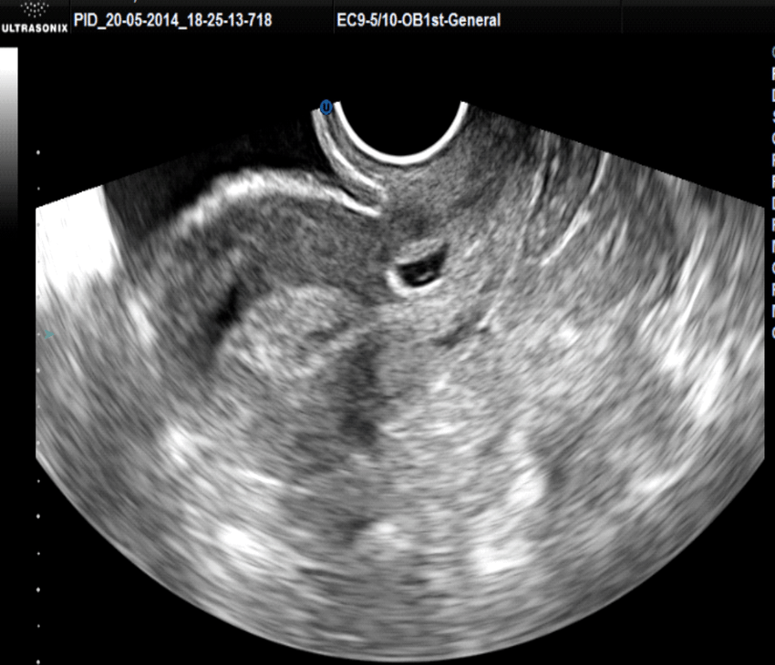
Non- fallopian tube Ectopic pregnancy
Cervical pregnancy :
Incidence : 1/9000-1/12000
Pathology : Implant embryo below the internal os
Diagnosis :
  1) Presence of cervical glands opposite the placental attachment site
  2) A portion of or entire placenta must be located below the uterine arteries or peritoneal reflection on the ant and post uterine surface
Treatment : medical or surgical

Slide 25
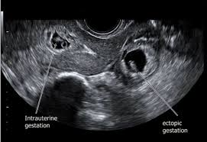
Non- fallopian tube Ectopic pregnancy
Heterotopic pregnancy
Incidence : 1/30000
  By ART : 1/100
Mechanism:
  Hydrostatic forces delivering embryo to corneal or tubal area
  Tip of the catheter toward the tubal ostia
  Reflux of uterine secretions
Treatment : surgery or kcl inject
Mtx IS CONTRAINDICATED

Slide 26
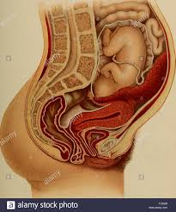
Non- fallopian tube Ectopic pregnancy
Abdominal pregnancy
Incidence: 1/10000
Etiology : primary implantation or secondary due to abortion
Treatment: surgery before fetal alive
Outcomes : 10-20% of fetuses alive but high deformity
Need to remain placenta and Embolization or MTX

Slide 27
EP and future fertility
the rate of repeated EP is 5 folds
Adhesion is higher in surgical method
Although ART is one of the risk factors but patients may need ART in the future

Slide 28
Take home massage
EP may be appear in different places of tube, ovary, uterine cornea, cervix or abdomen
Earlier diagnosis is associated with better prognosis
Serial BhCG and sonography are the best diagnostic tests
Medical treatment with MTX is associated with good prognosis
Surgical approach should be done in case of failure medical treatment
EP should be in mind in each patient that referred by abdominal pain in reproductive age (15-49 years old)

Slide 29
THANKS FOR YOUR ATTENTION

