Slide 2
Intrauterine Growth Restriction (IUGR)
Dr Soraya Saleh Gargari
Fellowship feto- maternal medicine
Shahid Beheshti university

Slide 3
At end of this lecture you should be able to:
describe IUGR
possible etiologies
possible complications
and outline a basic approach to evaluation and management of IUGR

Slide 4
CLINICAL CASE
A 26-year-old G2P1 female has been receiving routine prenatal care.
Her previous pregnancy and delivery were uncomplicated. She is of average height and weight.
When seen for her visit at a well-dated gestational age of 29 weeks, her fundal height is noted to be 24 cm.
Fetal heart tones are normal.
Based on the fact that her uterine size is less than the expected for her gestational age, you suspect intrauterine growth restriction (IUGR).

Slide 5
DEFINETION
INTRAUTERINE GROWTH RESTRICTION (IUGR)
A fetus or infant whose weight is less than the 10th percentile of a specific population at a given gestational age is designated as having IUGR.

Slide 6
Definition (SGA)
The term small for gestational age (SGA) is used to describe an infant with a birth weight below the 10th percentile for gestational age.

Slide 7
Limitation of using gestational age percentiles:
First, by definition, the prevalence of IUGR will be 9%, but not all such neonates are pathologically small.
Second, any percentile cutoff fails to take into account an individual’s growth potential.
Third, the time when the growth restriction is found may be a factor in morbidity and mortality

Slide 8
Significance of diagnosis (IUGR)
The goal of recognizing neonates with growth abnormalities is to identify infants at risk for increased short-term and long-term morbidity or
mortality

Slide 9
Short term complication of IUGR include :
Fetal
Intrauterine fetal death, asphyxia, acidemia, and intolerance to labor
Neonatal
low Apgar scores, polycythemia, hyperbilirubinemia, hypoglycemia, hypothermia, apnea, respiratory distress, seizures, sepsis, meconium aspiration, and neonatal death.

Slide 10
Long term complication of IUGR includs:
Adult obesity, cardiovascular disease (e.g., coronary heart disease, hypertension, and stroke), insulin resistance, and dyslipidemia

Slide 11
Significance of diagnosis (IUGR)
it is important to identify such infants in utero so that management maximizes the quality of their intrauterine environment, permits planning and implementation of delivery using the safest means possible, and provides necessary care in the neonatal period.

Slide 12
Pathophysiology IUGR:
adequate number of fetal cells
cells differentiation
nutrients and oxygen

Slide 13
TYPES OF IUGR:
Early-onset IUGR
Delayed-onset IUGR

Slide 14
Early-onset IUGR
Early in pregnancy, fetal growth occurs primarily through cellular hyperplasia.
Early-onset IUGR may lead to an irreversible diminution of organ size and, perhaps, function.
Etiology Early-onset IUGR:
Early-onset IUGR is also more commonly associated with genetic factors, immunologic abnormalities, chronic maternal disease, fetal infection, and multiple pregnancies.

Slide 15
Delayed-onset IUGR
Later in pregnancy, fetal growth depends on cellular hypertrophy.
Delayed-onset IUGR may also result in decreased cell size.

Slide 16
The placenta grows early and rapidly compared with the fetus, reaching a maximum surface area of about 11cm2 and weight of 500 g at approximately 37 weeks of gestational age.
Thereafter, there is a slow but steady decline in placental surface area (and, hence, function), primarily because of microinfarctions of its vascular system.

Slide 17
There is a close relationship between placental surface area and fetal weight, factors that act to decrease placental size are also associated with restricted, growth.
Abnormal placentation is the most common pathology associated with IUGR.

Slide 18
Etiology Late-onset IUGR
uteroplacental insufficiency

Slide 19
Etiology IUGR
maternal, fetal, and placental
A definite etiology of IUGR cannot be identified in approximately 50% of all cases.

Slide 20
Maternal factors associated with IUGR Include:
demographic factors and medical conditions

Slide 21
Maternal demographic factors associated with IUGR includs:
Extremes in maternal age
A history of prior obstetric complications
Maternal metabolism
Nutritional deficiencies and inadequate weight gain

Slide 22
Maternal medical conditions associated with IUGR:
• Pregestational diabetes mellitus
• Renal insufficiency
• Autoimmune disease (e.g., systemic lupus erythematosus)
• Cyanotic cardiac disease
• Pregnancy-related hypertensive diseases of pregnancy (e.g., chronic
hypertension, gestational hypertension, or preeclampsia)
• Antiphospholipid antibody syndrome
• Substance use and abuse (e.g., tobacco, alcohol, cocaine, or narcotics) (30% -50%.)
• Multiple gestation
• Teratogen exposure (e.g., cyclophosphamide, valproic acid, or
antithrombotic drugs)
• Infectious diseases (e.g., malaria, cytomegalovirus, rubella,
toxoplasmosis, or syphilis) (5-10%)

Slide 23
Fetal factors of IUGR:
Genetic disorders (e.g., trisomy 13, trisomy 18)
single-gene mutations ( such as the glucokinase gene mutation)
structural malformations (such as gastroschisis, congenital cardiac disease, and renal agenesis)
Multifetal pregnancies

Slide 24
Placental Factors of IUGR
• Placental disorders and umbilical cord abnormalities
• Abnormalities in placentation
• Uterine anomalies (uterine septum or fibroids)
• Genetic composition of the placenta (such as confined placental mosaicism)

Slide 25
Diagnosis of IUGR
Recognition of risk factors
Clinical assessment of uterine size
Biometric measurements

Slide 26
Physical Examination
Physical examination is limited in usefulness but it is an important screening test for abnormal fetal growth.
Maternal size and weight gain (limited value) a low maternal weight or little or no weight gain during pregnancy may suggest increased risk for IUGR.
Serial measurements of fundal height (screening test for IUGR but have high rates of false negative and false-positive predictive values)

Slide 27
Between 24 and 38 weeks of gestation, fundal height should increase approximately 1 cm/week, consistent with gestational age in weeks .
A significant discrepancy of more than 3 cm may indicate IUGR and the need for an ultrasound examination.
Clinical estimations of fetal weight alone are not helpful in diagnosing IUGR, except when fetal size is grossly diminished

Slide 28
Ultrasonography
If IUGR is suspected based on risk factors and/or clinical assessment, ultrasonography should be performed to assess fetal size and growth.
The four standard fetal biometry measurements include the (1) biparietal diameter, (2) head circumference, (3) abdominal circumference (AC), and (4) femur length.
A small AC or fetal weight estimate below the 10th percentile suggests the possibility of IUGR.

Slide 29
Direct invasive studies IN IUGR
INDICATION
Midtrimester onset of IUGR
structural abnormalities
concerning fetal infection
Amniocentesis (Fetal karyotyping and viral cultures and/or polymerase chain reaction)
Rarely, chorionic villus sampling or direct blood sampling may be necessary for specific studies.

Slide 30
Doppler Velocimetry
Doppler velocimetry has been shown to both reduce interventions and improve fetal outcome in pregnancies at risk for IUGR.
The rate of perinatal mortality is reduced by 29% when umbilical artery Doppler velocimetry is combined with standard antepartum surveillance (non-stress test, biophysical profile) in the setting of IUGR.

Slide 31
Fetal–placental circulation is evaluated in the umbilical artery and is measured by a systolic/diastolic (S/D) ratio. The S/D indirectly measures resistance downstream within the placental vessels.
As placental resistance increases, diastolic flow decreases and the S/D ratio rises.
A normal S/D ratio at term is 1.8 to 2.0.
Fetuses with IUGR with absent or reversed end-diastolic flow have progressively worse perinatal outcomes

Slide 32
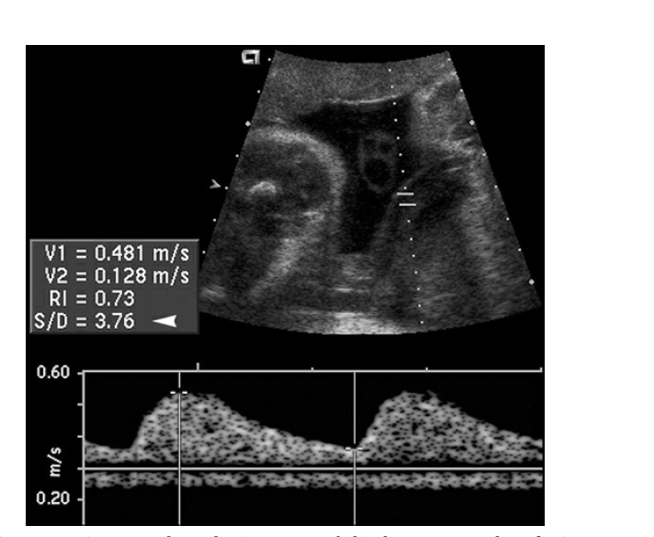

Slide 33
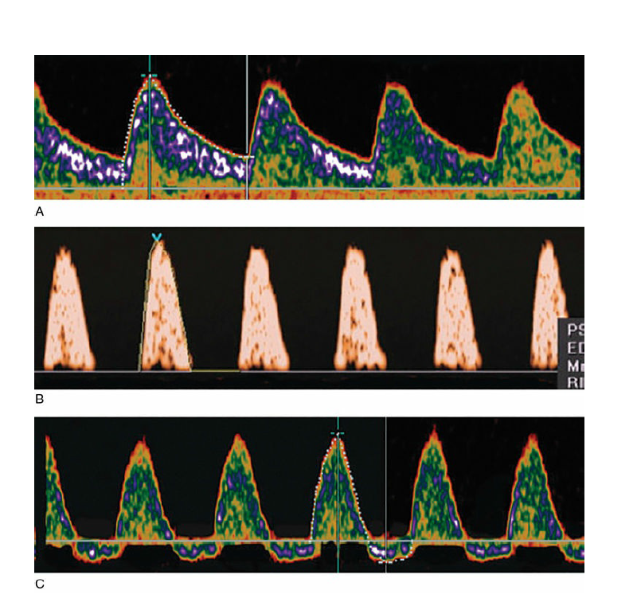

Slide 34
Management
The goal of management of a growth-restricted fetus is to deliver the healthiest possible infant at the optimal time. Continued management of pregnancy with IUGR is based on the results of fetal testing.
Serial evaluations of fetal biometry should be performed every 3 or 4 weeks to follow the extent of growth restriction.

Slide 35
Fetal surveillance Include:
fetal movement counting
nonstress testing
biophysical profiles
umbilical artery Doppler studies.
.

Slide 36
Treatment ( IUGR)
There are no specific therapies that have proven beneficial for pregnancies complicated by IUGR.
The fetus should be delivered if the risk of fetal death exceeds that of neonatal death, although in many cases these risks are difficult to assess

Slide 37
Time of delivery(IUGR)
Based on existing data and expert opinion, the following timing strategies have been recommended when IUGR has been diagnosed:
(1) delivery at 38 0/7 to 39 6/7 weeks in cases of isolated IUGR
(2) delivery at 34 0/7 to 37 6/7 weeks in cases of IUGR with additional risk factors for adverse outcome (e.g., more severe IUGR, oligohydramnios, abnormal umbilical artery Doppler velocimetry, maternal co-morbidities).

Slide 38
Management of IUGR infants
dependent on gestational age, includes:
preparation for neonatal respiratory compromise, hypoglycemia, hypothermia, and hyperviscosity syndrome

