Slide 1

Obstetric examinations:
علیرضا قربانی - 941315052
استاجر بخش زنان بیمارستان طالقانی

Slide 2

Introduction
Wash your hands
Introduce yourself
Confirm the patient’s details (name and date of birth)
Ask if the patient currently has any pain

Slide 3

General inspection
Radial pulse:
Assess pulse rate and rhythm
Women typically have a higher baseline heart rate during pregnancy (80-90 beats per minute)
Capillary refill time:
Less than 2 seconds is normal
A prolonged capillary refill time may suggest hypovolaemia (e.g. antepartum haemorrhage)

Slide 4
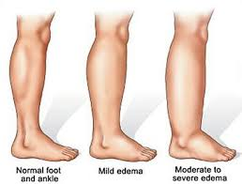
Peripheral oedema:
It is normal for women to have a degree of peripheral oedema during pregnancy (particularly in the later stages)
However, oedema can also be a sign of pre-eclampsia and therefore this diagnosis needs to be excluded.
If pre-eclampsia is suspected, you should check the patient’s blood pressure and perform urinalysis (looking for proteinuria)

Slide 5


Inspect the patient’s face, looking for relevant clinical signs:
Jaundice – associated with obstetric cholestasis
Melasma (benign dark and irregular hyperpigmented macules) – a non-pathological sign associated with pregnancy
Oedema – associated with pre-eclampsia
Conjunctival pallor – associated with anaemia

Slide 6
Inspect the abdomen
Position the patient:
The recommended positioning during pregnancy varies, depending on the patient’s current gestation:
Early pregnancy – position the patient supine on the couch, with the head end of the bed elevated to 15-30 degrees
Late pregnancy – position the patient in the left lateral position to avoid inferior vena cava compression

Slide 7
Closely inspect the abdomen
Expose the abdomen appropriately, from the xiphi sternum to the pubic symphysis and inspect for relevant clinical signs:
Note the shape of the abdomen (this may give an indication of the fetal lie)
Look for fetal movements (from 24 weeks gestation onwards)
Note any surgical scars (e.g. previous caesarean section)
Inspect for cutaneous signs of pregnancy:
  Linea nigra
  Striae gravidarum
  Striae albicans

Slide 8
Palpation:
Maintain your patient’s dignity at all times
Expose only as much of your patient as is required.
Ensure that your patient is positioned appropriately and that you have warm hands.
Palpate the abdomen using even movements of the flat of the palmar surface of closed fingers. (Aim to maintain hand to skin contact as much as possible rather than taking hands on and off the surface of the abdomen).
Do not prod the abdomen or use jerky movements as these are likely to irritate the uterus and stimulate a contraction.

Slide 9
Palpation
Ask about abdominal tenderness before palpating the abdomen and continue to monitor the patient’s face for signs of discomfort throughout the examination.
Palpate the 9 regions of the abdomen
Perform light palpation in each of the 9 regions of the abdomen
Note any tenderness, guarding, rebound or masses (other than the gravid uterus itself)

Slide 10
The fundal height
The woman lies supine.
Palpate for the fundus first. The fundus is not usually palpated abdominally before 12week gestation.
Apply gentle pressure with the flat palmar surface of your hand moving down wards from the xiphisternum-to palpate the top of the fundus. The fundal height can be measured in Cm.
Place the zero end of the tape measure at the fundus.

Slide 11
Zero ofthe tape measure is held at the fundus.
Gently stretch the tapemeasure over the abdomen to the superior border of the symphysis pubis.
Look on the reverse of the tape, and document the measurement in centimeters.

Slide 12
The expectation is that after week 24 of pregnancy the fundal height for a normally growing baby will match the number of weeks of pregnancy — plus or minus 2 centimeters
A fundal height measurement might be less accurate, however, if you have a body mass index of 30 or higher (obesity) or have a history of fibroids.
A fundal height that measures smaller or larger than expected — or increases more or less quickly than expected — could indicate:
Slow fetal growth (intrauterine growth restriction)
A multiple pregnancy
A significantly larger than average baby (fetal macrosomia)
Too little amniotic fluid (oligohydramnios)
Too much amniotic fluid (polyhydramnios)

Slide 13
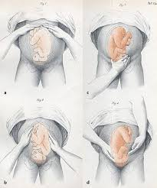
Leopold's maneuvers
Leopold's maneuvers are a common and systematic way to determine the position of a fetus inside the woman's uterus
The maneuvers consist of four distinct actions, each helping to determine the position of the fetus.
The maneuvers are important because they help determine the position and lie of the fetus, which in conjunction with correct assessment of the shape of the maternal pelvis can indicate whether the delivery is going to be complicated, or whether a caesarean section is necessary.

Slide 14
leopold's maneuvers are difficult to perform on obese women and women who have polyhydramnios
The palpation can sometimes be uncomfortable for the woman if care is not taken to ensure she is relaxed and adequately positioned.
To aid in this, the health care provider should first ensure that the woman has recently emptied her bladder. If she has not, she may need to have a straight urinary catheter inserted to empty it if she is unable to micturate herself.
The woman should lie on her back with her shoulders raised slightly on a pillow and her knees drawn up a little. Her abdomen should be uncovered, and most women appreciate it if the individual performing the maneuver warms their hands prior to palpation.

Slide 15
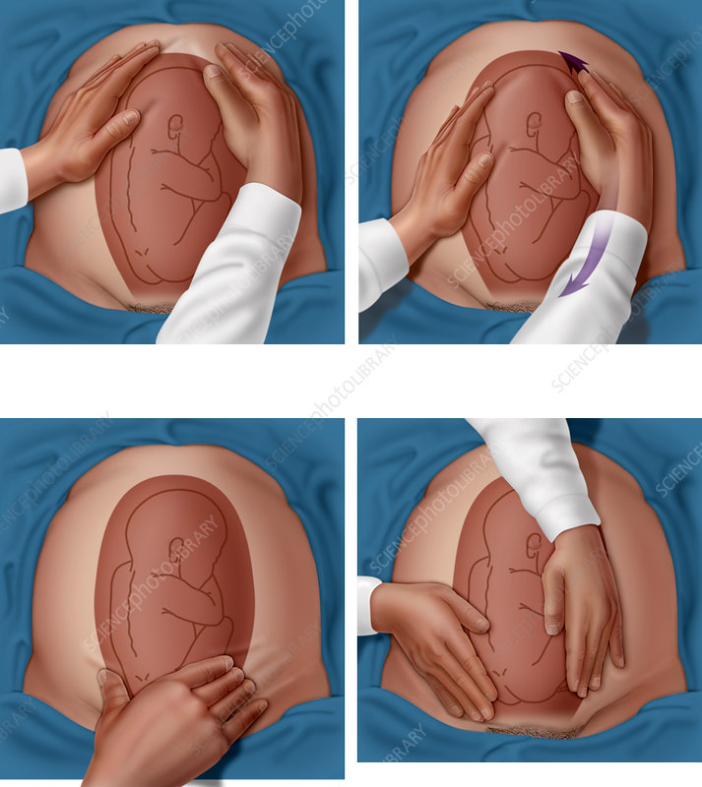
First maneuver: fundal grip
While facing the woman, palpate the woman's upper abdomen with both hands. An obstetrician can often determine the size, consistency, shape, and mobility of the form that is felt. The fetal head is hard, round, and moves independently of the trunk while the buttocks feel softer, are symmetric, and the shoulders and limbs have small bony processes; unlike the head, they move with the trunk.

Slide 16
Second maneuver: umbilical grip
After the upper abdomen has been palpated and the form that is found is identified, the individual performing the maneuver attempts to determine the location of the fetal back. Still facing the woman, the health care provider palpates the abdomen with gentle but also deep pressure using the palm of the hands. First the right hand remains steady on one side of the abdomen while the left hand explores the right side of the woman's uterus. This is then repeated using the opposite side and hands. The fetal back will feel firm and smooth while fetal extremities (arms, legs, etc.) should feel like small irregularities and protrusions. The fetal back, once determined, should connect with the form found in the upper abdomen and also a mass in the maternal inlet, lower abdomen.

Slide 17
Third maneuver: second pelvic grip
In the third maneuver the health care provider attempts to determine what fetal part is lying above the inlet, or lower abdomen. The individual performing the maneuver first grasps the lower portion of the abdomen just above the pubic symphysis with the thumb and fingers of the right hand. This maneuver should yield the opposite information and validate the findings of the first maneuver. If the woman enters labor, this is the part which will most likely come first in a vaginal birth. If it is the head and is not actively engaged in the birthing process, it may be gently pushed back and forth.

Slide 18
Fourth maneuver: Leopold's first pelvic grip
The last maneuver requires that the health care provider face the woman's feet, as he or she will attempt to locate the fetus' brow. The fingers of both hands are moved gently down the sides of the uterus toward the pubis. The side where there is resistance to the descent of the fingers toward the pubis is greatest is where the brow is located. If the head of the fetus is well-flexed, it should be on the opposite side from the fetal back. If the fetal head is extended though, the occiput is instead felt and is located on the same side as the back.

Slide 19

Fetal heart rate
You may be asked to identify the fetal heartbeat using a Pinard stethoscope (or a Doppler ultrasound probe). As a result, it is important to have a basic understanding of how to locate and identify the fetal heartbeat.
The average fetal heart rate is between 110 and 160 beats per minute.
1. Based on your assessment of the fetus’s position, you should place the Pinard stethoscope aiming between the fetal shoulders on the fetal back.
2. Palpate the patient’s radial pulse (maternal pulse).

Slide 20

3. Place your ear to the Pinard and take your hand away (so the Pinard is held against the abdomen using your ear only):
You should be applying gentle pressure, to ensure a good seal between your ear and the Pinard, as well as between the Pinard and the abdomen.
Pressing too hard will be uncomfortable for the patient and pressing too softly will make it difficult to hear anything at all.
4. Listen for the fetal heartbeat:
If the maternal pulse coincides with the pulse you can hear, you are most likely listening to the flow through the uterine vessels, rather than the fetal heartbeat.

Slide 21
Thanks for your attention

