Slide 1


Dr.Tahereh Ashrafganjoei
Gynecologic Oncologist
Associate Prof.
Shahid Beheshti University of Medical Sciences.

Slide 2
Reference:
Beckmann and Ling's Obstetrics and Gynecology,2019, eight edition, chapter50.
To read more:
Berek & Novak's Gynecology, 2020,sixteenth edition, chapter 39.

Slide 3
اهداف یادگیری، در پایان دانشجو باید بتواند:
دانشجو باید علم برخورد صحیح با توده های تخمدانی را کسب کند.
دانشجو باید بتواند کیست های فیزیولوژیک، نئوپلاسم های خوش خیم و نئوپلاسم های بدخیم تخمدانی را از هم افتراق دهد
دانشجو باید بتواند سه نوع تومور تخمدان را از هم افتراق دهد.
علل و سمپتوم‌های تومور تخمدان را بیان کند.
ریسک فاکتورهای تومور تخمدان را شرح دهد.
نشانه‌های تومور تخمدان را شرح دهد
روش‌های تشخیص تومور تخمدان را شرح دهد.
مرحله بندی تومور تخمدان را شرح دهد .
درمان تومور تخمدان را شرح دهد.

Slide 4
CLINICAL CASE
A 26-year-old patient comes to see you because of increasing girth in her abdomen.
She reports that she has been trying to lose weight .
she has been successful except in her abdominal area. Other than this planned weight loss, she denies any other symptoms.
On physical examination, the abdomen is soft and nontender, but you feel an unusual amount of fluctuance.
A computed tomography (CT) of the abdomen demonstrates a 22-cm fluid-filled mass.

Slide 5
INTRODUCTION
The area between the lateral pelvic wall and the cornu of the uterus is called the adnexal space.
The structures in this space are called the adnexa and include the ovaries, fallopian tubes, upper portion of the broad ligament and mesosalpinx, and remnants of the embryonic Müllerian duct.
Of these, the organs most commonly affected by disease processes are the ovaries and fallopian tubes.

Slide 6
DIFFERENTIAL DIAGNOSIS
Because the adnexal space is located near urinary and gastrointestinal (GI) organs, disorders of these organs may cause symptoms in the pelvic area that need to be distinguished from gynecologic disorders.
The most common urologic disorders are upper and lower urinary tract infection, and the less common are renal and ureteral calculi.
An isolated pelvic kidney may likewise present as an asymptomatic, solid, cul-de-sac mass.
Acute appendicitis should be considered in the differential diagnosis of acute right lower-quadrant pain and tenderness.
Less commonly, symptoms in the right adnexa may be related to intrinsic inflammatory bowel disease involving the ileocecal junction.
Left-sided bowel disease involving the rectosigmoid is seen more often in older patient. Because of the age of these patients and the proximity of the left ovary to the sigmoid, sigmoid diverticular disease is included in the differential diagnosis of a left-sided adnexal mass.
Finally, left-sided pelvic pain or a mass may be related to rectosigmoid carcinoma.
Midline disease can sometimes be related to a process involving a Meckel diverticulum or a sacral tumor.
An adnexal mass can of course originate from the Fallopian tube, including hydrosalpinx and ectopic pregnancy.

Slide 7
EVALUATION OF OVARIAN DISEASE
Interpretation of pelvic examination findings requires knowledge of the physical characteristics of the ovary during the stages of the life cycle.
In the premenarchal age group, the ovary should not be palpable. If it is, a pathologic condition is presumed, and further evaluation is necessary.
In the reproductive-age group, the normal ovary is not always palpable depending on patient body mass index, history of abdominal surgery with associated scarring, size and orientation of uterus, and other factors.
In reproductive-age women taking ovulation-inhibiting contraceptives, the ovaries are palpable less frequently and are smaller and more symmetric than in women who are not using these types of contraceptives.
the ovaries are nonpalpable in most women within 3 years of the onset of natural menopause.
A significant portion of all ovarian masses in postmenopausal women are malignant, whereas in reproductive-age women less than 10% of ovarian tumors are malignant.
Important considerations include ovarian size, shape, consistency (firm or cystic), and mobility.

Slide 8
EVALUATION OF OVARIAN DISEASE
Pelvic ultrasound is the primary component of evaluation. Simple,unilocular cysts less than 10 cm in diameter confirmed by transvaginal ultrasonography are almost universally benign and may safely be followed without intervention regardless of age; however, patients should be made aware of possible complications such as ovarian torsion or cyst rupture.
Biomarkers may also be helpful. CA-125 is a serum marker that is sometimes used to help distinguish benign from malignant pelvic masses. Any CA-125 elevation in a postmenopausal woman with a pelvic mass is highly suspicious, but not diagnostic, for cancer.

Slide 9
FUNCTIONAL OVARIAN CYSTS
Functional ovarian cysts are not neoplasms but, rather, anatomic variations that arise as a result of normal ovarian function.
They may present as an asymptomatic adnexal mass or become symptomatic, requiring evaluation and, possibly, treatment:
Follicular Cyst
Corpus Luteum Cysts
Theca Lutein Cyst

Slide 10
Follicular Cyst
When an ovarian follicle fails to rupture during follicular maturation, ovulation does not occur, and a follicular cyst may develop. This process, involves a lengthening of the follicular phase of the cycle,with resultant transient secondary amenorrhea.
Follicular cysts are lined by normal granulosa cells, and the fluid contained in them is rich in estrogen.
Symptoms associated with a follicular cyst may include mild to moderate unilateral lower abdominal pain and alteration of the menstrual interval.
Pelvic examination findings may include unilateral tenderness with a palpable,mobile, and cystic adnexal mass.
Pelvic ultrasonography :A benign tumor tends to appear as a unilocular simple cyst without any of the following solid components: thick septations, soft tissue elements, evidence of internal or external excrescences, and papillations

Slide 11
Follicular Cyst
Most follicular cysts spontaneously resolve within 6 weeks. If a contraceptive is given to suppress gonadotropin stimulation of the cyst, it does not shrink the existing cyst, but, instead, may suppress the development of a new cyst and permit resolution of the existing problem.
Because release of follicular fluid into the peritoneum produces only transient symptoms, surgical intervention is rarely necessary, and analgesics may be prescribed for short-term, symptomatic relief.
If the presumed functional cyst persists despite expectant management, another type of cyst or neoplasm should be suspected and further evaluated by imaging studies and/or surgery.

Slide 12
Corpus Luteum Cyst
A Corpus Luteum Cyst is designated a cyst rather than simply a corpus luteum when its diameter exceeds approximately 3 cm.
It is related to the postovulatory (i.e., progesterone-dominant) phase of the menstrual cycle.
Two variations of corpus luteum cysts are encountered. The first is a slightly enlarged corpus luteum, which may continue to produce progesterone for longer than the usual 14 days. Menstruation is delayed from a few days to several weeks.
Persistent corpus luteum cysts are often associated with ipsilateral dull lower quadrant pain. This pain and occasionally a missed menstrual period are the most common complaints associated with persistent corpus luteum cysts.
Pelvic examination usually discloses an enlarged, tender, cystic, or solid adnexal mass. Because of the triad of missed menstrual period, unilateral lower-quadrant pain, and adnexal enlargement, ectopic pregnancy is often considered in the differential diagnosis.
Patients with recurrent persistent corpus luteum cysts may benefit from cyclic oral contraceptive therapy.

Slide 13
Corpus Luteum Cysts
A second, less common type of corpus luteum cyst is the rapidly enlarging luteal-phase cyst into which there is spontaneous hemorrhage.
This hemorrhagic corpus luteum cyst may rupture late in the luteal phase. A typical patient would be one not using oral contraceptives, with regular periods, who presents with acute pain late in the luteal phase.
Some patients present with evidence of hemoperitoneum as well as hypovolemia and require surgical resection of the bleeding cyst. In others, the acute pain and blood loss are self-limited.These patients may be managed with mild analgesics and reassurance.
Patients at risk for repetitive hemorrhagic corpus luteum cysts include those who are taking anticoagulation medication and those who have a clotting disorder. This clinical presentation may be the genesis of a coagulopathy investigation.

Slide 14
Theca Lutein Cyst
The third type of functional cyst is the least common, the theca lutein cyst, which is associated with pregnancy. Usually bilateral, they are most common in multiple gestations, trophoblastic disease, and ovulation induction with clomiphene and human menopausal gonadotropin/human chorionic gonadotropin (hCG).
They may not only become large and multicystic but also regress spontaneously in most cases without intervention.

Slide 15
BENIGN OVARIAN NEOPLASMS
Although most ovarian enlargements in the reproductive-age group are functional cysts, about 25% prove to be nonfunctional ovarian neoplasms.
In the reproductive-age group, 90% of these neoplasms are benign, whereas the risk of malignancy rises to approximately 25% when postmenopausal patients are also included.
Thus, ovarian masses in older patients and in reproductive-age patients that show no response to expectant management are of special concern.
Unfortunately, unless the mass is particularly large or becomes symptomatic, these masses may remain undetected.

Slide 16
Ovarian neoplasms are usually categorized by the cell type of origin:
• Epithelial cell tumors, the largest class of ovarian neoplasm
• Germ cell tumors, the most common ovarian neoplasm in
reproductive-age women, the benign cystic teratoma or dermoid
• Stromal cell tumors, some of the rarer types

Slide 18
Benign Epithelial Cell Neoplasms
Evidence exists to suggest that these cells are derived from mesothelial cells lining the peritoneal cavity.
It is hypothesized that these tissues are capable of differentiating into glandular tissue.
The more common epithelial tumors of the ovary are grouped into serous, mucinous, and endometrioid neoplasms

Slide 20
Serous Tumors
The most common epithelial cell neoplasm is serous cystadenoma . Seventy percent of serous tumors are benign; approximately 10% are of low malignant potential, and the remaining 20% are frankly malignant by both histologic criteria and clinical behavior.

Slide 21
Serous Tumors
Treatment of serous tumors is surgical, because of the relatively high rate of malignancy. In the younger patient with smaller tumors, ovarian cystectomy may be attempted to minimize the amount of ovarian tissue removed. For large, unilateral serous tumors in young patients, unilateral oophorectomy with preservation of the contralateral ovary is indicated to maintain fertility.
In patients post menopause, bilateral oophorectomy along with hysterectomy may be indicated, not only because of the chance of future malignancy but also because of the increased risk of a coexistent serous tumor in the contralateral ovary.

Slide 22
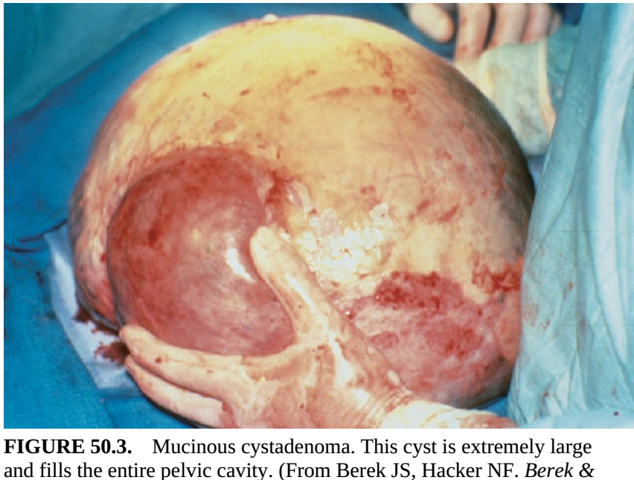
Mucinous Tumors
The mucinous cystadenoma is the second most common epithelial cell tumor of the ovary.
The malignancy rate of 15% is lower than that for serous tumors.
These cystic tumors can become quite large, sometimes filling the entire pelvis and extending into the abdominal cavity .
Ultrasound assessment will often reveal multilocular septations.
Surgery is the treatment of choice.

Slide 23
Endometrioid Tumors
A third type of benign epithelial neoplasm is endometrioid tumor.Most benign endometrioid tumors take the form of endometriomas, which are cysts lined by well-differentiated, endometrial-like glandular tissue.

Slide 24
Brenner tumor
Brenner tumor is an uncommon benign epithelial cell tumor of the ovary. This tumor is usually described as a solid ovarian tumor because of the large amount of stroma and fibrotic tissue that surrounds the epithelial cells.
It is rarely malignant.
It is more common in older women, and occasionally occurs in association with mucinous tumors of the ovary.
When discovered as an isolated tumor of the ovary, it is relatively small compared with the large size often attained by the serous and especially by the mucinous cystadenomas.

Slide 25
Benign Germ Cell Neoplasms
Germ cell tumors are derived from the primary germ cells.
The most common tumor found in women of all ages is benign cystic teratoma, also called a dermoid cyst or dermoid .
Eighty percent occur during the reproductive years, with a median age of occurrence of 30 years. In children and adolescents, mature cystic teratomas account for about one-half of benign ovarian neoplasms. Dermoids may contain differentiated tissue from all three embryonic germ layers (i.e., ectoderm, mesoderm, and endoderm).
The most common elements found are of ectodermal origin, primarily squamous cell tissue such as skin appendages (e.g., sweat, sebaceous glands) with associated hair follicles and sebum. It is because of this predominance of dermoid derivatives that the term “dermoid” is used.
Other constituents of dermoids include central nervous system tissue, cartilage, bone, teeth, and intestinal glandular elements, most of which are found in well-differentiated form.
One unusual variant is struma ovarii, in which functioning thyroid tissue is found.

Slide 27
Dermoid
A dermoid is frequently encountered as an asymptomatic, unilateral adnexal mass that is mobile and nontender. This tumor often has a high fat content that makes it more readily identified by CT evaluation, as well as giving it a more buoyant tendency in the pelvis, resulting in a relatively high rate of ovarian torsion (15%) in comparison with other types of neoplasms.
Treatment of dermoids depends on size, patient symptoms, surgical risk, and suspicion of malignancy. The rate of malignancy is low, but surgical removal should be considered because of the possibility of ovarian torsion and rupture, resulting in intense chemical peritonitis due to the sebaceous contents and the subsequent surgical emergency.
Between 10% and 20% of these cysts are bilateral, underscoring the need for examination of the contralateral ovary at the time of surgery. If expectant management is chosen, then close follow-up with continued ultrasound monitoring. should be undertaken, with close attention to increase in size or development of more malignant appearing radiologic characteristics.

Slide 28
Benign Stromal Cell Neoplasms
Stromal cell tumors of the ovary are usually considered solid tumors and are derived from specialized sex cord stroma of the developing gonad. These tumors may develop along a primarily female cell type into granulosa theca cell tumors, or into a primarily male gonadal type of tissue, known as Sertoli-Leydig cell tumors. Both of these tumors are referred to as “functioning tumors” because of their hormone production.
Granulosa theca cell tumors primarily produce estrogenic components and may be manifest in patients through feminizing characteristics, whereas Sertoli-Leydig cell tumors produce androgenic components, which may contribute to hirsutism or virilization.
These neoplasms occur with approximately equal frequency in all age groups, including pediatric patients. When the granulosa cell tumor occurs in the pediatric age group,it may contribute to signs and symptoms of precocious puberty, including precocious thelarche and vaginal bleeding. Vaginal bleeding may also occur when this tumor develops in the postmenopausal years.
Both granulosa cell tumor and the Sertoli-Leydig cell tumor have malignant potential.

Slide 29
Ovarian fibroma
The ovarian fibroma is the result of collagen production by spindle cells. These tumors account for 4% of ovarian tumors and are most common during middle age.
It is unlike other stromal cell tumors in that it does not secrete sex steroids. It is usually a small, solid tumor with a smooth surface and is occasionally clinically misleading because ascites are present.
The combination of benign ovarian fibroma coupled with ascites and right pleural effusion has historically been referred to as Meigs syndrome.

Slide 30
Key Points
The following are the key points that can be made regarding benign
ovarian neoplasms:
• They are more common than malignant tumors of the ovary in all age
groups.
• The risk of malignant transformation increases with increasing age.
• Surgical treatment should be considered if there is high potential for
malignancy or torsion.
• Preoperative assessment with pelvic imaging techniques such as
ultrasound is necessary.
• Surgical treatment may be conservative for benign tumors, especially if
future reproduction is desired.

Slide 31
MALIGNANT OVARIAN NEOPLASMS
Ovarian cancer is the fifth most common cause of cancer death in women in the United States (following, in order, lung, breast, colorectal, and pancreatic).
The mortality rate of this disease is the highest of all the gynecologic malignancies, primarily because of the difficulty in detecting the disease before widespread dissemination.
About 65% to 70% are diagnosed at an advanced state when the 5- year survival rate is approximately 20%.
Of the estimated 22,400 new cases of ovarian cancer yearly, approximately 50% to 65% will die within 5 years.

Slide 32
Epidemiology
Ovarian cancer presents most commonly in the fifth and sixth decades of life. The incidence of ovarian cancer in Western European countries and in the United States is higher, with a five- to sevenfold greater incidence than the age-matched populations in East Asia.
In the United States, White women are more likely to develop ovarian cancer than African American women.

Slide 33
Risk Factors
The risk of a woman developing ovarian cancer during her lifetime is approximately 1 in 70. The risk increases with age until approximately 70 years.
In addition to age, the epidemiologic factors associated with development of ovarian cancer include nulliparity, primary infertility, and endometriosis.
Approximately 8% to 13% of cases of ovarian cancer are caused by inherited mutations in the cancer susceptibility genes BRCA1 and BRCA2.
The risk of ovarian cancer through age 70 years for women with Lynch syndrome is estimated to be 5% to 10%, compared with approximately 1% in the general population.

Slide 34
Risk Factors
It has been suggested that the so-called incessant ovulation may predispose to neoplastic transformation of the epithelial cell surfaces of the ovary.
Long-term suppression of ovulation may protect against the development of ovarian cancer, at least for epithelial cell tumors.
Five years of cumulative suppression of ovulation through the use of oral contraceptives appears to decrease the lifetime risk of ovarian cancer by one-half.
No evidence exists to implicate the use of postmenopausal hormone therapy in the development of ovarian cancer.

Slide 35
Early Symptoms
Symptoms of ovarian cancer are often confused with benign conditions or interpreted as part of the aging process, with the final diagnosis often delayed.
The most common symptoms are abdominal bloating or distension, abdominal or pelvic pain, decreased energy or lethargy, early satiety, and urinary urgency.
Usually these symptoms occurred more frequently and were more severe than in patients without cancer.
Because no clinically applicable screening test is available, approximately two thirds of patients with ovarian cancer have advanced disease at the time of diagnosis.

Slide 36
Pathogenesis and Diagnosis
Malignant ovarian epithelial cell tumors spread primarily by direct extension within the peritoneal cavity as a result of direct cell sloughing from the ovarian surface.
This process explains the widespread peritoneal dissemination at the time of diagnosis, even with relatively small primary ovarian lesions. Although epithelial cell ovarian cancers also spread by lymphatic and bloodborne routes, their direct extension into the virtually unlimited space of the peritoneal cavity is the primary basis for their late clinical presentation.

Slide 37
Diagnosis
Currently, it appears that the best way to detect early ovarian cancer is for both the patient and her clinician to be aware of early warning signs.
These signs should not be ignored in postmenopausal women (median age at diagnosis is 63 years).

Slide 39
Diagnosis
The early diagnosis of ovarian cancer in the symptomatic patient is made even more difficult by the lack of effective screening tests. Neither pelvic ultrasound nor CA-125 should be routinely used to screen for ovarian cancer.
CA-125 should be used primarily to follow response to therapy and evaluate for recurrent disease.

Slide 40
CA-125
In premenopausal women with symptoms, a CA-125 measurement has not been shown to be useful in most circumstances, because elevated levels of CA-125 are associated with a variety of common benign conditions, including uterine leiomyomata, pelvic inflammatory disease, endometriosis, adenomyosis, pregnancy, and even menstruation.
Nongynecologic conditions associated with elevated CA-125 include
cirrhosis, pleural effusion, and peritoneal effusion.
In postmenopausal women with a pelvic mass, a CA-125 measurement may be helpful in predicting a higher likelihood of a malignant tumor than a benign tumor. However, a normal CA-125 measurement alone does not rule out ovarian cancer, because up to 50% of early-stage cancers and 20% to 25% of advanced cancers are associated with normal values.

Slide 41
Histologic Classification and Staging
Malignant epithelial cell tumors, which are the most common type; malignant germ cell tumors; and malignant stromal cell tumors .
The decision regarding removal of one or both ovaries, however, must be individualized based on age, type of tumor, desire for future fertility, genetic predisposition for malignancy, and the patient’s concern regarding future risks.

Slide 42
The staging of ovarian carcinoma is based on the extent of spread of tumor and histologic evaluation of the tumor.

Slide 44
Borderline Ovarian Tumors
Approximately 10% of seemingly benign epithelial cell tumors may contain histologic evidence of intraepithelial neoplasia, commonly referred to as borderline malignancies, or “tumors of low malignant potential” .
These tumors generally remain confined to the ovary, are more common in premenopausal women (ages 30–50 years), and have good prognoses. About 20% of such tumors show spread beyond the ovary.
They require carefully individualized therapy following the initial surgical resection of the primary tumor. If frozen section pathology demonstrates borderline histology, unilateral oophorectomy with a staging procedure and follow-up is appropriate, assuming the woman wishes to retain ovarian function and/or fertility and understands the risks of such conservative management.

Slide 46
Malignant epithelial serous tumors
Approximately 90% of all ovarian malignancies are of the epithelial cell type, derived from mesothelial cells.
Malignant epithelial serous tumors (serous cystadenocarcinoma) are the most common malignant epithelial cell tumors.
Approximately 50% of these cancers are thought to be derived from their benign precursors(serous cystadenoma), and as many as 30% of these tumors are bilateral at the time of clinical presentation.
They are typically multiloculated and often have external excrescences on an otherwise smooth capsular surface.
Calcified, laminated structures, psammoma bodies, are found in more than one-half of serous carcinomas.

Slide 47
mucinous cystadenocarcinoma
Another epithelial cell variant that contains cells reminiscent of endocervical glandular mucous-secreting cells is the malignant mucinous epithelial tumor (mucinous cystadenocarcinoma).
They make up approximately one-third of all epithelial tumors, the majority of which are benign or of low malignant potential; only 5% are cancerous. These tumors have a lower rate of bilaterality and can be among the largest of ovarian tumors, often measuring more than 20 cm.
They may be associated with widespread peritoneal extension with thick, mucinous ascites, termed pseudomyxomatous peritonei.

Slide 48
Hereditary Epithelial Ovarian Cancer
Although most epithelial carcinomas occur sporadically, a small percentage (5%–10%) occurs in familial or hereditary patterns involving first- or second-degree relatives with a history of epithelial ovarian cancer.
Having a first-degree relative (i.e., mother, sister, and daughter) with an epithelial carcinoma confers a 5% lifetime risk for ovarian cancer, whereas having two first-degree relatives increases this risk to 20% to 30%.
Such hereditary ovarian cancers generally present in patients at a younger age than nonhereditary tumors.

Slide 49
Hereditary Epithelial Ovarian Cancer
Women with breast/ovarian familial cancer syndrome, a combination of epithelial ovarian and breast cancers in first- and second degree family members, are at two to three times the risk of these cancers as the general population.
Women with this syndrome have an increased risk of bilaterality of breast cancer and developing ovarian tumors at a younger age. This syndrome has been associated with the BRCA1 orBRCA2 gene mutations, which are inherited in an autosomal-dominant fashion.
Women with these gene mutations have a cumulative lifetime risk of 50% to 85% for breast cancer and 15% to 45% for ovarian cancer.
Women of Ashkenazi Jewish ancestry have a 1 in 40 chance of carrying this gene, a 10-fold risk over the general population.

Slide 50
Hereditary Epithelial Ovarian Cancer
Lynch syndrome occurs in families with first- and second-degree members with combinations of colon, ovarian, endometrial, and breast cancers.
Women in families with this syndrome may have a threefold or more increased risk of ovarian cancer over the general population, with those cancers occurring at a younger age.
Women in families with these syndromes should have more frequent screening tests and may benefit from risk-reducing salpingo-oophorectomy.

Slide 51
Endometrioid Tumors
Most endometrioid tumors are malignant. These tumors contain histologic features similar to those of endometrial carcinoma and are commonly found in association with endometriosis or are coincident with endometrial cancer of the uterus.

Slide 52
Germ Cell Tumors
Germ cell tumors are the most common ovarian cancers in women younger than 20 years. Germ cell tumors may be functional, producing hCG or α-fetoprotein (AFP), both of which can be used as tumor markers.
The most common germ cell malignancies are dysgerminoma and immature teratoma. Other tumors are recognized as mixed germ cell tumors, endodermal sinus tumors, and embryonal tumors.
Improved chemotherapeutic and radiation protocols have resulted in greatly improved 5-year survival rates.

Slide 53
Dysgerminomas
Dysgerminomas are usually unilateral and are the most common type of germ cell tumor seen in patients with gonadal dysgenesis .
These tumors often arise in benign counterparts, called the gonadoblastoma. The tumors are particularly radiosensitive and chemosensitive.

Slide 54
Dysgerminomas: treatment
Because of the young age of patients with dysgerminomas, removing only the involved ovary while preserving the uterus and contralateral tube and ovary may be considered if the tumor is less than approximately 10 cm and if no evidence of extraovarian spread is found.
Unlike the epithelial cell tumors, these malignancies are more likely to spread by lymphatic channels, and, therefore, the pelvic and periaortic lymph nodes must be sampled at the time of surgery.
If disease has spread outside the ovaries, conventional hysterectomy and bilateral salpingo-oophorectomy are necessary, usually followed by cisplatin-based chemotherapy that is used in combination with bleomycin and etoposide.
The prognosis of these tumors is generally excellent. The overall 5-year survival rate for patients with dysgerminoma is 90% to 95% when the disease is limited to one ovary.

Slide 55
Immature teratomas
Immature teratomas are the malignant counterpart of benign cystic teratomas (dermoids).
These tumors are the second most common germ cell cancer and are most often found in women younger than age 25 years.
They are usually unilateral, although, on occasion, a benign counterpart may be found in the contralateral ovary. Because these tumors are rapidly growing, they may produce painful symptomatology relatively early, due to hemorrhage and necrosis.
The disease is, therefore, diagnosed when it is limited to one ovary in two-thirds of patients.
As with dysgerminoma, if an immature teratoma is limited to one ovary, unilateral oophorectomy is sufficient.
Treatment with chemotherapeutic agents provides a good prognosis.

Slide 56
Rare Germ Cell Tumors
Endodermal sinus tumors and embryonal cell carcinomas are uncommon malignant ovarian tumors that have had a remarkable improvement in cure rate.
New chemotherapeutic protocols have resulted in an overall 5-year survival rate of more than 70%.
These tumors typically occur in childhood and adolescence, with the primary treatment being surgical resection of the involved ovary followed by combination chemotherapy.
The endodermal sinus tumor produces AFP, whereas the embryonal cell carcinoma produces both AFP and β-hCG.

Slide 57
Gonadal Stromal Cell Tumors
The gonadal stromal cell tumors make up an unusual group of tumors characterized by hormone production; hence, these tumors are called functioning tumors.
They can be both benign and malignant though malignant forms are more rare.
The hormonal output from these tumors is usually in the form of female or male sex steroids or, on occasion, adrenal steroid hormones.

Slide 58
Granulosa cell tumor
The granulosa cell tumor is the most common in this group. These tumors occur in all ages, although, in older patients, they are more likely to be benign.
Granulosa cell tumors may secrete large amounts of estrogen, which, in some older women, may cause endometrial hyperplasia or endometrial carcinoma.
Thus, endometrial sampling is especially important when ovarian tumors such as the granulosa tumor are estrogen producing.

Slide 59
Granulosa cell tumor
Surgical treatment should include removal of the uterus and both ovaries in postmenopausal women as well as in women of reproductive age who no longer wish to remain fertile.
In a young woman with the lesion limited to one ovary with an intact capsule, unilateral oophorectomy with careful surgical staging may be adequate.
This tumor may demonstrate recurrences up to 10 years later. This is especially true with large tumors, which have a 20% to 30% chance of late recurrence.

Slide 60
Gonadal Stromal Cell Tumors
Sertoli-Leydig cell tumors (arrhenoblastoma) : are the rare, testosterone secreting counterparts to granulosa cell tumors.
They usually occur in older patients and should be suspected in the differential diagnosis of perimenopausal or postmenopausal patients with hirsutism or virilization and an adnexal mass.
Treatment for these tumors is similar to that for other ovarian malignancies in this age group and is based on extirpation of uterus and ovaries.
Other stromal cell tumors include fibromas and thecomas, which rarely demonstrate malignant potential, and their malignant counterparts,the fibrosarcoma and malignant thecoma.

Slide 61
Other Ovarian Cancers
Rarely, the ovary may be the site of initial manifestation of lymphoma. These tumors are usually found in association with lymphoma elsewhere, although cases have been reported of primary ovarian lymphoma. Once diagnosed, their management is similar to that of lymphoma of other origin.
Malignant mesodermal sarcomas (carcinosarcomas), another rare type of ovarian tumor, usually show aggressive behavior and are diagnosed at late stages. The survival rate is poor.

Slide 62
Cancer Metastatic to the Ovary
Classically, the term Krukenberg tumor describes an ovarian tumor that is metastatic from other sites such as the GI tract and breast.
Between 5% and 10% of women thought to have a primary ovarian malignancy ultimately will receive the diagnosis of a nongenital tract malignancy.
Most of these tumors are characterized as infiltrative, mucinous carcinoma of predominantly signet-ring cell type.
They are often bilateral and associated with widespread metastatic disease.
On occasion, these tumors are associated with abnormal uterine bleeding or virilization, leading to the supposition that some may produce estrogens or androgens.
Breast cancer metastatic to the ovary is common, with autopsy data suggesting ovarian metastasis in one-quarter of cases.

Slide 63
Cancer Metastatic to the Ovary
In approximately 10% of patients with cancer metastatic to the ovary, an extraovarian primary site cannot be demonstrated. In this regard, it is important to consider ovarian preservation versus prophylactic oophorectomy at the time of hysterectomy in patients who have a strong family history (i.e., first-degree relatives) of epithelial ovarian cancer, primary GI tract cancer, or breast cancer.
In patients previously treated for breast or GI cancer, consideration should be given to the incidental removal of the ovaries at the time of hysterectomy, because these patients have a high predilection for the development of ovarian cancer.
The prognosis for most patients with carcinoma metastatic to the ovary is generally poor.

Slide 64
FALLOPIAN TUBE DISEASE
Normal fallopian tubes cannot be palpated and are usually not considered in the differential diagnosis of adnexal disease in the asymptomatic patient.
Common problems involving the fallopian tubes include ectopic pregnancy, salpingitis, hydrosalpinx, tubo-ovarian abscess, and endometriosis.

Slide 65
Benign Disease of the Fallopian Tube and Mesosalpinx
Paraovarian cysts develop in the mesosalpinx from vestigial Wolffian duct structures, tubal epithelium, and peritoneum inclusions.
These are differentiated from paratubal cysts, which are found near the fimbriated end of the fallopian tube, are common, and are called hydatid cysts of Morgagni.
Both are usually small, although, rarely, they can reach large proportions.

Slide 66
Carcinoma of the Fallopian Tube
Primary fallopian tube carcinoma is usually an adenocarcinoma, although other cell types, including adenosquamous carcinoma and sarcoma, are rarely reported.
About two-thirds of patients with this rare gynecologic cancer (1% of gynecologic cancers) are postmenopausal.

Slide 67
Carcinoma of the Fallopian Tube
Grossly, these tumors are often rather large, resembling a hydrosalpinx, and unilateral. Microscopically, most appear like typical papillary serous cystadenocarcinomas of the ovary.
The symptoms of this tumor are so minimal that the tumor is often advanced before a problem is recognized.
The most common complaint associated with fallopian tube carcinoma is postmenopausal bleeding, followed by abnormal vaginal discharge.
Profuse serosanguineous discharge, called hydrotubae profluens, is sometimes considered diagnostic of this tumor; however, other findings are watery vaginal discharge, pain, and pelvic mass.

Slide 68
Carcinoma of the Fallopian Tube
Staging is surgical, similar to that for ovarian carcinoma .
Progression is similar to that of ovarian carcinoma, with intraperitoneal metastases and ascites.
Because the fallopian tubes are richly permeated with lymphatic channels, periaortic and pelvic lymph node spread often occurs.
The overall 5-year survival rate is 35% to 45%, with stage I having the most favorable rate.
Initial management with staging and debulking is the same as for ovarian cancer treatment.

Slide 69
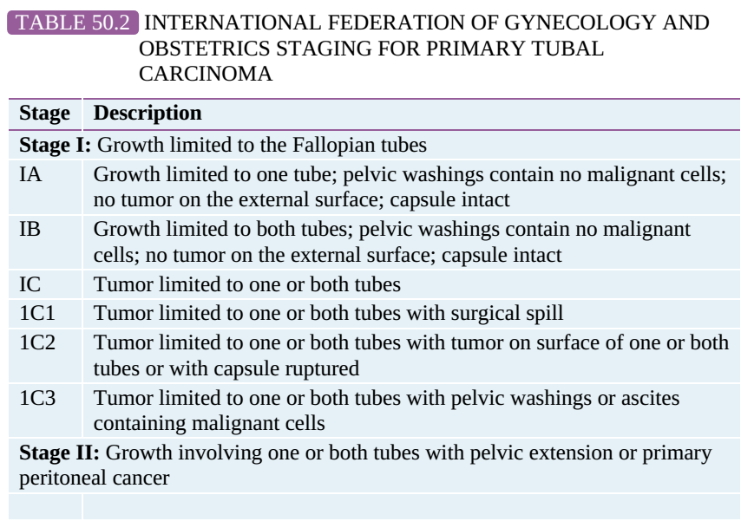

Slide 70
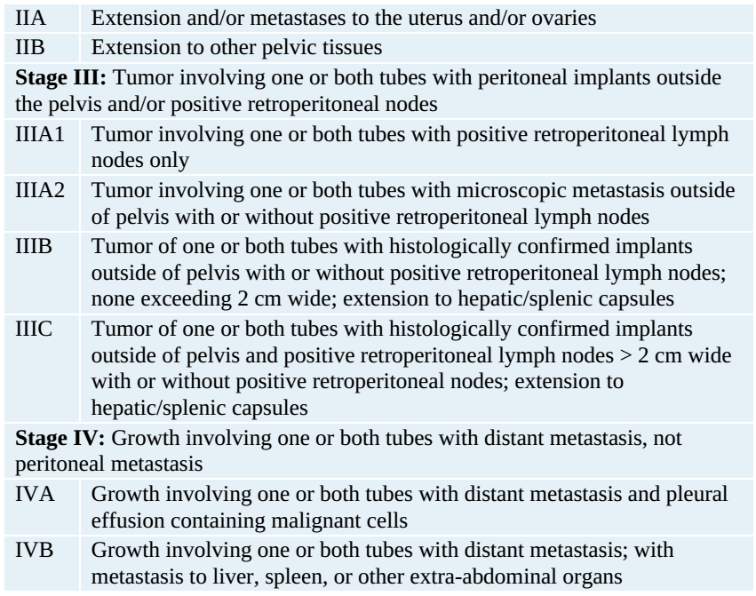

Slide 71
Carcinoma Metastatic to the Fallopian Tube
Carcinoma metastatic to the fallopian tube, coming mainly from the uterus and ovary, is far more common than the primary fallopian tube carcinoma.

Slide 72
MANAGEMENT OF OVARIAN AND FALLOPIAN TUBE CANCERS
Primary surgical therapy is indicated in most of the ovarian malignancies, using the principle of cytoreductive surgery, or “tumor debulking.” The rationale for cytoreductive surgery is that adjunctive radiation therapy and chemotherapy are more effective when all tumor masses are reduced to less than 1 cm in size
Because direct peritoneal seeding is the primary method of intraperitoneal spread, multiple adjacent structures commonly contain tumor, resulting in cytoreductive procedures that are often extensive.

Slide 73
cytoreductive surgery
Each procedure includes the following:
1. Peritoneal cytology is obtained on entering the abdomen to assess microscopic spread of tumor. Gross ascites is aspirated and submitted for cytologic analysis or, if no ascites are found, saline irrigation is used to “wash” the peritoneal cavity in an attempt to find microscopic disease.
2. Inspection and palpation of the entire peritoneal cavity are performed to determine the extent of disease. This involves palpation of the pelvis, paracolic gutters, omentum, and upper abdomen, including the liver, spleen, and undersurface of the diaphragm.
3. Partial omentectomy is usually performed for histologic examination of the omental tissue, whether or not tumor involvement is grossly evident.
4. Sampling of the pelvic and periaortic lymph nodes is performed.
Without gross disease, biopsies are obtained from the anterior and posterior cul-de-sac, right and left pelvic sidewalls, right and left pericolic gutters, and diaphragm.

Slide 74
Chemotherapy
Because most ovarian cancer presents at an advanced stage, adjunctive treatment using chemotherapy is usually necessary.
First-line chemotherapy is with paclitaxel (Taxol) combined with carboplatin or cisplatin.
With recurrence of disease, other chemotherapeutic agents may be used, including ifosfamide, doxorubicin, topotecan, gemcitabine, etoposide, vinorelbine, docetaxel, pemetrexed, bevacizumab, cyclophosphamide, leucovorin-modulated 5-fluorouracil, and tamoxifen.
Radiation therapy has only a limited role in the management of ovarian cancer.
Follow-up consists of clinical history and examination, various imaging studies (ultrasound and/or CT), and in epithelial cell tumors, the use of serum tumor markers such as CA-125.

Slide 75
CLINICAL FOLLOW-UP
You perform an exploratory laparotomy with pelvic washings and planned excision of the tumor.
It appears to originate from the ovary and is filled with 13 L of fluid.
Pathology on the specimen reveals a serous cystadenoma.
The patient is pleased that her abdomen is no longer so rotund and recovers well from surgery.

