Slide 1

General Obstetrics and Gynecology
Physical Examination
Dr. Minoo Yaghmaei

Slide 2
Reference:
1. Beckmann and Ling's Obstetrics and Gynecology, eight edition, pages:33-50.
To read more:
2. BATES' Guide to Physical Examination AND History Taking, 12th edition, pages: 583-595.

Slide 3
اهداف یادگیری:
در پایان فراگیر باید بتواند
1- سه معاینه اصلی در مراقبت‌های زنان و زایمان را بیان کند.
2- معیارهای فشارخون طبیعی و غیرطبیعی را بیان کند.
3- معیارهای تعیین فشارخون سیستولیک و دیاستولیک را بیان کند.
4- بگوید وضعیت مناسب جهت اندازه‌گیری فشارخون چیست.
5- بهترین ابزارهای تشخیص زودرس سرطان پستان را بیان کند.
6- نحوه گزارش معاینه پستان را بیان کند.
7- پوزیشن مناسب جهت مشاهده پستان را بیان کند.
8- نکات غیرطبیعی در مشاهده پستان را بیان کند.
9- اهمیت ترشح خونی پستان را بیان کند.
10- چگونگی حصول بهترین نتیجه در لمس پستان را بیان کند.
11- شیوه‌های لمس پستان را نام ببرد.

Slide 4
اهداف یادگیری (ادامه):
12- پوزیشن مناسب جهت لمس پستان را بیان کند.
13- نکات کلیدی در لمس پستان را بیان کند.
14- مفهوم و فایده breast self-awareness را بیان کند.
15- مفهوم، روش، فایده و دلیل حذف معاینه پستان توسط خود فرد از غربالگری را بیان کند.
16- شرایط مناسب برای انجام معاینه لگن را بیان کند.
17- مراحل معاینه لگن را به ترتیب نام برده و آنها را شرح دهد.
18- نام دو نوع از اسپکولوم‌ها را بگوید و شکل و کاربرد آنها را شرح دهد.
19- فلکشن و ورشن رحم و انواع آنرا شرح دهد.
20- نحوه معاینه رکتوواژینال را شرح دهد.

Slide 5
The general physical examination serves to detect abnormalities suggested
by the medical, surgical, or gynecologic history
unsuspected asymptomatic problems

Slide 6
The extent of the examination is generally determined by
the patient’s complaints
what is being medically managed by other clinicians
what is medically indicated from history

Slide 7
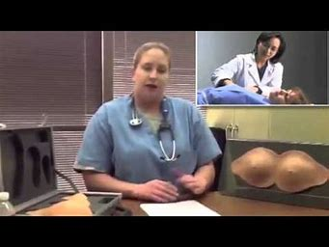
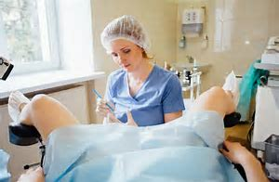

Physical examination in OB & GYN
the breast examination
the abdominal examination
the pelvic examination

Slide 8

Hand washing

Slide 9
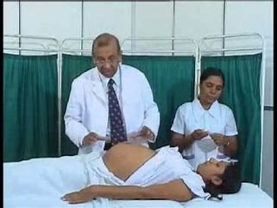
chaperone

Slide 10
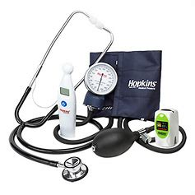
Vital Signs
Every physical examination begins with vital signs:
temperature
pulse
blood pressure
height; weight; and a derived value, the body mass index

Slide 11
BLOOD PRESSURE CATEGORIES
Based on Whelton, P.K., et al., 2017
Blood Pressure Category | Systolic BP (mm Hg) | Diastolic BP (mm Hg)
normal | <120 | And <80
elevated | 120 -129 | And <80
Stage 1 hypertension | 130 -139 | Or 80 - 89
Stage 2 hypertension | 140 or higher | 90 or higher
Hypertensive crisis | >180 | >120

Slide 12
Blood pressure
Systolic blood pressure at or after first two heart sounds
diastolic blood pressure just before disappearance of heart sounds
Blood pressure taken seated after 5 minutes of quiet
appropriately sized blood pressure cuff
diagnostic value is the average of two or more measurements taken at two or more office visits

Slide 13
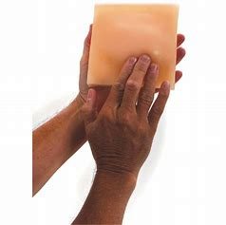
Breast examination

Slide 14
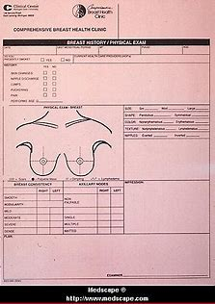
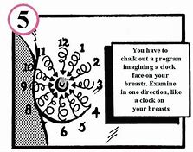
Breast Examination
results of the breast examination

Slide 15
Breast examination
inspection
with the patient’s arms at her sides, and then
with her hands pressed against her hips, and/or with her
arms raised over her head
If the patient’s breasts are especially large and pendulous: Inspect while leaning forward
Some asymmetry of the breasts is common,
but marked differences or recent changes deserve further evaluation.

Slide 16
Inspect with arms at sides

Slide 17
Inspect with arms over head

Slide 18
Inspect while leaning forward

Slide 19
Palpation breast examination
Palpation
This part of the examination is usually done with the patient in the supine position
the patient’s arms at her sides
and then with the arms raised over her head
for examination of the most lateral aspects of the axilla, the patient may also be seated,
with her arm resting on the examiner’s shoulder or over her head

Slide 20
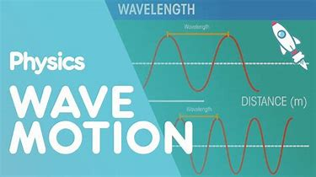

Palpation
using the flat part of the fingers rather than the tips
The fingers are moved up and down in a wavelike motion
moving the tissues under them back and forth

Slide 23
Palpate the nipple

Slide 24
Compress the areola for nipple discharge

Slide 25
Breast Examination
Early detection of breast cancer
The breast examination by a physician
combined with
appropriately scheduled mammography

Slide 26
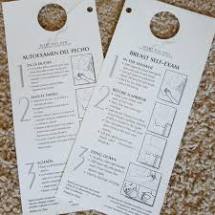
Counseling Breast Self-Awareness
woman’s awareness of the normal appearance and feel of her breasts.
associated with an increased likelihood of earlier detection of breast cancer

Slide 27
Breast Self Examination
Encouraging breast self-awareness may include BSE if
desired
in women at higher risk for breast cancer
Routine teaching of BSE is no longer generally recommended
high incidence of false-positive findings
unnecessary testing including breast biopsy

Slide 28
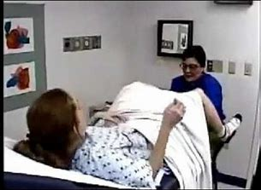
Pelvic examination

Slide 29

Pelvic Examination
the need for a pelvic examination on an annual basis for asymptomatic women not needing a Pap?
ACOG continues to recommend an annual
Pelvic examination for women 21 years
and older.

Slide 30
Pelvic examination
elevation of the head of the examining table to approximately 30° from horizontal
lithotomy position
Inspection and Examination of the External Genitalia
gently milk the urethra
Palpate the area of the Bartholin glands

Slide 31
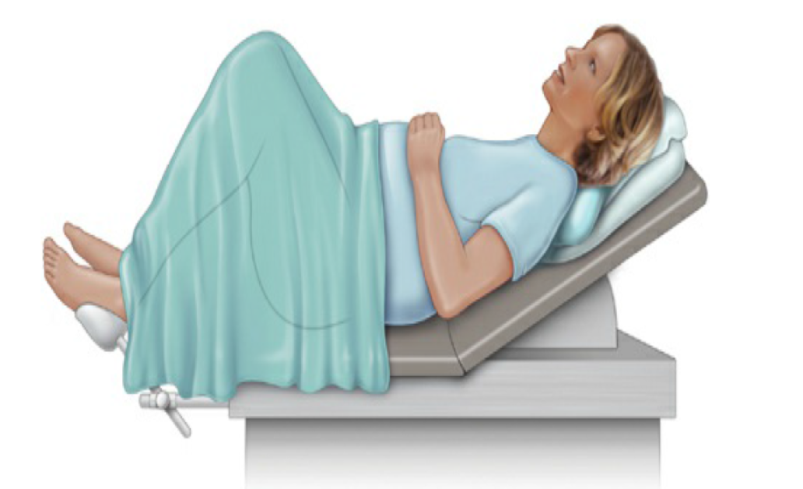
Lithotomy position during a pelvic examination

Slide 32
Palpation of the Bartholin, urethral, and Skene glands

Slide 33
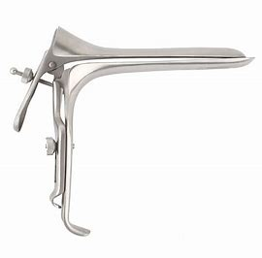
Speculum

Slide 34
Speculum Examination
Pederson speculum

Slide 35
Speculum Examination
Pederson speculum
flat and narrow blades
barely curve on the sides
The Pederson speculum works well for most nulliparous women and for postmenopausal women with atrophic, narrowed vaginas.

Slide 36
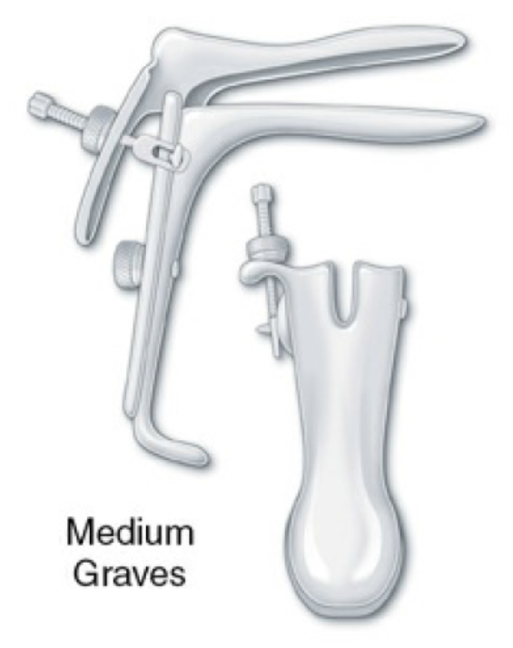
Speculum examination
Graves speculum

Slide 37
Speculum Examination
Graves speculum
has blades that are wider, higher, and curved on the sides
it is more appropriate for most parous women

Slide 38
Speculum insertion

Slide 39
Insert the Speculum
Select a speculum of appropriate size and shape
moisten it with warm water
Let the patient know
Some clinicians carefully enlarge the vaginal introitus by lubricating one finger with water and applying downward pressure at its lower margin, then palpate the location of the cervix in order to angle the speculum more accurately.

Slide 40
Insert the Speculum
With your other hand, introduce the closed speculum past your fingers at a downward slope

Slide 41
Speculum insertion
Two methods help you to avoid placing pressure on the sensitive urethra:
(1) when inserting the speculum, hold it at an angle
(2) slide the speculum inward along the posterior wall of the vagina
applying downward pressure to keep the vaginal introitus relaxed.

Slide 42
Speculum insertion
After placing the speculum in the vagina, remove your fingers of your other hand from the introitus
Rotate the speculum into a horizontal position, maintaining pressure posteriorly, and insert it to its full length
Do not open the blades of the speculum prematurely

Slide 43
Speculum insertion

Slide 44
Insert the speculum to full length

Slide 45
Gently open and fix the speculum

Slide 46
Inspect the Cervix
Note the color of the cervix; its position and surface characteristics; and any
ulcerations, nodules, masses, bleeding, or discharge
Inspect the cervical os for discharge
Obtaining the Pap Smear

Slide 47
Inspect the Vagina
Withdraw the speculum slowly while observing the vaginal walls
As the speculum clears the cervix, release the thumbscrew and maintain the open position of the speculum with your thumb
During withdrawal, inspect the vaginal mucosa
Check for bulging in the vaginal wall and the degree of uterine prolapse
Close the speculum as it emerges from the introitus

Slide 48
Bimanual examination

Slide 49
Palpate the ovaries

Slide 50
Bimanual examination of the adnexa
Bimanual examination of the adnexa to assess the ovaries, fallopian
tubes, and support structures
The ovaries are palpable in
normal menstrual women approximately half of the time,
palpation of ovaries in postmenopausal women is less common

Slide 51
Bimanual examination of the uterus
The uterus may tilt on its long axis (from cervix to fundus, version) yielding three positions
anteverted
midposition,
retroverted
It may also tilt on a shorter axis (from just above or at the area of the lower uterine segment, flexion) yielding two positions
anteflexed
retroflexed

Slide 54
Rectovaginal examination

