Slide 1
Physical examination in pregnancy and labour
Maryam farahani
Mahdieh hospital

Slide 2
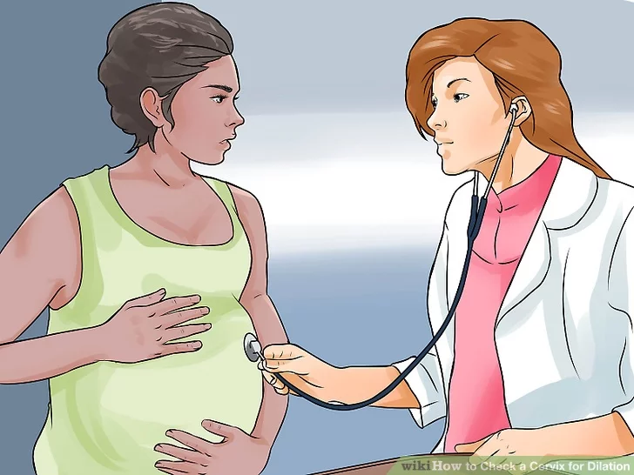
Physical examination in labour When you physically examine a woman in labour, your focus will be on her abdomen, vagina and cervix, so remember to: 1)Maintain her privacy 2) Examine her comprehensively (head to toe) 3) Look for signs of anaemia (paleness inside the eyelids, pale fingernails and gums) 4) Look for yellowish discoloration of the eyes (jaundice), which indicates liver disease.

Slide 3
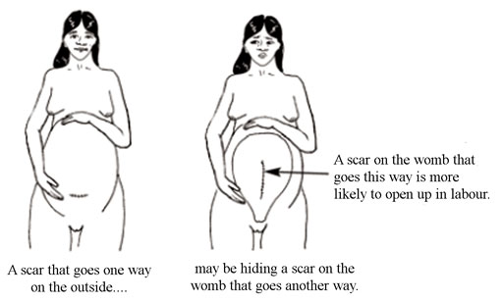
Inspection of the abdomen
Size: Is the abdomen too big or too small for the gestational age of the fetus? If it is too small, the baby may not have developed properly; if it is too big, the woman may have twins, or a condition called polyhydramnios .
Shape: Does the abdomen have an oval shape (like an egg — a little bit wider at the top of the uterus and narrower at the lower segment)? At near to full term, or in labour, this shape usually indicates that the baby is presenting ‘head-down’. If it is round like a ball, it may indicate an abnormal presentation
Scar: Observe if she has a scar from an operation in the lower abdomen, from a previous caesarean delivery ; the scar will usually be just above her pubic bone; if she has had surgery on her uterus previously . Scarring of the uterus puts her at risk of uterine rupture during the current delivery.Previous caesarean surgery increases the risk during the next labour.

Slide 4
Palpation of the abdomen
Palpation means feeling the abdomen with your hands in specific positions, or moving them in particular ways, using certain levels of pressure. Ask the mother to lie down on her back and bend her legs at the knees, with her feet flat on the bed. You need to be able to move around her: sometimes you will be palpating her abdomen while standing at her feet and looking up her body towards her head; sometimes you will be standing behind her and facing her feet; and sometimes you will stand beside her.
Can you recall the purposes of abdominal palpation in a woman in labour?
Answer : Palpation helps you to assess the size of the fetus, its presentation (which part of the baby will ‘present’ at the cervix during delivery), and its position relative to the mother’s body (e.g. is it facing towards her front or her back).

Slide 5
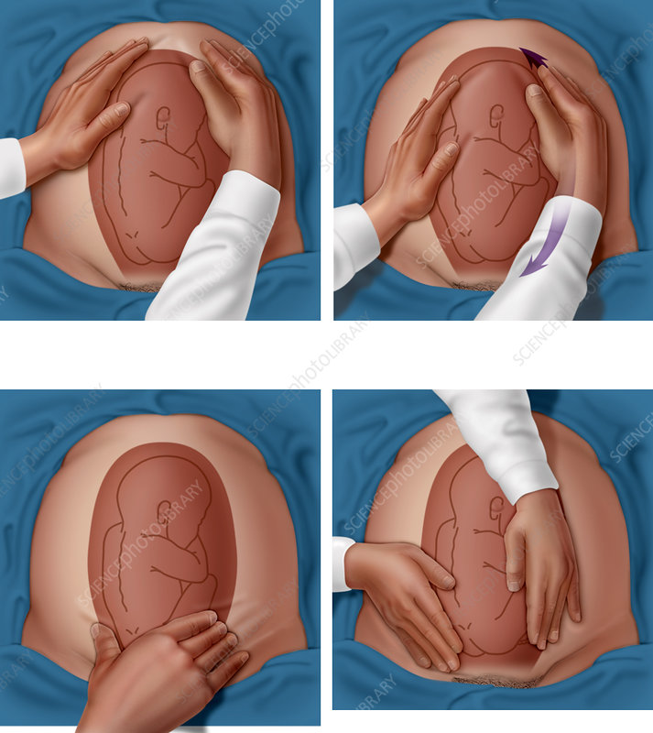
There are four palpations of the abdomen, which are commonly referred to by midwives and doctors as Leopold’s manoeuvres. You need to do them in the correct sequence.

Slide 6
First Leopold’s manoeuvre: fundal palpation
Fundal palpitation means palpating the dome-shaped upper part of the uterus, called the fundus. During antenatal care, you should have been measuring the length of the uterus from the mother’s pubic bone to the fundus, and comparing this with the baby’s gestational age to see if it was growing normally. The purpose of palpating the fundus in a woman in labour is to discover how the baby is lying in the uterus.
Use the palms of both hands to palpate on either side of the fundus, with your fingers quite close together
Feel whether the top part of the uterus is hard and rounded or soft and irregular. If the shapes feel soft and irregular and they don’t easily move under gentle pressure from your hands, then the baby’s buttocks are occupying the fundus and it is ‘head-down’. This is cephalic presentation.There are several different cephalic presentations, The most common, and the easiest for the baby to be born, is called the vertex presentation.

Slide 7
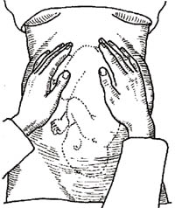
Fundal palpation — the first manoeuvre. This baby is in a cephalic (head-down) presentation. (Source: WHO, 2008, Managing Prolonged and Obstructed Labour, Figure 7.4, page 115)
If you can feel a hard, round shape in the fundus, this is the baby’s head. In a woman who is already in labour, this means the baby is in the breech presentation (the buttocks are the presenting part). It is safest to refer a woman whose baby is in the breech position because the birth is likely to be more difficult and the risk of complications is higher. If the fundus feels ‘empty’, the baby may be lying diagonally or transversely across the uterus. The second manoeuvre will help to clarify this.

Slide 8
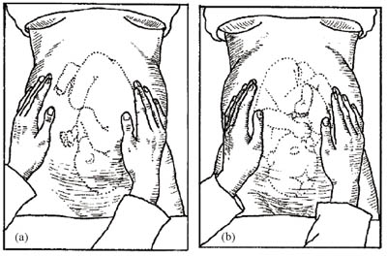
Second Leopold’s manoeuvre: lateral palpation
The second manoeuvre helps you to discover the fetal lie: is the baby lying longitudinally (straight), obliquely (diagonally across the uterus), or transversely (horizontally)? The longitudinal lie is normal .A transverse lie in labour should be referred urgently; the baby cannot be born through the vagina in this position and may need caesarean surgery to deliver it.
Lateral palpation–the second manoeuvre.
(a) The back of the fetus is towards the front of the mother’s abdomen;
(b) The back of the fetus is towards the mother’s back.

Slide 9
Place your hands on either side of the middle of her abdomen. Push gently with one hand while holding the other hand firm to steady the uterus; alternate the pressure between your two hands. If you feel the round, hard shape of the baby’s head at one side, and the fundus feels empty, it may be a transverse lie and you should refer the mother urgently.
The second manoeuvre also helps to determine whether the baby is facing inwards or outwards. Note the regularity of the shapes you can feel under your hands. If you can feel a large smooth shape under one hand, this is probably the baby’s back, which means it is facing inwards (Figure 2.5a)
If you can feel small irregular ‘lumps’ under your hands, these are probably the baby’s feet, knees and elbows and it is facing outwards (Figure 2.5b). It is not so easy for it to rotate as it passes down the birth canal from this starting position.

Slide 10
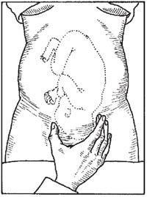
Third Leopold’s manoeuvre: deep pelvic palpation
The third manoeuvre helps to confirm your earlier findings about the fetal presentation—is it cephalic or breech?
Using the thumb and fingers of one hand the lower abdomen is grasped just above the pubic symphysis to establish if the presenting part is engaged. If not engaged a movable body part will be felt. The presenting part is the part of the fetus that is felt to be in closest proximity to the birth canal.
Figure 2.6 Deep pelvic palpation–the third manoeuvre helps to determine if the presenting part is engaged.

Slide 11
Fourth Leopold’s manoeuvre:
. The last maneuver requires that the health care provider face the woman's feet, as he or she will attempt to locate the fetus' brow. The fingers of both hands are moved gently down the sides of the uterus toward the pubis. The side where there is resistance to the descent of the fingers toward the pubis is greatest is where the brow is located. If the head of the fetus is well-flexed, it should be on the opposite side from the fetal back. If the fetal head is extended though, the occiput is instead felt and is located on the same side as the back.

Slide 12
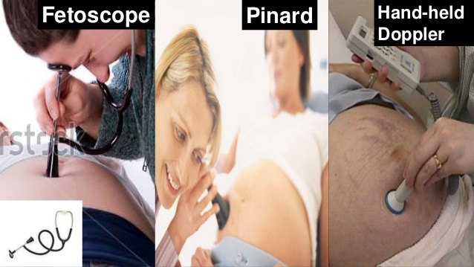
Measuring fetal heart rate
Use a fetoscope or stethoscope to listen to the fetal heart rate immediately after a contraction. Count the number of fetal heartbeats for a full minute at least once every 30 minutes during the active phase first stage of labour and every 5 minutes during the second stage. If there are fetal heart rate abnormalities (less than 120 or more than 160 beats per minute, sustained for 10 minutes), suspect fetal distress and refer urgently to a health facility, unless the labour is progressing fast and the baby is about to be born.

Slide 13
Measuring contractions
To assess the frequency and duration of contractions, put your hand over the mother’s abdomen, around the fundus. You will sense the abdomen starting to tighten and become hard. The mother may make ‘pain’ sounds with the contraction. Count the frequency, i.e. number of contractions in 10 minutes, and the duration (the time elapsed during each contraction in seconds).

Slide 14
Vaginal examination
The functions of a vaginal examination are to:
Determine if true labour has begun and the stage it has reached, based on measuring the dilatation of the cervix
Assess the progress of labour in terms of the rate of increase in cervical dilatation and the descent of the fetus down the birth canal
Identify the fetal presentation and position
Detect any moulding of the fetal skull bones (the extent to which they overlap under pressure from the birth canal)
Assess the size of the mother’s pelvis and its adequacy for the passage of the fetus
Check the colour of the amniotic fluid.

Slide 15
Assess the external genitalia and vagina
.Look carefully to see if there is:
Any abnormal discharge (thick yellowish or white and foul smelling) from the vagina, or inflamed sores on the external genitalia, which may be due to a urinary tract infection or sexually transmitted infection.
Vaginal scarring due to injury during a previous birth, or from female genital mutilation (circumcision). This increases the risk of a fistula occurring during labour (a torn opening between the vagina and other organs).
Is there swelling in the vagina, and if there is, could it obstruct the passage of the baby?

Slide 16
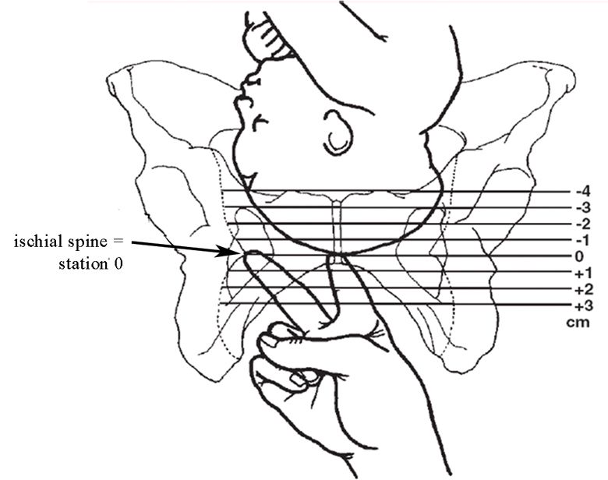

Slide 17
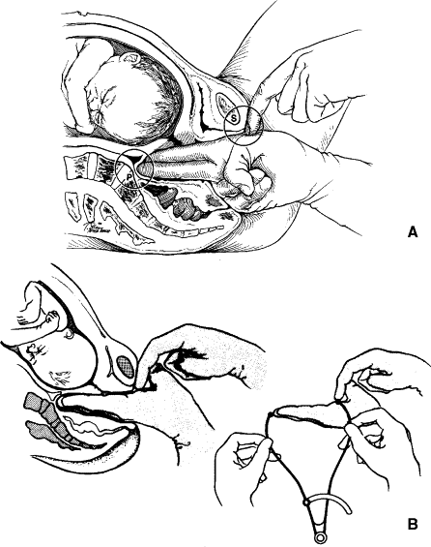
Assess the size of the mother’s pelvis and its adequacy for the passage of the fetus

Slide 18
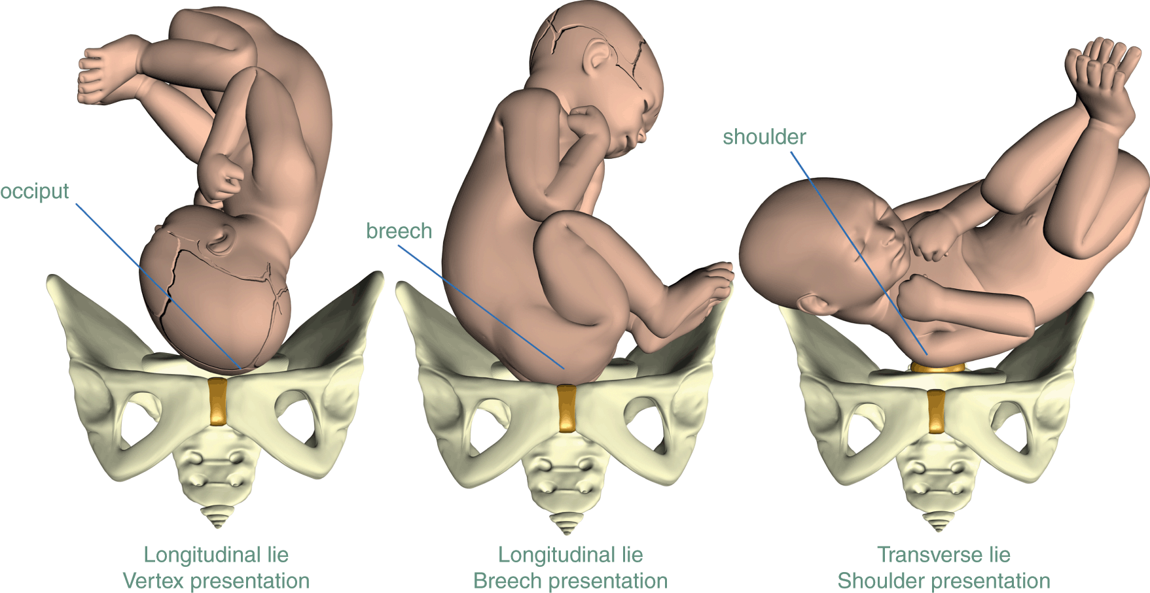

Slide 19
Assessing cervical dilatation
Wash your hands thoroughly with soap and clean water for two full minutes. Then put on new sterile gloves. Tell the mother what you are going to do. Vaginal examination is done using two gloved fingers. Try to collect all the information you need before withdrawing from the vagina, because once you have withdrawn your fingers you should not put them back in again.
Can you explain why not?
Answer: Putting your examining fingers back into the vagina could introduce infection.
In particular repeated vaginal examination causes infection: it should not be done more often than every 4 hours, unless there is a justifiable need (e.g. to confirm second stage of labour).

Slide 20
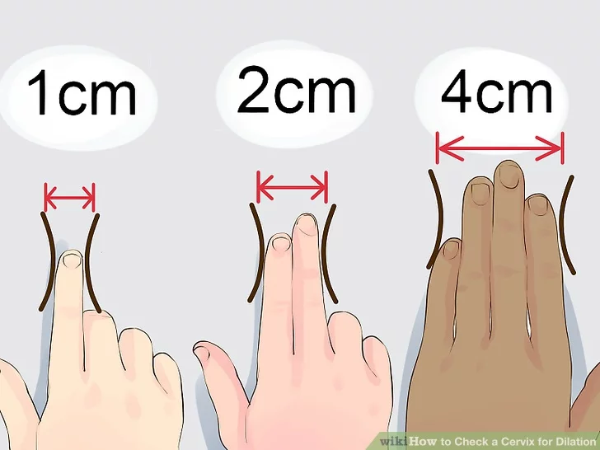
The woman should lie down on her back, bend her legs and open her knees. Gently swab the external genitalia with sterile gauze dipped in antiseptic solution. Separate the labia with two fingers on your non-dominant hand .Dip your examining fingers (index and middle fingers) into an antiseptic lubricating cream and insert them very gently into the vagina, following the direction of the vagina, upwards and backwards. Ask the woman to take deep breaths and try to relax, as this will help to decrease the discomfort of the procedure.
Cervical dilatation is the increase in diameter of the cervical opening, estimated in centimeters. Dilatation happens after the cervix has effaced (the 3 cm length of the cervix has been drawn up into the uterus, Estimating the diameter of the cervical opening takes practice.

Slide 22
Thanks for your attention

