Slide 2
Postpartum Hemorrhage
M.AFRAKHTEH
SHOHADA HOSPITAL TAJRISH
May 2020

Slide 3
worldwide, 140,000 women die of postpartum
hemorrhage (PPH) each year—
one every 4 minutes
More than half of all maternal deaths occur within 24 hours of delivery.
In addition to death, serious morbidity may follow PPH.
Sequelae include adult respiratory distress syndrome, coagulopathy, shock, loss of fertility, and pituitary
necrosis (Sheehan syndrome).

Slide 4
The prevalence of PPH is about 4%.
It can be sudden and profuse, or
blood loss can occur more insidiously
. PPH has been traditionally defined
as a delivery-associated blood loss in excess of 500 mL for vaginal delivery
1,000 mL for cesarean birth

Slide 5
The estimation of blood loss is subjective, introducing wide variance and inaccuracy
Criteria in use include
a 10% drop in hematocrit,
need for transfusion,
signs and symptoms along the spectrum of physiologic effects of blood loss

Slide 6
ACOG
ACOG Revitalize program has recommended a single definition of PPH regardless of route of delivery:
a cumulative blood loss of ≥1000 mL or blood loss accompanied by signs and symptoms of
hypovolemia within 24 hours following delivery

Slide 7
PPH is termed “primary” (also called
immediate or early) if it occurs within 24 hours of delivery and
“secondary” (dsecondary”elayed or late) if it occurs between 24 hours and (usually)
12 weeks after delivery.
Primary PPH is of much greater importance,
insofar as secondary PPH is less common and generally much less serious in nature.

Slide 8
RECOGNITION AND EARLY DETECTION
PPH is not a diagnosis but, rather, a critically important sign that often occurs without warning and in the absence of risk factors

Slide 9
The loss of 10% (500 mL for an average
patient with a singleton pregnancy) of blood volume may be tolerated with no signs or symptoms.
As blood loss approaches 15% to 20%, the first
signs of intravascular depletion manifest, including tachycardia, tachypnea, and delayed capillary refill, followed by orthostatic changes
and narrowed pulse pressure (due to elevated diastolic pressure secondary to vasoconstriction with maintenance of systolic pressure).

Slide 10
Beyond approximately 30% volume loss, breathing and heart rate further increase, and overt hypotension develops.
Finally, with profound blood loss above 40% to 50%, oliguria, shock, coma, and death may occur.

Slide 11
Risk Factors for Postpartum Hemorrhage
• Prolonged labor
• Augmented labor
• Rapid labor
• History of postpartum hemorrhage
• Episiotomy, especially mediolateral
• Preeclampsia
• Overdistended uterus (macrosomia, multiple gestation, and hydramnios)
• Prior uterine surgery and other risk factors for abnormal placentation
• Operative delivery
• Asian or Hispanic ethnicity
• Chorioamnionitis

Slide 12
The source and etiology of bleeding should be identified as soon as possible, and targeted interventions applied in order to minimize morbidity
and prevent mortality.
The most common cause of PPH is uterine atony,
representing about 80% of cases.
Retained placenta,
genital tract trauma, lacerations,
coagulation disorders are other causes.
Hematomas can occur anywhere in the lower genital tract.
Ruptured uterus and inverted
uterus are rare but serious causes of PPH.

Slide 13
GENERAL MANAGEMENT OF PATIENTS
PPH is an unequivocal emergency;
all available resources should be mobilized immediately upon its recognition

Slide 14
Because most cases of PPH are caused by uterine atony, the uterus should be palpated abdominally, seeking the soft, “boggy” consistency of the relaxed uterus
. If this finding is confirmed, oxytocin infusion should be increased and either methylergonovine maleate or prostaglandins administered if excessive bleeding continues.

Slide 15
Evaluate excessive bleeding immediately
• Assess overall patient status
• Notify other members of obstetrics team (i.e., obtain help!)
• Monitor and maintain circulation
Establish intravenous (IV) access: two large bore
Type and cross-match blood
Begin/increase crystalloid infusion
Assess for clotting or check coagulation profile

Slide 16
Review clinical course for probable cause
Any difficulty removing placenta?
Were forceps used?
Other predisposing factors?
• Have operating room (OR) and personnel on standby

Slide 17
Evaluation: Perform in Rapid Succession
Assess hemodynamic status
Bimanual examination: assess for atony
May palpate for retained placental fragments May palpate uterine wall for rupture
• Inspect perineum, vulva, vagina, and cervix
Identify lacerations, hematomas, inversions
Recruit assistance for exposure
You or assistant may re-inspect placenta
• Assess clotting

Slide 18
Atony
Immediate bimanual massage
• Administer uterotonics (with requisite precautions)
Oxytocin—IV: 10 to 40 units/1 L normal saline or lactated Ringer solution, continuous
Methylergonovine—intramuscular (IM): 0.2 mg IM; may repeat in 2 to 4 hours
15-Methyl PGF2α—IM 0.25 mg every 15 to 90 minutes for up to 8 doses
Dinoprostone—Suppository: rectal; 20 mg every 2 hours
Misoprostol—600 to 1,000 μg orally or rectally; one dose
Intrauterine tamponade—Bakri balloon, packing

Slide 19
Operative Measures
Uterine compression sutures
• Sequential arterial ligation or selective arterial embolization
• Hysterectomy

Slide 20
Retained Placenta
Manual removal; manage atony as above
• Ultrasound assessment/guidance to assure complete removal
• Suction curettage—ideally performed with ultrasound guidance in OR
• Maintain suspicion for accreta—additional intervention required

Slide 21
Genital Tract Lacerations and Hematomas
Repair lacerations immediately
• Exposure critical—get assistance, move to OR
• No blindly placed sutures
• Packing may be necessary
• Observe stable, asymptomatic hematomas

Slide 22
Coagulopathy
Appropriate factor replacement
• Identify underlying cause
• Hemorrhage, infection, amniotic fluid embolism, other

Slide 23
Was expulsion of the placenta spontaneous and apparently complete?
(Think: retained placental fragment?)
• Were forceps or other instrumentation used in delivery? (Think: laceration?)
• Was the baby large or the delivery difficult or precipitous? (Think: uterine atony?)
• Were the cervix and vagina inspected for lacerations?
• What was the admission or baseline hematocrit?
• Is the blood clotting? (Think: coagulopathy?)

Slide 24
supportive measures
Such measures include large-bore intravenous access; rapid crystalloid infusions; type,
cross-match, and administration of blood or blood components as needed; periodic assessment of hematocrit and coagulation profile; and monitoring of urinary output.

Slide 25
The judicious use of blood component therapy is key to management
. There has been a shift in philosophy regarding transfusion of blood products in the setting of active hemorrhage, with greater willingness to intervene earlier and prevent coagulopathy rather than to delay treatment until coagulopathy is diagnosed.

Slide 26
The mainstay of blood replacement therapy is packed red blood cells (PRBCs), with other components used as indicated for various disorders of the clotting cascade.
Depending on the clinical scenario, the use of laboratory measurements to guide transfusion of plasma, cryoprecipitate, and platelets may be reasonable.
However, in the setting of severe, ongoing hemorrhage (4 or more units of PRBCs needed over 1 hour or 10 or more units over 12–24 hours), the current recommendation is to transfuse blood products in a 1:1 ratio (i.e., for each unit of PRBCs transfused, 1 unit of fresh frozen plasma
and 1 unit of random donor platelets should also be transfused).

Slide 27
The recent recommendation to avoid transfusion in stable, asymptomatic hospitalized patients with a hemoglobin >7 to 8 mg/dl does not apply in the setting of
postpartum hemorrhage.

Slide 28
BLOOD COMPONENT THERAPY

Slide 29
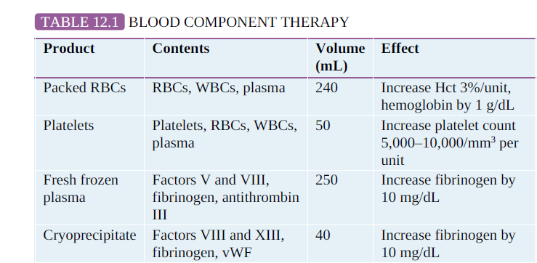

Slide 30
Precautionary Measures to Prevent or Minimize Postpartum Hemorrhage
Before Delivery
• Baseline hematocrit
• Blood type and screen (cross-match for very high risk)
• Intravenous access
• Obtain baseline coagulation studies and platelet count, if indicated Identify risk factors

Slide 31
Precautionary Measures to Prevent or Minimize Postpartum Hemorrhage
In Delivery Room
• Avoid excessive traction on umbilical cord
• Use forceps and vacuum judiciously
• Inspect placenta for complete removal
• Perform digital exploration of uterus (if indicated)
• Active management of the third stage
• Visualize cervix and vagina
• Remove all clots in uterus and vagina before transfer to recovery area

Slide 32
Precautionary Measures to Prevent or Minimize Postpartum Hemorrhage
In Recovery Area
• Closely observe patient for excessive bleeding
• Continue uterotonic agents
• Frequently palpate uterus with massage
• Determine vital signs frequently

Slide 33
Uterine Atony
Ordinarily, the uterine corpus contracts promptly after delivery of the placenta, constricting the spiral arteries in the newly created placental bed, which prevents excessive bleeding.
This muscular contraction, rather than coagulation, prevents excessive bleeding from the placental implantation site.
When contraction does not occur as expected, the resulting uterine atony leads to PPH.

Slide 34
Conditions that predispose to uterine atony
extraordinary enlargement of the uterus
(e.g., hydramnios and multiple fetuses), abnormal labor
(both precipitous and prolonged or augmented by oxytocin)
conditions that interfere with contraction of the uterus
(e.g., uterine leiomyomata and magnesium sulfate).

Slide 35
The clinical diagnosis of atony is based largely on the tone of the uterine muscle on palpation.
Instead of the normally firm, contracted uterine corpus, a softer, more pliable—often called “boggy”—uterus is found.
The cervix is usually open. Frequently, the uterus contracts briefly when massaged, only to become relaxed again when the manipulation ceases. Because hemorrhage can occur in the absence of atony, other etiologies must be sought in the presence of a firm fundus.

Slide 36
Management of Uterine Atony
Management of uterine atony is both preventive and therapeutic.
Active management of the third stage of labor (the interval between the delivery
of the fetus and delivery of the placenta) has been shown to reduce the incidence of PPH by as much as 70%.

Slide 37
management of the third stage
The protocol for management of the
third stage includes oxytocin infusion (usually 20 units in 1 L of normal saline infused at 200 to 500 mL/hour) initiated immediately following
delivery of the infant or its anterior shoulder, gentle cord traction, and uterine massage.
Some physicians do not begin oxytocin infusion until after delivery of the placenta to avoid placental entrapment;

Slide 38
Immediate breastfeeding may also enhance uterine contractility and, thus, reduce blood loss.
In low resource settings, 10 units IM oxytocin may be given if there is no IV access,
or 600 μg misoprostol may be given orally if no oxytocin is available

Slide 39
Once uterine atony is diagnosed, management can be categorized as medical, manipulative, or surgical.
Management must be individualized in cases of severe uterine atony, taking into account the extent of hemorrhage, the overall status of the patient, and her future childbearing desires

Slide 40
Bimanual uterine massage
Bimanual uterine massage alone is often successful in causing uterine contraction, and this should be done while preparations
for other treatments are under way

Slide 41
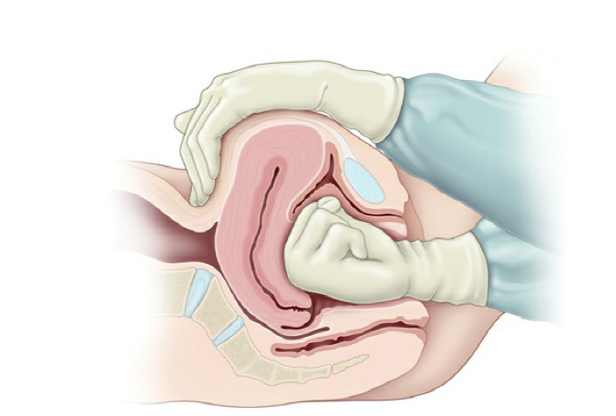

Slide 42
Uterotonic Agents
Uterotonic agents include oxytocin, methylergonovine maleate,
misoprostol (an analogue of prostaglandin E1), dinoprostone (an analogue of prostaglandin E2), and 15-methyl prostaglandin F2α, administered separately or in combination.
Methylergonovine maleate is a potent uterotonic agent that can cause uterine contractions within several minutes.
It is always given intramuscularly, because rapid intravenous administration can lead to dangerous hypertension, and its use is often avoided in those with hypertensive disorders.

Slide 43
Although it should be avoided or used with extreme caution in those with cardiac, pulmonary, liver, or renal diseases, 15-methyl prostaglandin F2α may be given
intramuscularly or directly into the myometrium

Slide 44
Dinoprostone may be given by rectal suppository. More recently, misoprostol has been used for
treatment and prevention of PPH.
These prostaglandins result in strong uterine contractions
. Typically, oxytocin is given prophylactically, as
noted previously; if uterine atony occurs, the infusion rate is increased, and additional agents are given sequentially.

Slide 45
Uterotonic agents are only effective for uterine atony.
If the uterus is firm, the use of these agents is
not necessary and other causes of bleeding should be explored.

Slide 46
Occasionally, uterine massage and uterotonic agents are unsuccessful in bringing about adequate uterine contraction, and other measures must be used.
Some practitioners use intrauterine compression with in utero packing or placement of a balloon compression device (e.g., Bakri, BTcath,
and Foley catheters) as a means of halting blood loss while preserving the uterus.

Slide 47
Surgical Management
Surgical management of uterine atony may include uterine compression sutures
(B-Lynch or multiple squares),
sequential arterial ligation (ascending or descending branches of the uterine, utero-ovarian, then internal iliac arteries),
selective arterial embolization, and hysterectomy

Slide 48
Very high success rates have been noted with surgical compression techniques, with consequent decreases in the use of hysterectomy and iliac artery ligations, both of which are associated with high rates of morbidity.
Additional advantages of compression techniques include rapid execution and preservation of fertility.

Slide 49
As in other clinical circumstances, recombinant factor VIIa is reserved
for life-threatening hemorrhage despite virtually all other therapies.
Extremely expensive, such therapy also increases the likelihood of subsequent and serious thrombosis.

Slide 50
Lacerations of the Lower Genital Tract
Lacerations of the lower genital tract are far less common than uterine atony as a cause of PPH, but they can be serious and require prompt surgical repair.
Predisposing factors include instrumented delivery, manipulative delivery such as a breech extraction, precipitous labor,
presentations other than occiput anterior, and macrosomia

Slide 51
Although minor lacerations to the cervix are common in delivery, extensive lacerations and those that are actively bleeding usually require repair. To minimize blood loss caused by significant cervical and vaginal

Slide 52
To minimize blood loss caused by significant cervical and vaginal lacerations, all patients with any predisposing factors and any patient in whom blood loss soon after delivery appears to be excessive despite a firm and contracted uterus should have a careful repeat inspection of the lower genital tract.
This vaginal examination may require assistance to allow adequate visualization.
As a rule, repair of these lacerations is usually not difficult, if adequate exposure is provided.

Slide 53
Lacerations of the vagina and perineum (first-degree through fourthdegree vaginal and periurethral lacerations) are not common causes of substantial blood loss, although the continued steady loss of blood, which may come from deeper lacerations, may become so significant that their timely repair is requisite.
Periurethral lacerations may be associated with sufficient edema to occlude the urethra, causing urinary retention; a Foley catheter for 12 to 24 hours usually alleviates this problem.

Slide 54
Retained Placenta
Normally, separation of the placenta from the uterus occurs because of cleavage between the zona basalis and the zona spongiosa facilitated by uterine contraction.
Once separation occurs, expulsion is caused by strong uterine contractions.

Slide 55
Retained placenta can occur when either the process of separation or the process of expulsion is incomplete.
Predisposing factors to retained placenta include a previous cesarean delivery,
uterine leiomyomata,
prior uterine curettage,
and accessory (succenturiate) placental lobe.

Slide 56
Placental tissue remaining in the uterus can prevent adequate contractions, leading to atony and excessive bleeding.
After expulsion, every placenta should be inspected to detect missing placental cotyledons, which may remain in the uterus

Slide 57
Sheared or abruptly ending surface vessels may indicate an accessory, or succenturiate, placental lobe.
If retained placenta is suspected— Either because of apparently absent cotyledons or because of excessive bleeding it can often be removed by inserting two fingers through the cervix into the uterine cavity and manipulating the retained tissue downward into the vagina.
If this is unsuccessful, or if there is uncertainty regarding the cause of hemorrhage, an ultrasound examination of the uterus can be helpful.

Slide 58
Curettage with a suction apparatus and/or a large, sharp curette may be used to remove the retained tissue.
Care must be exercised to avoid perforation through the uterine fundus.
An additional concern is that overly vigorous curettage can lead to Asherman syndrome,
in which intrauterine adhesions can lead to a variety of complications, including
menstrual irregularities, infertility, and future pregnancy loss.

Slide 59
Abnormal Placental Separation
Placental tissue may also remain in the uterus because separation of the placenta from the uterus may not occur normally.
At times, placental villi penetrate the uterine wall to varying degrees, collectively called placenta accreta.

Slide 60
Risk factors for placenta accreta
Risk factors for placenta accreta include
placenta previa with and without prior uterine surgery, previous myomectomy
, prior cesarean delivery,
prior endometrial ablation,
Asherman’ syndrome,
submucous leiomyomata
maternal age greater than 35 years

Slide 61
More specifically, abnormal adherence of the placenta to the superficial lining of the uterus is termed placenta accreta, penetration into the uterine muscle itself is called placenta increta, and complete invasion through the thickness of the uterine muscle is termed placenta percreta.

Slide 62
this abnormal attachment involves the entire placenta, no part of the placenta separates.
Much more commonly, however, attachment is not complete, with a portion of the placenta separating and the remainder attached.
Major, lifethreatening hemorrhage can ensue.
More recently, the term morbidly adherent placenta has been used to collectively describe placenta accreta, increta, and percreta

Slide 63
cesarean delivery increases in the United States, the number of repeat cesarean deliveries increases as well.
In a large prospective study of cesarean delivery without labor, the rate of morbidly adherent placenta
increased with increasing number of cesarean sections; 0.2% with the first cesarean delivery,
0.3% with the second
, 0.6% with the third,
2% with the
fourth, and almost 7% with six or more cesarean deliveries.

Slide 64
If the current pregnancy is complicated by placenta previa, the rate of morbidly adherent
placenta is even higher;
3% with the first cesarean section,
11% with the second,
40% with the third,
and greater than 60% with four or more
cesarean deliveries.

Slide 65
If a portion of the placenta separates and the remainder stays attached, hysterectomy is often required;
however, an attempt to separate the
placenta by curettage or other means of controlling the bleeding (such as surgical compression or sequential arterial ligation) may be appropriate in trying to avoid a hysterectomy in a woman who desires more children.

Slide 66
Hematomas
Hematomas can occur anywhere from the vulva to the upper vagina as a result of delivery trauma.
Hematomas may also develop at the site of
episiotomy or perineal laceration.
Hematomas may occur without disruption of the vaginal mucosa such as when the fetus or forceps causes shearing of the submucosal tissues without mucosal tearing

Slide 67
Vulvar or vaginal hematomas are characterized by exquisite pain with or without signs of shock. Hematomas that are ≤5 cm in diameter and are
not enlarging can usually be managed expectantly by frequent evaluation of the size of the hematoma and close monitoring of vital signs and urinary output.
Application of ice packs can also be helpful. Larger and enlarging hematomas must be managed surgically.

Slide 68
If the hematoma is at the site of episiotomy, the sutures should be removed, and a search made for the actual bleeding site, which is then ligated.
If it is not at the episiotomy site the hematoma should be opened at its most dependent portion and drained;
the bleeding site identified, if possible; and the site closed with interlocking hemostatic sutures

Slide 69
surgical management
“oversewing” the mucosal edges of the vaginal wall with interlocking suture.
Drains and vaginal packs are often used to prevent reaccumulation of blood.
It should be noted that large amounts of blood can dissect and accumulate along tissue planes, especially into the ischiorectal fossa, precluding easy identification.

Slide 70
Coagulation Defects
Virtually, any congenital or acquired abnormality in blood clotting can lead to PPH.
Abruptio placentae, amniotic fluid embolism, acute fatty liver, sepsis, and severe preeclampsia
are obstetric conditions associated with disseminated intravascular coagulopathy.

Slide 71
The treatment of coagulation disorders involves correction of the coagulation defect with appropriate factor replacement.
It also should be recalled that
profuse hemorrhage itself can lead to coagulopathy, thus creating a vicious cycle of bleeding.

Slide 72
Amniotic Fluid Embolism
Amniotic fluid embolism is a rare, sudden, and sometimes fatal obstetric complication thought to be caused primarily
by entry of amniotic fluid into the maternal circulation

Slide 73
Significant biochemical, as well as physical,
mediators are thought to be involved in the development of the clinical scenario, which unfolds as five findings that occur in sequence:
1) respiratory distress, 2) cyanosis, 3) cardiovascular collapse, 4)
hemorrhage, and 5) coma.
Amniotic fluid embolism also often results in severe coagulopathy.
Treatment is directed toward total support of the cardiovascular and coagulation systems

Slide 74
Uterine Inversion
Uterine inversion is a rare condition in which the uterus literally turns inside out, with the top of the uterine fundus extending through the cervix into the vagina and sometimes even past the introitus
Hemorrhage with uterine inversion is characteristically severe and sudden.

Slide 75
Treatment includes manual replacement, which frequently requires administration of an agent that causes uterine relaxation (e.g., sublingual nitroglycerin, terbutaline, magnesium sulfate, and halogenated general
anesthetics)
. If manual replacement fails,
surgery is required.

Slide 77
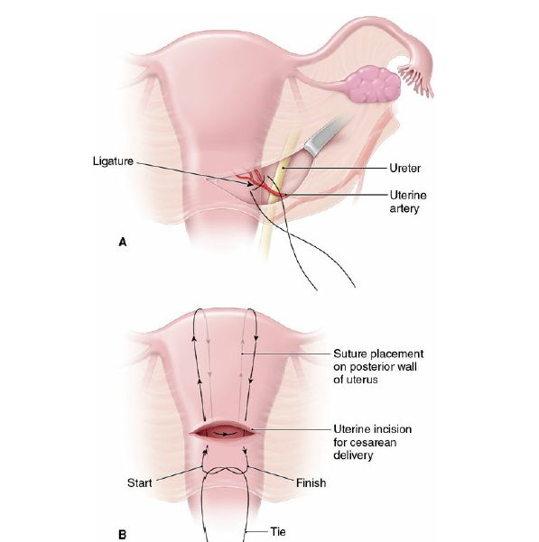

Slide 79
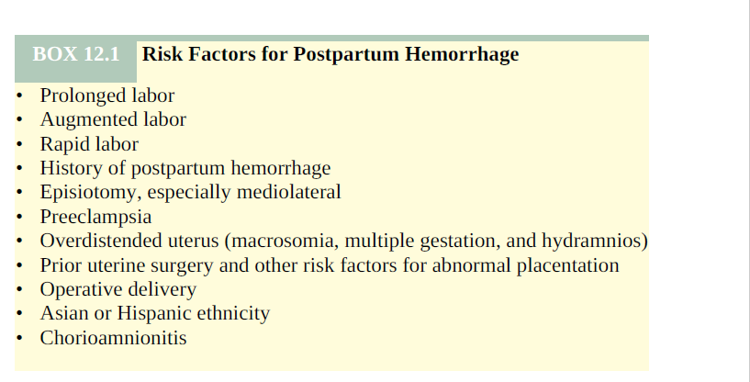

Slide 80
